Slide 1
MSc in Biomedical Engineering Info session on Master Thesis requirements 2020-2021
Patrick Segers – Ghent University
Johan Stiens – Vrije Universiteit Brussel

Slide 2
Why this info session?
Student surveys learn that students feel insufficiently informed about
Formal requirements of the master thesis
Evaluation and assessment of the thesis
New element in the thesis: Ethics and scientific integrity!
Reflection on ethical aspects that apply to your research; ethical concerns regarding the impact of results of your research
Ethical behaviour (plagiarism/copying/paraphrasing without proper citation)

Slide 3
Thesis modalities – UGent
Link to faculty web-site
Link to instructions on lay-out
Submission via Plato
(auto-generated cover page)
Extra for BME:
Add VUB-logo to the cover page
Appendix 1: Ethics and ethical implications of the work

Slide 4
Thesis modalities - VUB
Layout similar to UGent
Link to instructions on lay-out
Submission via email:
secretariaat.ingenieurswetenschappen@vub.be
Extra for BME:
Add VUB and UGent logo to the cover page
Appendix 1: Ethics and ethical implications of the work

Slide 5
Some examples
See https://www.ugent.be/ea/bme/en/program/masterthesis_biomedical_engineering.htm

Slide 6
Thesis assessment
Oral presentation of max. 20 minutes followed by minimally 10 minutes of questions
Assessment of work
Slight differences in weights, but same aspects are evaluated, and overlap of categories
UGent | VUB
Year’s work (30%) | Personal effort (20%)
Thesis (50%) | Technical-Scientific contents (50%)
 | Written presentation (15%)
Oral presentation (20%) | Oral presentation (15%)

Slide 7
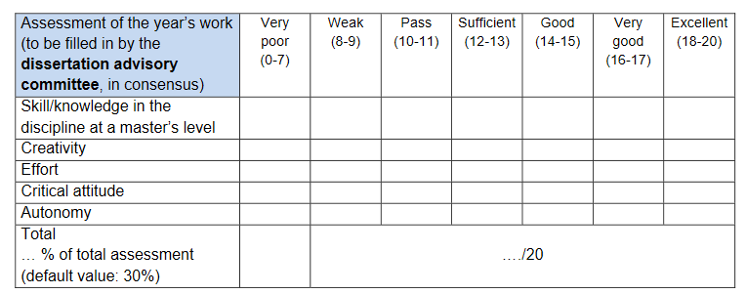
Rubrics UGent - Plato– 1/3

Slide 8
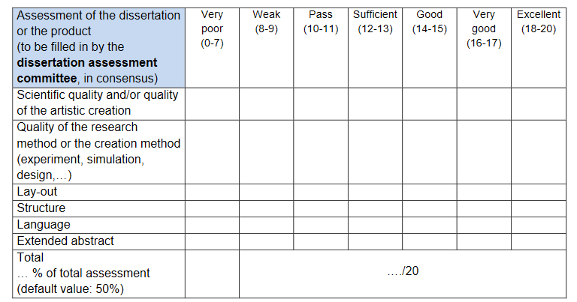
Rubrics UGent - Plato– 2/3

Slide 9
Rubrics UGent - Plato– 3/3

Slide 10
Assessment sheet VUB

Slide 11
Timelines
 | UGent | VUB
Final title | 01/04/2021 | -
Cover page submission | - | 28/05/21 (noon)
Thesis submission | 07/06/2021 – noon | 07/06/2021 – noon
Thesis defense | 21/06/21 – 27/06/21 | 21/06/21 – 27/06/21

Slide 12
Some additional remarks
You are entitled to (intermediate) feedback – ask for it when not spontaneously provided
Keep in close contact with your supervisor(s), send texts and ask feedback on texts.
In case of struggles, talk to your promotors and don’t do this at the very end
We know from experience that cultural differences may refrain students from contacting supervisors and promotors. Don’t be afraid of this (and do this in a respectful way)

Slide 13
Any further questions?

