Slide 2
Planning and scheduling your thesis
department of electromechanical, systems and metal engineering
  research group sustainable thermo-fluid energy systems
Steven Lecompte

Slide 3






Why make a Planning?
October | November | December | January
February | March | April | May
What can I do?
To own your project!
Notes:
Core message: make a planning to own your project:
ownership = you are responsible for the project’s results and timing
Owning your timing will bring peace to your master thesis.
TODAY: a basic framework for project planning + a basic tool for project planning.

Slide 4
Project definition
Process
Time
Question
Answer
Budget
Quality

Slide 5
Phasing your master thesis
After each phase build in:
  Concrete result
  Decision moment
Control the scope of the project
Why?
What?
Idea
How?
As planned?
Ok?
Analyze
Prepare
Execute
Closure
Result

Slide 6


Phasing your master thesis
Idea
We want to reduce the cost of our fire tube boilers
Why?: because we want to increase revenue
Analyze
Our designs are not tailor made for each customer -> oversiz
What? Customize to the need of the specific client.
Prepare
How? Build a heat transfer / design model of the boiler.
Execute
As planned?
Closure
Can we use the models for boiler design?

Slide 7
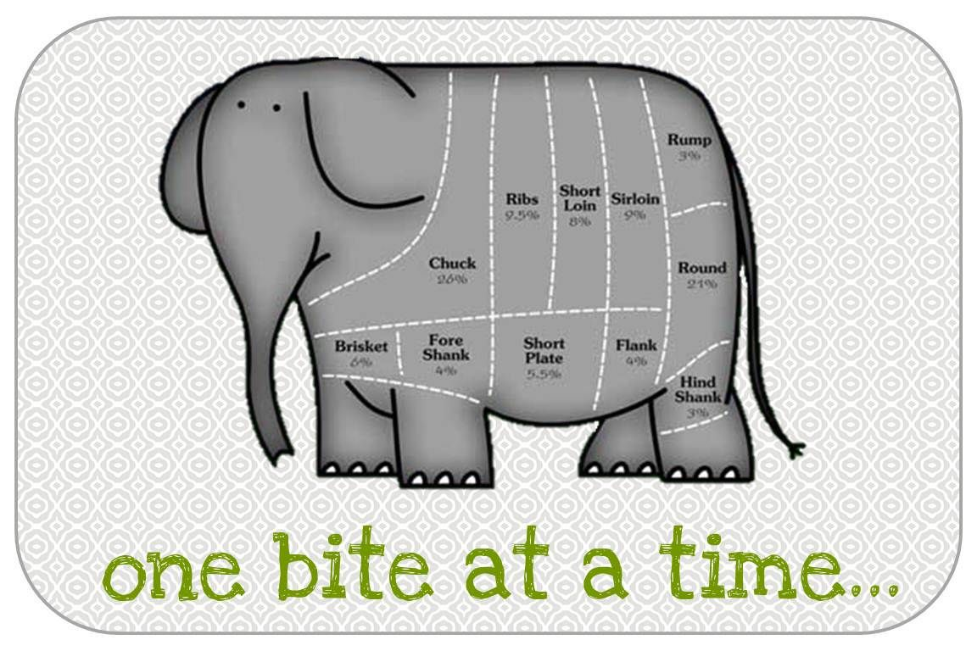
How to do a large task?
How to eat an elephant ?

Slide 8
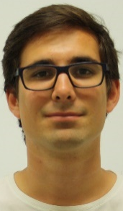
Work breakdown structure
Divide the project into sub tasks until:
  Each task has one owner
  Each task has an estimated duration
Identify milestones
  e.g. literature review, finished setup …
Identify decision moments
  e.g. components to buy , scope of the study
Identify logical sequence of tasks
Supervisor
Technician

Slide 9
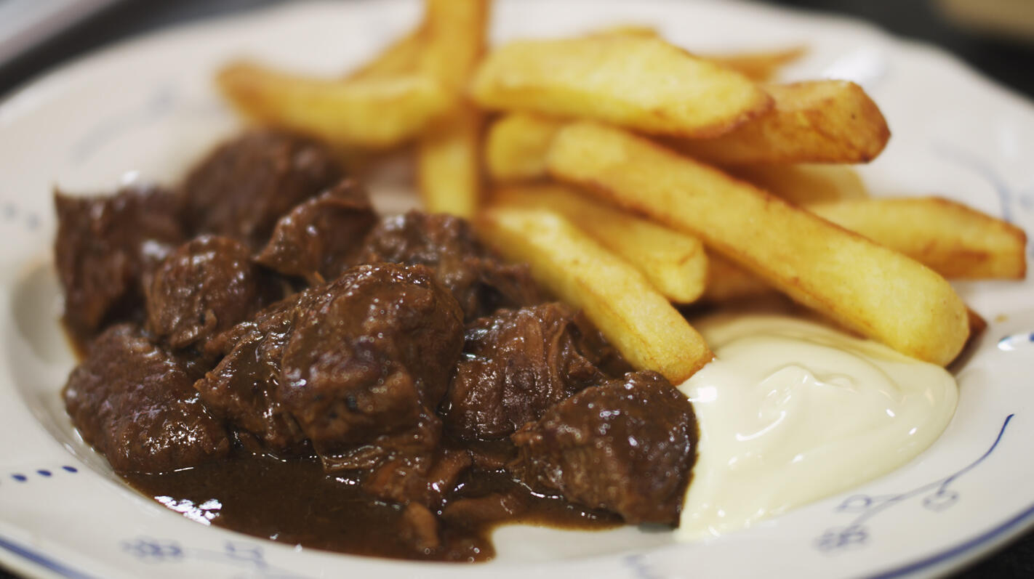
Task duration
Large tasks are hard to estimate
Subdivide a task until you can estimate the task duration
e.g. : How long does it take to cook beef stew?
Cutting onions 10 min
Cutting meat 10 min
Collecting herbs 15 min
Cooking onions 10 min
Searing meat 5 min
Stewing 1,5 h
=> 2h15 min ?

Slide 10
Milestones and decision moments
e.g. : beef stew?
Cutting onions 10 min
Cutting meat 10 min
Collecting herbs 15 min
Cooking onions 10 min
Searing meat 5 min
Stewing 1,5 h
Milestone: Mise en place
Decision moment: tasting
Milestone: beefstew

Slide 11


Task ownership
e.g. : beef stew?
Cutting onions 10 min
Cutting meat 10 min
Collecting herbs 15 min
Cooking onions 10 min
Searing meat 5 min
Stewing 1,5 h
Milestone: Mise en place
Decision moment: tasting
Milestone: beefstew
Does it still take 2h15min?

Slide 12
Network planning
Cutting onions 10 min
Cooking onions 10 min
Cutting meat 10 min
Searing meat 5 min
Collecting herbs 15 min
Stewing 1,5 h
☹
Taste?
☺
Beef stew

Slide 13
Critical Path
=The longest chain of dependent tasks
  Any delay in the critical path is a delay in the project
Cutting onions 10 min
Cooking onions 10 min
Cutting meat 10 min
Searing meat 5 min
Path 1: 1h55
Collecting herbs 15 min
Stewing 1,5 h
☹
Beef stew
☺
Taste?

Slide 14
Critical Path
=The longest chain of dependent tasks
  Any delay in the critical path is a delay in the project
Cutting onions 10 min
Cooking onions 10 min
Cutting meat 10 min
Searing meat 5 min
Path 1: 1h55
Path 2: 1h45
Collecting herbs 15 min
Stewing 1,5 h min
☹
Beef stew
☺
Taste?

Slide 15
Critical Path
=The longest chain of dependent tasks
  Any delay in the critical path is a delay in the project
Cutting onions 10 min
Cooking onions 10 min
Cutting meat 10 min
Searing meat 5 min
Path 1: 1h55
Path 2: 1h45
Collecting herbs 15 min
Path 3: 1h45
Stewing 1,5 h min
☹
Beef stew
☺
Taste?

Slide 16
Critical Path
=The longest chain of dependent tasks
  Any delay in the critical path is a delay in the project
Critical path
Cutting onions 10 min
Cooking onions 10 min
Cutting meat 10 min
Searing meat 5 min
Path 1: 1h55
Path 2: 1h45
Collecting herbs 15 min
Path 3: 1h45
Stewing 1,5 h min
☹
Beef stew
☺
Taste?

Slide 17

Gantt chart
= Graphical overview of:
Tasks
Task name | 0 | 10min | 20min |  | 30min | 40min | 50min | 1h | 1h 10 | 1h 20 | 1h 30 | 1h 40 | 1h 50
Cutting onions
Cooking onions
Cutting meat
Herbs
Searing
Stewing
Tasting?
Sequence
Milestones
Decision
moments
Notes:
What is a gantt chart?
- task
- duration
- sequence +
possibly:
milestones or deliverables
How to use:
keep track of your progress vs planned progress
adjust your planning and goals along the way

Slide 18
Project planning example: garden shed
This holiday you will build a garden shed in your new garden. You already know the size and location of the shed (4x5m). Furthermore, the required installations are also known: 3 single phase electricity connections, tap water and rainwater connection and finally lighting. The precise design of the shed is still to be determined.
The shed first requires the vegetation to be cleared. After this first step, the foundation for the base plate is dug using a rental machine. Concrete has to be ordered and poured in the foundation. The concrete base plate should contain steel supports at the location of the main supporting pillars which should follow from finishing the design of the shed.
Based on the design, beams of wood, windows and doors are ordered. The structure is built after which the electrical and water connections are finished. For the electrical and water connections, a ditch is dug from the main house to the garden shed. Finally, the work bench and tools are placed in the shed.

Slide 19
garden shed: Step 1 Task list
Design shed
Order-deliver excavator
Pour base plate
Clear vegetations
Order-deliver concrete
Order wood windows and doors
Electrical and water connections
Dig ditch
Place the work bench
Construct shed

Slide 20
garden shed: Step 2 network planning
Design shed
Order wood windows and doors
Construct shed
Place the work bench
Order-deliver concrete
Pour base plate
Dig ditch
Electrical and water connections
Clear vegetation
Dig foundation
Order-deliver excavator
Work breakdown structure

Slide 21
garden shed: Step 3: task duration
5d
4w
0,5d
Design shed
Order wood windows and doors
4w
Place the work bench
Construct shed
2d
1d
2w
1d
Dig ditch
Electrical and water connections
Order-deliver concrete
Pour base plate
5d
Clear vegetation
Early start | Duration | Early Finish
Task name
Late start | Slack | Late Finish
2d
Dig foundation
3w
Order-deliver excavator

Slide 22
garden shed: Step 3: Critical path
1week=5days
0d
5d
5d
5d
4w
5w
5w
9w
9w
0,5d
9w,5
Design shed
Order wood windows and doors
4w
Place the work bench
Construct shed
0d
2d
2d
9w
1d
9w1
0d
2w
2w
3w2
1d
3w3
Dig ditch
Electrical and water connections
Order-deliver concrete
Pour base plate
0d
5d
5d
Clear vegetation
Early start | Duration | Early Finish
Task name
Late start | Slack | Late Finish
3w
2d
3w2
Dig foundation
0d
3w
3w
Order-deliver excavator

Slide 23
garden shed: Step 3: critical path
1week=5days
0d
5d
5d
5d
4w
5w
5w
9w
9w
0,5d
9w,5
Design shed
Order wood windows and doors
4w
Place the work bench
Construct shed
0d
0d
5d
5d
0d
5w
5w
0d
9w
9w,5
,5d
9w1
0d
2d
2d
9w
1d
9w1
0d
2w
2w
3w2
1d
3w3
Dig ditch
Electrical and water connections
Order-deliver concrete
Pour base plate
2w4
4w4
4w4
1w2
5w
8w3
8w3
9w
9w
0d
9w1
2w4
0d
5d
5d
Clear vegetation
3w2
3w2
4w2
Early start | Duration | Early Finish
Task name
Late start | Slack | Late Finish
3w
2d
3w2
Dig foundation
4w2
1w2
4w4
0d
3w
3w
Order-deliver excavator
1w2
1w2
4w2

Slide 24
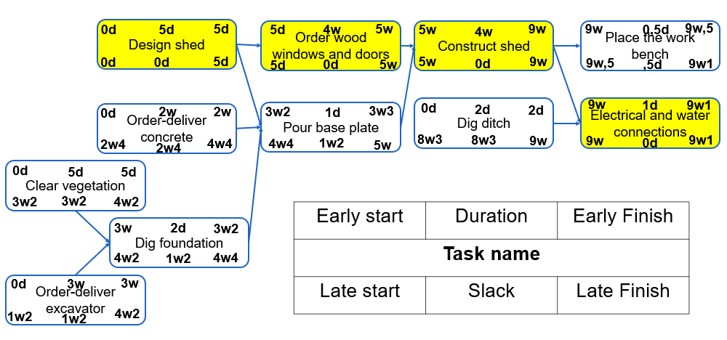
garden shed: Step 3: Gant chart

Slide 25
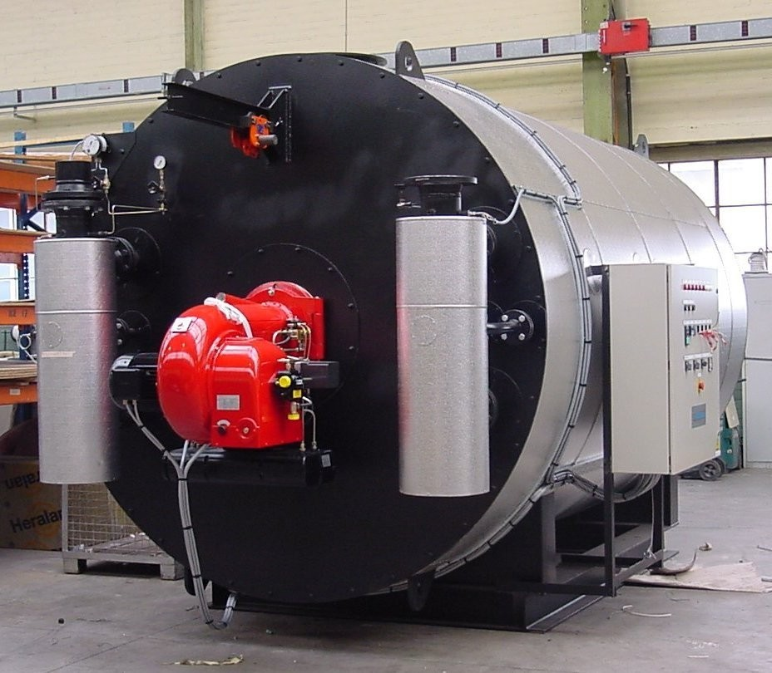
Case study: my master thesis
We want to reduce the cost of our fire tube boilers.
Notes:
Project planning: can be quite abstract
Therefore: use an example to show the implementation of a planning
Present example: my master thesis.
Core message : Deconinck Wanson wanted to reduce the cost of their fire tube boiler. Before the master thesis they used catalogue solutions based on their experience.
They wanted to model the FTB to tailor each boiler to the needs of a specific client.
The result would be a downsized design == cheaper boiler.

Slide 26

Work breakdown structure: case
Table of articles
Select articles
Summary of available articles: 5 days
Read selected articles: 20 days
Literature review
Summarize read articles: 5 days
Model structure
Prepare
Content review
Write review story: 3 days
Experimental boiler Data: 1
Steady state data

Slide 27
Work breakdown structure: case
Content: model structure
Furnace: 5 days
Program model
Tube pass: 5 days
Turn box: 1 day
Furnace: 2
Tube pass: 2
Content: Verification
Integration: 10 day
Turn box: 2
Verification
Integration: 2
Test
models
Execute
Content: validation
Validation 4
Design analysis: 10
Content: guide
27

Slide 28
Work breakdown structure: case
Literature review: 10 days
Dissertation
Chapter model structure: 5 days
Book
Chapter verification and validation: 5 days
Closure
Chapter: design analysis: 10 days
Extended abstract: 5 days
Summary: 1 day
Presentation: 5

Slide 29
Network planning
Identify the logical sequence of tasks
Based on dependencies :
- task-intrinsic
- resource bound
Summary of available articles
Select articles
Read selected articles
Summarize read articles
Write review
Be on holiday

Slide 30
Critical path
=The longest chain of dependent tasks
  Any delay in the critical path is a delay in the project
Summary of available articles: 5
Read selected articles:
20
Summarize read articles:
5
Write review story:
3
Path length: 33 days
Model structure
Program model: 21
Test models: 14
Design analysis: 10
Path length: 75 days => critical path

Slide 31
 |  |  |  | week |  | 1 | 2 | 3 | 4 | 5 | 6 | 7 | 8 | 9 | 10 | 11 | 12 | 13 | 14 | 15 | 16 | 17 | 18 | 19 | 20 | 21
1 | Literature review
 | 1.1 | Summary of available articles
 | 1.2 | Read selected articles
 | 1.3 | Summarize read articles
 | 1.4 | Write review story
2 | Experimental boiler data
3 | Program model
 | 3.1 |  | Furnace
 | 3.2 |  | Tube pass
 | 3.3 |  | turn box
 | 3.4 |  | integration
4 | Test models
 | 4.1 |  | verification
 |  |  | 4.1.1 |  | Furnace
 |  |  | 4.1.2 |  | Tube pass
 |  |  | 4.1.3 |  | Turn box
 |  |  | 4.1.4 |  | Integration
 | 4.2 |  | validation
5 | Design analysis
Notes:
Example for the present case:
From WBS->network -> critical path->

Slide 32
Summary
Project phasing
Work Breakdown structure
Network planning
Identify critical path
Scheduling: Gantt chart
Divide and conquer
Ownership and duration
Identify logical task sequence
Find path with longest duration
When will I do what
Notes:
Use stick ons

Slide 33
Some final advise
Planning is a tool, not a goal
Include contingency in your planning
Start roughly, refine as you come closer
The worst plan is no plan at all
  The second worst plan is a plan that cannot change

Slide 34

Steven Lecompte
Department of electromechanical, systems and metal engineering
E wim.beyne@ugent.be www.ugent.be
Universiteit Gent

