Slide 1
Culture shock
The feeling of disorientation experienced by someone when they are suddenly subjected to an unfamiliar culture, way of life, or set of attitudes. (Oxford Languages)
International relations office FEA
iWISE 6 February 2026
Fien Porrez, International Relations Officer
Notes:
Hi everyone, welcome!
Today we’re going to talk about something many of you might experience while you’re in Belgium: culture shock.
As exchange students, you’re starting an exciting adventure full of new experiences and opportunities. Living in another country is amazing, but it can also be challenging. You’ll notice things that are different from home, and it might take some time to adjust. That’s what we call culture shock. It can affect how you feel and how you behave.
In this presentation, we’ll look at:
What culture shock is
The different stages
How you might notice it during your stay in Belgium
And of course, we’ll share tips to help you deal with it, so your semester here is fun and rewarding.
Let’s dive in and learn how to make the most of your time in Belgium – and enjoy the cultural differences that make this experience special!

Slide 2
1) Who has already noticed something surprising, unusual or unexpected in Ghent or Belgium?
2) Who has already felt a bit of a culture shock in daily life?
3) Who thinks the academic culture at Ghent University will be different from their home universtity?

Slide 3

Culture shock
= refers to the stress and disorientation you experience when entering a new culture

Slide 4

Rhinesmith's Ten Stages of Adjustment
2. initial
excitement
4. superficial adjustment
6. acceptance of host culture
8. return excitement
10. reintegration
initial
anxiety
3. initial culture shock
5. depression–frustration
7. return anxiety
9. re-entry shock
= rollercoaster!
Notes:
Riding the Roller Coaster of Culture Shock
Experiencing culture shock is a bit like riding a roller coaster – full of ups and downs. Sometimes you’ll feel excited and curious, and other times you might feel confused or frustrated. Everyone experiences these highs and lows differently, and that’s completely normal when adjusting to a new culture.
Stages 1–5: First Contact with a New Culture
Before coming to Belgium, you’re probably excited about all the new adventures ahead. When you arrive, you might feel independent and ready to explore Belgian culture. At first, expectations can be high, and you might see everything like a tourist. You may compare Belgium to your home country a lot. It’s normal to notice what feels “missing” or “different,” and that can lead to frustration. Everyday things like banking, eating, or making friends might feel hard. These feelings are signs of culture shock.
Stage 6: Getting Comfortable
Over time, things that seemed strange will start to feel normal. You’ll slowly adjust your lifestyle to fit Belgian culture. The things that once annoyed you will just become part of life. You’ll start to understand and appreciate the differences. If challenges pop up, you might feel frustrated again, but you’ll adapt more easily. You might make new friends, travel more, and even start dreaming in another language. The “Belgian way” will start to feel like your way of living.
Stages 7–10: Going Home
The more you get used to Belgian culture, the harder it can be to readjust when you go back home. Your home country might look different, and you might notice things you never thought about before. This is called reverse culture shock. Don’t let that stop you from fully enjoying your time here. Even if you adapt well, going home will still feel different at first. But with time, you’ll settle back in.
https://studentsabroad.com/handbook/adjustments-and-culture-shock.php?country=Belgium

Slide 5
Understanding Culture Shock: Three Key Areas
Personal shock
Social shock
Academic shock
Notes:
Culture Shock Can Affect You in Different Ways
It’s helpful to know the three main areas it affects:
1. Personal Shock
This is about how you feel emotionally and mentally in a new place. You might feel homesick, stressed, or overwhelmed as you get used to new routines and surroundings.
2. Social Shock
This is about fitting in socially. You might find it hard to understand local customs, communicate well, or feel like you belong.
3. Academic Shock
This is about adjusting to a new education system. Teaching styles, expectations, and academic pressure might be very different from what you’re used to.
By knowing these areas, you can prepare better and handle culture shock more easily during your time in Belgium.

Slide 6
Personal shock
sadness
loneliness
homesickness
frustration
anxiety
Notes:
Personal Shock: How It Can Affect You
When you go through culture shock, your emotions and mental well-being can really be impacted. Here are some common feelings:
Sadness
You might feel sad because you miss familiar places, people, and routines. This is a normal reaction to being in a new environment.
Loneliness
Being far from family and friends can make you feel lonely. It takes time to build new friendships and find support in your new surroundings.
Homesickness
Missing home is one of the most common challenges. You might miss the comfort and familiarity of your country, which makes adjusting harder. Homesickness can hit early or later—often around holidays or family events. Many students also feel it more in winter when it’s dark, rainy, and cold.
Frustration
Learning new ways of doing things can be frustrating. Simple tasks might feel complicated, and language barriers or different social norms can add stress.
Anxiety
Not knowing what to expect in a new culture can cause anxiety. You might worry about fitting in, doing well in school, or managing daily life.

Slide 7
social shock
feeling left out
feeling misunderstood
developing negative views of local people
searching for company among people of your own region
homesickness
Notes:
Social Shock: How It Can Affect You
Social shock can make it harder to connect with people and feel at home in your new environment. Here are some common challenges:
Feeling Left Out
You might feel excluded from activities or conversations, especially if you don’t know the local customs or language. This can make it hard to feel like you belong.
Feeling Misunderstood
Cultural differences can cause misunderstandings. You might feel like people don’t “get” your background or the way you express yourself, which can be frustrating.
Negative Views of Local People
When adapting feels hard, it’s easy to think locals are unfriendly or difficult to relate to. This can slow down your integration.
Sticking to People from Your Own Country
It’s natural to look for others from your home country for comfort. While this helps, it can also make adapting to the new culture slower.
Homesickness
Social shock can make homesickness worse. Missing your usual social support can make it harder to engage with new people and experiences.

Slide 8
academic shock
Not used to the types of lectures
Not understanding the lecturer
Underestimating the amount of work
Misunderstanding assignments, exams
Notes:
Academic Shock: What It Means
Adjusting to a new education system can be a big challenge. Here are some common issues:
Different Lecture Styles
Lectures might look and feel different from what you’re used to. This can make it harder to follow and take good notes.
Understanding the Lecturer
Accents, teaching styles, or local references can make it tough to understand your professors, which can lead to confusion.
Underestimating the Workload
The amount of work or expectations might be higher or just different. It’s easy to underestimate and fall behind, which can cause stress.
Assignments and Exams
Every academic system has its own way of doing things. You might not fully understand what’s expected, which can lead to mistakes or lower grades.

Slide 9
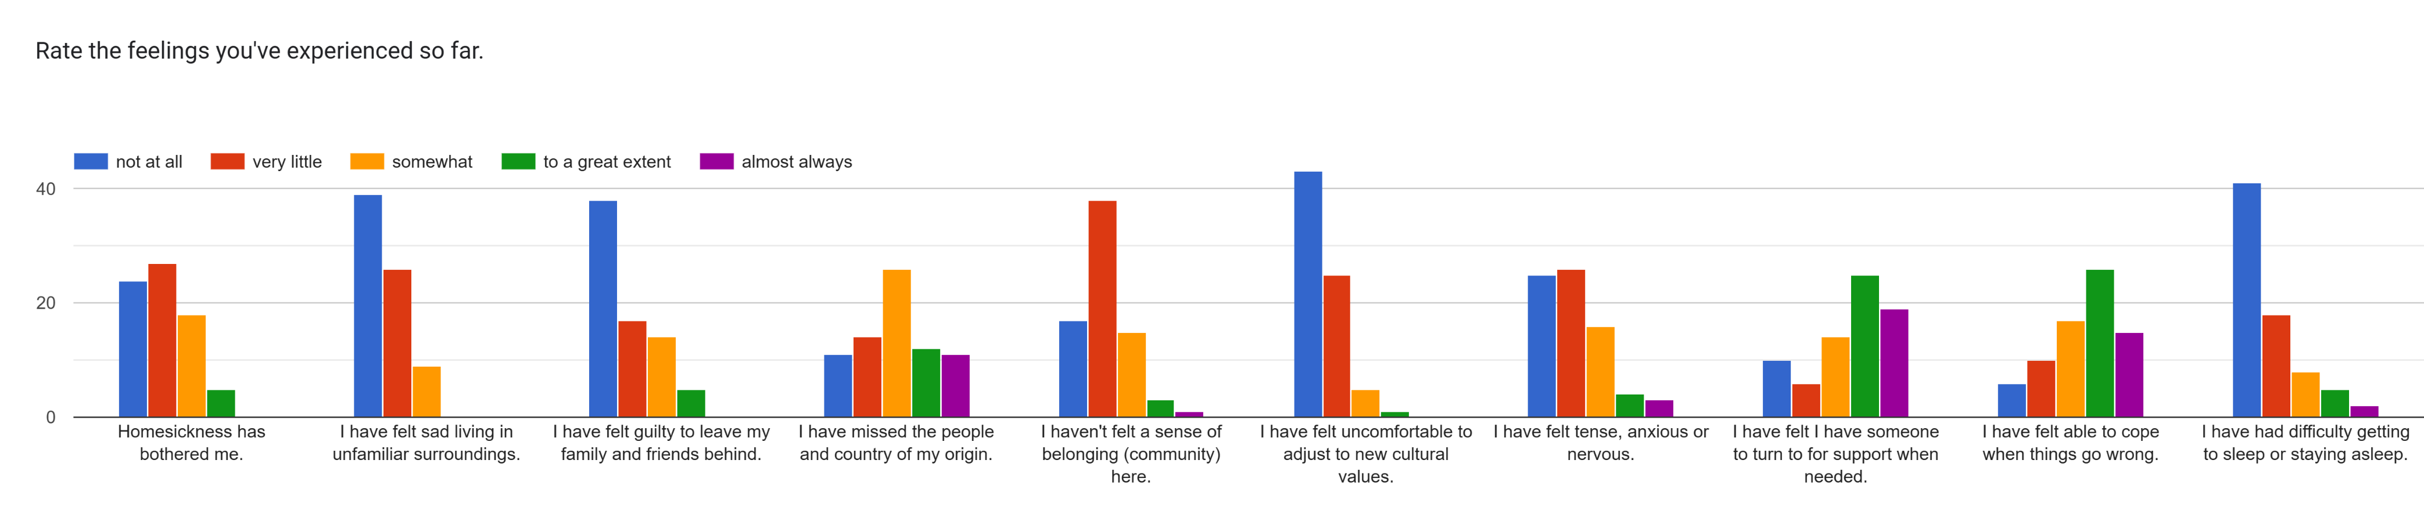
You’re not alone
Notes:
It's important to know that you are not alone in experiencing culture shock. Results from a recent survey show that almost all students, to varying degrees, experience culture shock during their time abroad.
So if you feel confused, frustrated, or homesick, that’s completely normal—and many others feel the same way.
By understanding these feelings, we can support each other and find ways to adapt together. Don’t hesitate to share how you feel and ask for help from other students, professors, or advisors.
Together, we can make sure your time in Belgium is not only challenging but also rewarding and unforgettable.

Slide 10
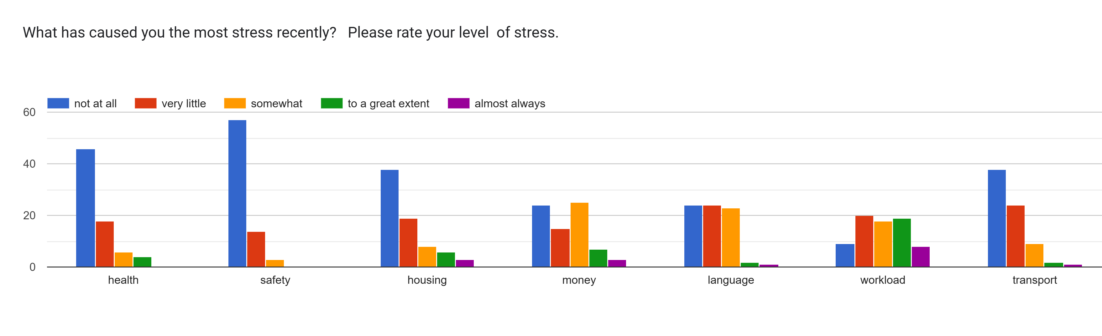

You’re not alone
Notes:
Main Sources of Stress
This slide shows the biggest stress factors for students:
Heavy workload
Contact with national students
Different teaching methods
Course level
These challenges are closely linked to academic shock, which we talked about earlier.

Slide 11
TIPS for the crisis phase:
Try to avoid constantly comparing to your home country
Try not to contact friends and family back home too often (homesickness)
Avoid judging too quickly during this phase
Be aware that during this phase you may discriminate, judge or hold prejudices
Don’t isolate yourself too much in this phase

Slide 12
What helps with the culture shock?
Building a social network
Communicating with the locals
Adjusting your expectations
Accepting differences
Reflecting on your own culture
Acknowledging that culture shock is normal

Slide 13
Cultural and social differences
at Ghent University
In Belgian society:
  social behaviour
  interpersonal relations
  daily life
Notes:
When you come to Belgium, you’ll notice some cultural and social differences. These can show up in two main areas:
At Ghent University – Things like teaching styles, classroom interaction, and how students and professors communicate might feel different from what you’re used to.
In Belgian society – Daily life can bring surprises too. Social behavior, how people build relationships, and everyday routines might not be the same as at home.

Slide 14
At ghent university
Second term
Monday 09-02-2026 through Saturday 04-04-2026: 8 weeks of teaching activities 2nd term (including feedback first term exam period through Saturday 21/02/2026)
Easter recess: Monday 06-04-2026 through Saturday 18-04-2026 (2 weeks)
Monday 20-04-2026 through Saturday 16-05-2026: 4 weeks of teaching activities 2nd term
Monday 18-05-2026 through Wednesday 20-05-2026: catch-up activities
Thursday 21-05-2026 through Saturday 23-05-2026: no teaching activities or catch-up activities
Tuesday 26-05-2026 through Saturday 04-07-2026: 6 weeks second term examination period (including exam preparation, deliberations, proclamations through Thursday 02/07/2026 and feedback second term examination period)
Summer recess: Monday 06-07-2026 through Saturday 15-08-2026 (6 weeks)
Notes:
The academic calendar can differ significantly from that of your home university. Understanding these differences is crucial for planning your studies and managing your time effectively. Be sure to familiarize yourself with important dates, such as the start and end of semesters, exam periods, and holidays, to ensure a smooth academic experience at Ghent University.

Slide 15
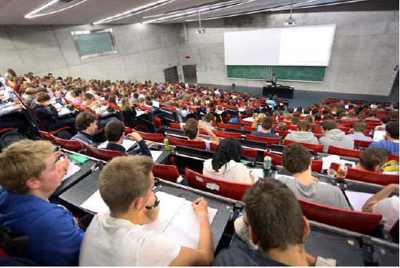
At ghent university
Be on time!!
Active participation!
Ask questions!
Notes:
Be aware of the formal and informal ways students and staff interact. Classes start on time, so being in time is crucial. Respect for professors and peers is important, and participation in group work and discussions is encouraged.

Slide 16
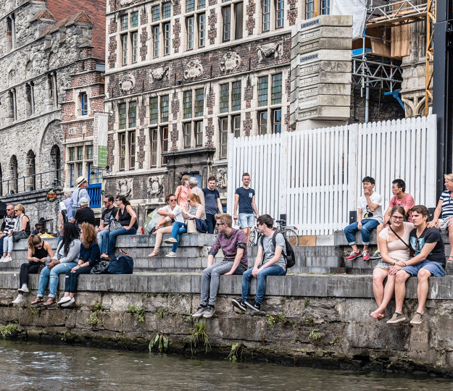
Social behaviour: What do Belgians in general not appreciate?
showing off or bragging
looking away when talking to someone, snapping your fingers, putting hands in pockets, yawning, scratching, back slapping, putting feet on tables or chairs
giving too many compliments
showing up without warning
to insist on something after you’ve been told it is not possible
with room for individual differences!
Notes:
Showing Off or Bragging:Belgians value modesty and humility. Avoid showing off or bragging about your achievements or possessions.
Body Language and Gestures:Looking away when talking to someone, snapping your fingers, putting your hands in your pockets, yawning, scratching, back slapping, and putting your feet on tables or chairs are considered disrespectful.
Compliments:While compliments are appreciated, giving too many can come across as insincere or excessive.
Unannounced Visits:Showing up without warning is generally frowned upon. It's best to call or message ahead to arrange a visit.
Persistence:If you've been told that something is not possible, insisting on it can be seen as rude and pushy. Respect the response and move on.

Slide 17
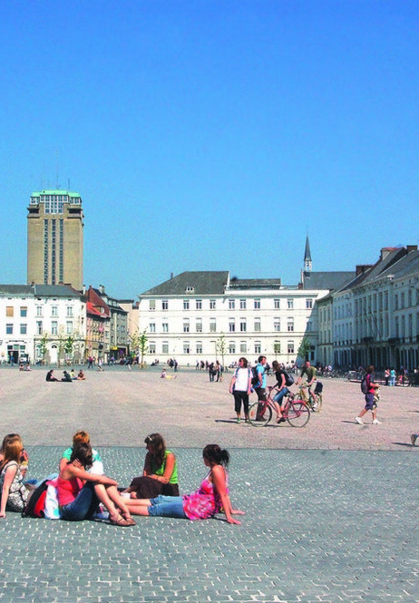
Social behaviour: What do Belgians (in general) appreciate?
simplicity and modesty
eye contact (but don’t stare either)
calling and making an appointment before showing up
being (right) on time
small presents when visiting for dinner (e.g. wine)
helping out (a little bit) when being a guest
with room for individual differences!
Notes:
What Belgians Do Appreciate
Simplicity and Modesty:Belgians value simplicity and modesty. Being humble and down-to-earth is highly appreciated.
Eye Contact:Making eye contact during conversations shows respect and attentiveness. However, avoid staring as it can make people uncomfortable.
Calling and Making an Appointment:Before visiting someone, it's courteous to call and make an appointment. This shows respect for their time and privacy.
Punctuality:Being on time is important. Arriving right on time or even a few minutes early is seen as respectful and considerate.
Small Presents When Visiting for Dinner:Bringing a small gift, such as a bottle of wine, when invited for dinner is a thoughtful gesture that is much appreciated.
Helping Out When Being a Guest:Offering to help out a little bit when you're a guest, such as setting the table or clearing dishes, is seen as polite and kind.

Slide 18
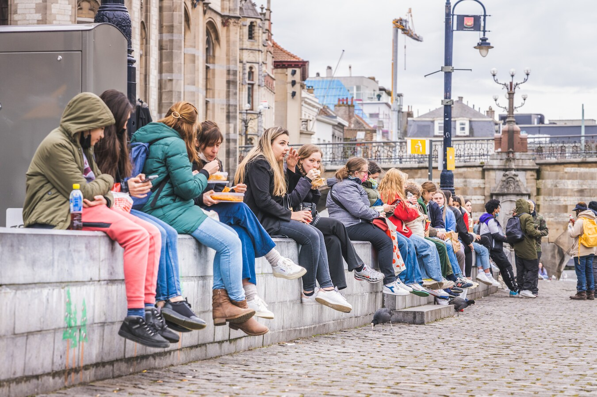
Social behaviour: helpful cultural tips
- Sneezing → People often say “Gezondheid” (similar to “Bless you”).
- Burping → Usually considered impolite; saying “sorry” is appreciated.
- Coughing → Cover your mouth, preferably into your elbow.
- Blowing your nose → Totally fine, just use a tissue or handkerchief.
- Spitting → Generally seen as unacceptable in public.
- Smoking → Not allowed indoors; look for designated areas marked with signs.
Notes:
Understanding local etiquette can help you navigate social situations more smoothly. Here are some key points to keep in mind:
Sneezing: When someone sneezes, it's polite to say "Gezondheid," which means "Bless you."
Burping: Burping is considered impolite. If it happens, it's customary to say "sorry."
Coughing: Always cough into your elbow to prevent spreading germs.
Blowing Your Nose: It's perfectly acceptable to blow your nose in public, but use a handkerchief or tissue.
Spitting: Spitting in public is unacceptable and considered very rude.
Smoking: Smoking is forbidden indoors and in many public places. Look for clearly marked signs indicating where smoking is allowed.
By following these guidelines, you can show respect for local customs and make a positive impression.

Slide 19
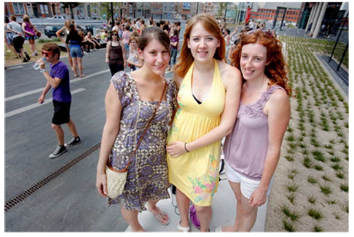
Interpersonal relations: equality m-f-x
women = men = X (professionally, rights, thoughts....)
liberal/flimsy dress code is allowed
unappropriate behaviour → no go
Notes:
Equality
Women = Men
Gender equality is a basic principle in modern society. Men and women should have the same opportunities, rights, and respect in all professional settings. Everyone deserves an inclusive environment where all voices are heard.
Dress Code
Liberal Dress Code Allowed
People are free to express themselves through clothing. While personal style is welcome, it’s still important to keep a level of professionalism that matches the organization’s values.
Behavior
Respect Is Non-Negotiable
Inappropriate behavior—such as harassment or discrimination—is never acceptable. Creating a safe and respectful space for everyone is essential.

Slide 20

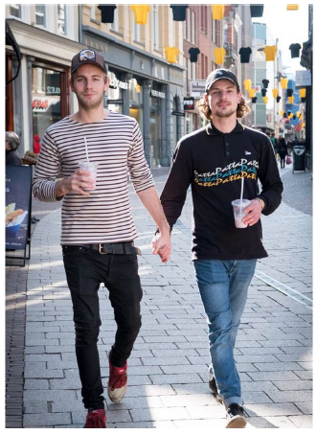
Interpersonal relations: LGBTTTQQIAA
love is love
equal rights (marriage, adoption, protected by law…)
Notes:
Equal Rights
In Ghent, Belgium, everyone has equal rights—no matter their sexual orientation or gender identity. This includes the right to marry, adopt children, and be protected by law from discrimination and harassment.
Marriage
Same-sex marriage has been legal in Belgium since 2003, making it one of the first countries in the world to recognize marriage equality.
Adoption
Since 2006, same-sex couples have had the right to adopt children, ensuring all families are treated equally under the law.
Legal Protections
Belgium has strong anti-discrimination laws that protect people from unfair treatment based on sexual orientation or gender identity—in areas like work, housing, and public services.

Slide 21
Interpersonal relations: legal consequences
hate crimes (e.g. verbal or physical violence) against people (based on sexism, discrimination, homophobia, racism,…) are severely punished
if you are a victim of discrimination or a hate crime:
    go to the police
Notes:
Addressing Hate Crimes and Discrimination in Ghent
Strict Penalties
In Belgium, hate crimes—such as verbal or physical violence based on sexism, racism, homophobia, or other forms of discrimination—are taken very seriously. The law imposes strict punishments to protect victims and prevent these offenses.
Reporting Matters
If you experience discrimination or a hate crime, report it to the police. Belgian law enforcement is committed to handling these cases and ensuring everyone’s safety and rights.

Slide 22
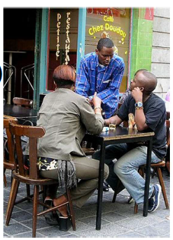
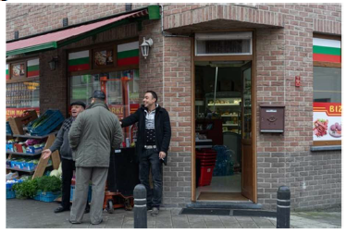
Interpersonal relations: multicultural society
plenty of nationalities (± 150 in Ghent)
mixture of cultures
enriching our culture & science
Notes:
Diversity and Enrichment in Ghent
Many Nationalities
Ghent is home to around 150 different nationalities. This diversity makes the city lively and exciting.
Mix of Cultures
Different cultures come together in Ghent, creating a unique atmosphere. You can see this in festivals, food, and everyday life. It helps build community and mutual respect.
Cultural and Scientific Growth
Ghent’s diversity brings new ideas and perspectives. This drives creativity, innovation, and scientific progress, making the city a hub for culture and knowledge.

Slide 23
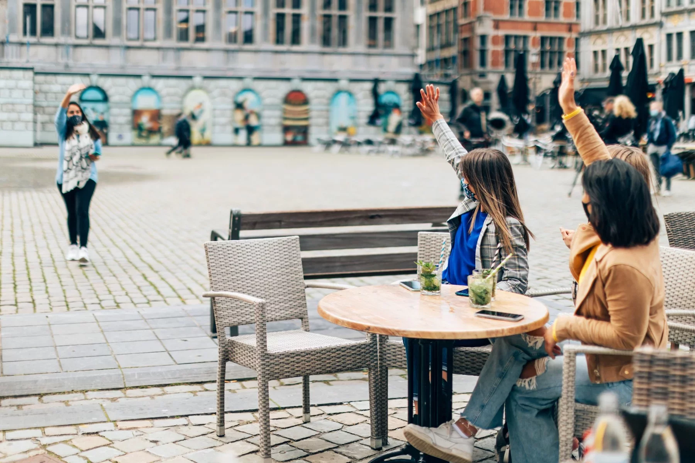
daily life: greetings
first time: shake hands → nice to meet you
more familiar → one kiss on the right cheek or three kisses, especially for women, family, to congratulate
men: usually a handshake
Wallonia: men kiss their male friends
with room for individual differences!
Notes:
When meeting someone for the first time, it's customary to shake hands and say, "Nice to meet you." As you become more familiar with someone, the greetings can become more personal. For instance, it's common to give one kiss on the right cheek or three kisses, especially among women, family members, or when congratulating someone.
Men usually greet each other with a handshake. However, in Wallonia, it's not uncommon for men to kiss their male friends as a form of greeting.

Slide 24
daily life: food
Breakfast (6AM – 8AM): bread, cereals, coffee/tea, juice, sometimes pastries
Lunch (12PM – 2PM): hot meal, sandwich, salad, soup …
Dinner (between 6PM and 8PM): sandwich, bread, or hot meal
with room for individual differences!
Notes:
Daily Meal Schedule
Breakfast (6AM – 8AM):
Typically includes bread, cereals, coffee or tea, juice, and sometimes pastries.
Lunch (12PM – 2PM):
Often consists of a hot meal, sandwich, salad, or soup.
Dinner (between 6PM and 8PM):
Can be a sandwich, bread, or a hot meal.

Slide 25
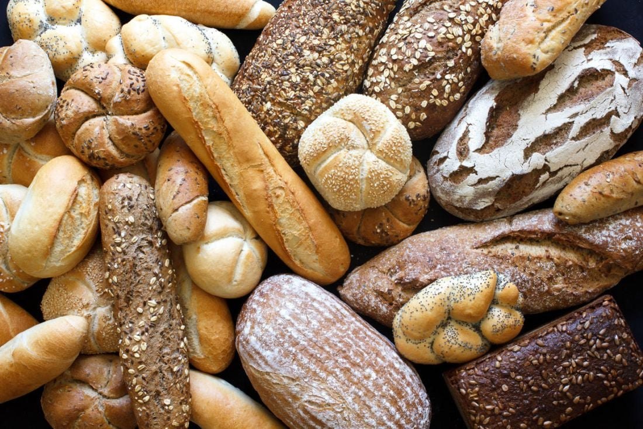
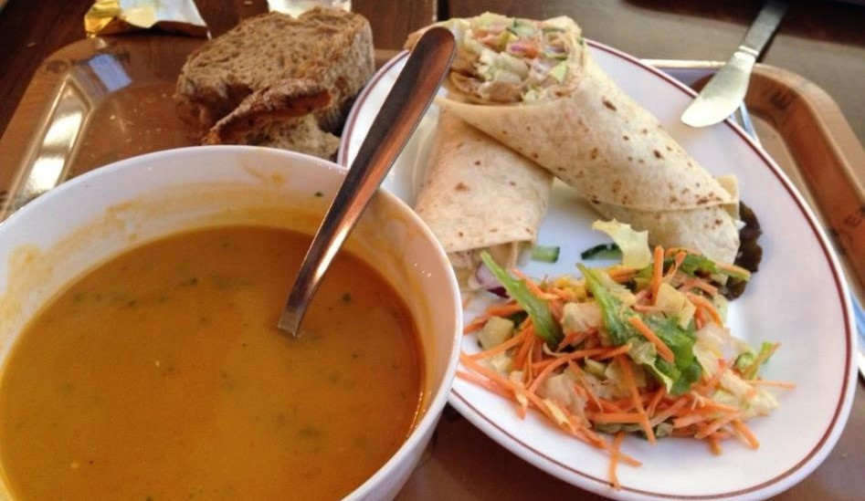
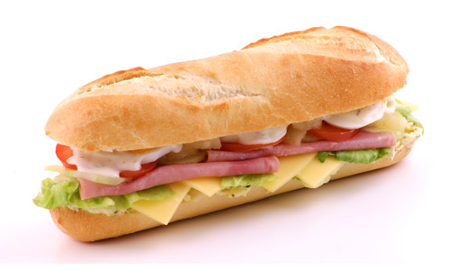
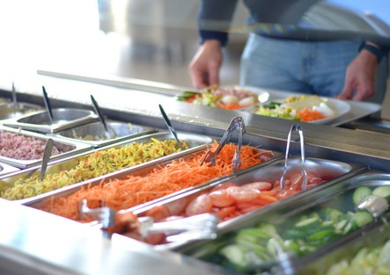
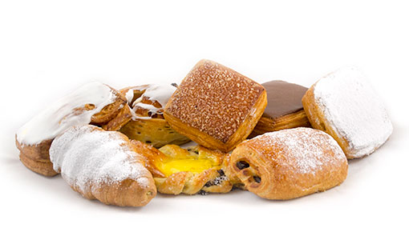
daily life: food
with room for individual differences!
Notes:
Delicious and Diverse Food Options
Soup: A warm and comforting bowl of soup, perfect for a light meal or a starter.
Wrap with Vegetables: A healthy and colorful wrap filled with fresh vegetables, offering a nutritious and tasty option.
Sandwich (Belegd Broodje): A classic belegd broodje, generously filled with various ingredients like meats, cheeses, and vegetables.
All Kinds of Bread: An assortment of breads, showcasing the variety available, from crusty baguettes to soft rolls.
Pastries: A tempting display of pastries, including croissants, tompouce met yellow pastry cream, ronde suisse
Salad Bar: A vibrant salad bar with a wide range of fresh vegetables, toppings, and dressings, allowing for a customizable and healthy meal.

Slide 26

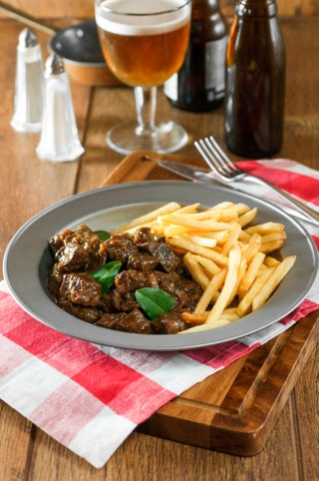

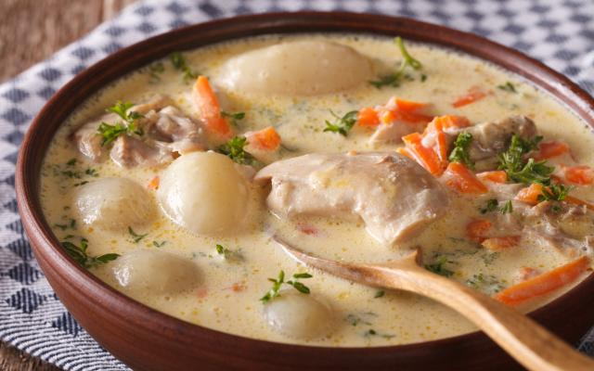
daily life: food - Specialities
Notes:
Typical Flemish Food
Mussels with Fries:
A classic Belgian dish, mussels are often steamed with onions, celery, and white wine, and served with crispy Belgian fries.
Flemish Stew (Stoofvlees):
This hearty beef stew is slow-cooked with onions, beer, and spices, resulting in tender meat and a rich, flavorful sauce. It's typically served with fries or bread.
Chicon Gratin/chicory with :
Also known as "witloof met hesp en kaassaus," this dish features Belgian endives wrapped in ham, covered with a creamy cheese sauce, and baked until golden and bubbly.
Gentse Waterzooi:
A traditional dish from Ghent, this creamy stew is made with chicken or fish, vegetables, and potatoes, all simmered in a flavorful broth.

Slide 27
daily life: shops
clothing, gifts, furniture, books …:
open from 10AM until 6PM: closed on Sunday and
Public Holidays
̶ food:
open from 8AM until 7PM/8PM/9PM, some of them are open on Sunday morning
Notes:
lothing, Gifts, Furniture, Books, etc.:
These stores are typically open from 10AM until 6PM. They are closed on Sundays and Public Holidays.
Food Stores:
Food stores generally open earlier, from 8AM, and close between 7PM and 9PM. Some of these stores are also open on Sunday mornings.

Slide 28
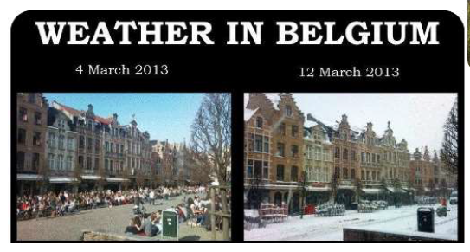
daily life: weather
Very changeable
Notes:
Changeable Weather in Belgium
Unpredictable Conditions:Belgium is known for its highly changeable weather. It's not uncommon to experience sunshine, rain, and even snow all in one day.
Frequent Rain:Rain is a frequent occurrence throughout the year. It's always a good idea to carry an umbrella or a raincoat, as showers can happen unexpectedly.
Seasonal Variations:Winters can be cold and damp, with occasional snowfall. Summers are generally mild, but heatwaves can occur. Spring and autumn often bring a mix of sunny and rainy days.
Be Prepared:Due to the unpredictable nature of the weather, it's important to be prepared for sudden changes. Dressing in layers and checking the weather forecast regularly can help you stay comfortable.

Slide 29
daily life: clothing
formality depends on the occasion
formal clothing during exams is not mandatory but
sometimes appreciated
wear what you feel comfortable in!
Notes:
The level of formality in clothing depends on the occasion. It's important to consider the context and dress accordingly.
Exams:
While formal clothing during exams is not mandatory, it is sometimes appreciated. Dressing neatly can help create a positive impression.
Comfort:
Ultimately, wear what you feel comfortable in! Comfort can boost confidence and help you perform your best.

Slide 30
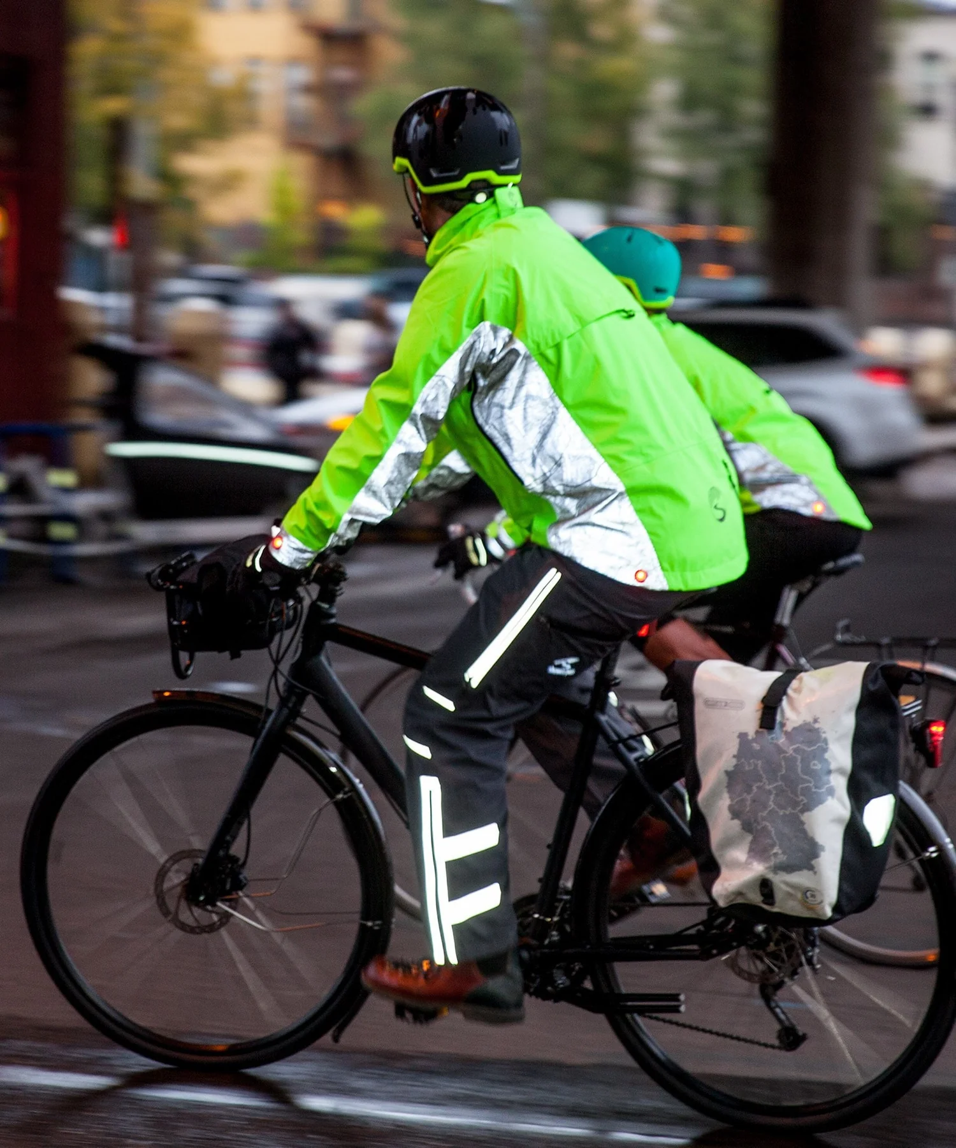
daily life: winter clothing
waterproof jacket
rain pants (when biking)
gloves (!) (when biking)
sturdy shoes
Notes:
Essential Gear for Biking in Belgium
Waterproof Jacket:
A must-have for staying dry during unexpected rain showers. It helps keep you comfortable and protected from the elements.
Rain Pants:
Especially important when biking. They provide an extra layer of protection to keep your legs dry and warm.
Gloves:
Don't forget your gloves! They are crucial for keeping your hands warm and maintaining a good grip on the handlebars, especially in cold or wet conditions.
Sturdy Shoes: Opt for sturdy shoes that can handle various weather conditions and provide good support while biking.

Slide 31
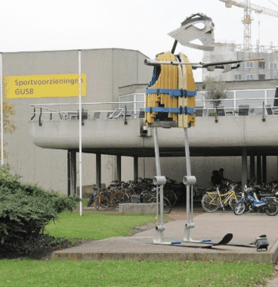
Interpersonal relations: daily life: sports
UGent Sports Centre
HOGent Sports Centre
various fitnesses (Jims, Basic Fit, Stadium Coupure)
climbing and bouldering
various dance studios
water sports
running tracks
…
Notes:
UGent Sports Centre:
The UGent Sports Centre offers a wide range of sports facilities, including indoor halls, a swimming pool, and various fitness classes. It's a great place for students and staff to stay active and healthy1
HOGent Sports Centre:
HOGent provides diverse sports opportunities for students and staff, including recreational and competitive sports, fitness activities, and special events2
Various Fitness Centers:
Ghent has several fitness centers, including Jims, Basic Fit, and Stadium Coupure. These gyms offer a variety of equipment, group classes, and flexible membership options3
Climbing and Bouldering:
For those interested in climbing, Ghent has excellent facilities for both climbing and bouldering. These centers provide routes for all skill levels and offer a great way to stay fit and have fun6
Various Dance Studios:
Ghent is home to numerous dance studios offering classes in various styles, from ballet to hip-hop. These studios cater to all ages and skill levels, providing a fun and creative way to stay active7
Water Sports:
The city offers a range of water sports activities, including kayaking, rowing, and sailing. These activities are perfect for those who enjoy being on the water and staying active
Running Tracks:
Ghent has several running tracks available for public use. These tracks provide a safe and convenient place for runners to train and stay fit

Slide 32


daily life: public space
No noise in the streets between
10PM and 7AM
Drink responsibly
Public parks
Blaarmeersen, Bourgoyen
Notes:
Community Guidelines and Amenities in Ghent
No Noise in the Streets Between 10PM and 7AM:
To ensure a peaceful environment for all residents, noise in the streets is prohibited between 10PM and 7AM. This includes loud conversations, music, and other disturbances
Drink Responsibly:
Enjoying Ghent's vibrant nightlife and famous Belgian beers is a great experience, but it's important to drink responsibly. Be mindful of your limits and respect others around you
Public Parks:
Ghent boasts beautiful public parks where you can relax and enjoy nature. Two notable parks are:
Blaarmeersen: A sports and recreation park with a large lake, sandy beach, and numerous activities like jogging, kayaking, and mini-golf
Bourgoyen: A nature reserve perfect for hiking and bird-watching, offering a peaceful escape from the city

Slide 33
IWISE - Introduction WEEK for International Students in Engineering
Culture shock
Fien Porrez, International Relations Officer
Notes:
Thank you for joining this presentation on culture shock in Ghent. As we've explored, Ghent is a city rich in diversity, culture, and history. While adjusting to a new environment can be challenging, it's also an opportunity for growth and learning.
Remember, experiencing culture shock is a normal part of adapting to a new place. Embrace the differences, stay open-minded, and take advantage of the resources and support available to you. Whether it's enjoying the local cuisine, participating in community activities, or simply exploring the beautiful city, Ghent has so much to offer.
By understanding and appreciating the unique aspects of life in Ghent, you'll find yourself feeling more at home in no time. If you have any questions or need further assistance, don't hesitate to reach out.
Thank you, and best of luck on your journey in Ghent!

