Slide 1
ICT and e-Learning platforms
iWISE Of Engineering And Architecture

Slide 2
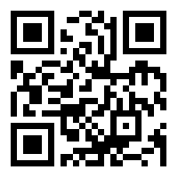
Ufora
Official digital learning environment of Ghent University and by far the most important communication tool used for:
  - downloading documents
  - doing exercises
  - checking your schedule with tasks and deadlines
  - submitting papers, assignments and reports
Checking Ufora on a regular basis is crucial!
https://ufora.ugent.be
Notes:
Ufora
Ufora is de officiële digitale leeromgeving van de Universiteit Gent en is het communicatiemiddel bij uitstek. De student kan er documenten downloaden, oefeningen maken, agenda met taken en deadlines raadplegen, papers, opdrachten en verslagen inleveren. Regelmatig raadplegen is de boodschap!
https://ufora.ugent.be

Slide 3
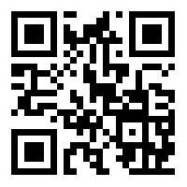
STUDY GUIDE
Overview of the complete range of programs offered by UGent
Program summary: overall course schedules per semester
Course specifications: educational and organizational description:
  - contents
  - position of the course
  - lecturers
  - learning materials
  - teaching methods
  - evaluation methods
  - calculation of the examination mark
  - initial and final competences
http://studiekiezer.ugent.be/en
Notes:
Als vb eventueel https://studiekiezer.ugent.be/studiefiche/en/E028700/2023
Alle lesroosters zijn te raadplegen via de study guide 2023-2024: http://studiekiezer.ugent.be/en
Alle algemene lesroosters staan in de studie guide. Kies je opleiding en klik rechtsboven op ‘Lesrooster 1ste semester’ of ‘Lesrooster 2de semester’. Je individuele lesrooster kan je raadplegen in Oasis. De algemene academische kalender van de UGent vind je op https://www.ugent.be/student/en/class-exam-exchange-intern/class-exam/academiccalendar/academic-calendar-2023-2024.htm
Studiefiches en study guide
Bij elk opleidingsonderdeel hoort een studiefiche. Deze fiche bevat de onderwijskundige en organisatorische beschrijving van dat opleidingsonderdeel: inhoud, doelstellingen, lesgever(s), studiematerialen, werkvormen, evaluatievormen, eindscoreberekening, vereiste begin- en eindcompetenties, … Studiefiches zijn een belangrijke bron van informatie!
Alle studiefiches zijn terug te vinden in de study guide: http://studiekiezer.ugent.be/en

Slide 4
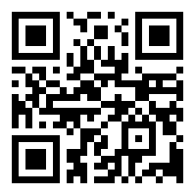
OASIS
OnderwijsAdministratie- en StudentenInformatieSysteem of UGent
Used for:
  - viewing and updating personal information
  - re-enrolment
  - printing certificates: public transport, proof of enrolment, insurance…
  - curriculum: viewing; for degrees also changing, submitting to the faculty, signing and approving
  - exam results: viewing, downloading and printing
  - consulting your individual schedule
  - requesting a special status
http://oasis.ugent.be
Notes:
Oasis
Oasis is het OnderwijsAdministratie- en StudentenInformatieSysteem van UGent. De student kan er:
- persoonsgegevens nakijken en aanpassen
- herinschrijven
- attesten afdrukken: openbaar vervoer, inschrijvingsbewijs, verzekeringsattest, attest van slagen, …
- curriculum bekijken, bewerken, voorleggen aan de faculteit, ondertekenen
- puntenbrief raadplegen en afdrukken
- bijzonder statuut aanvragen
http://oasis.ugent.be

Slide 5
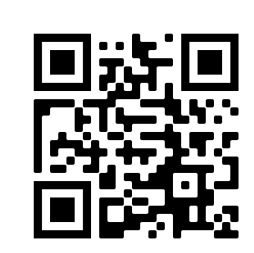
OUTLOOK
Check mails sent to your official Ugent email address through https://outlook.office.com/
e.g. mails from
  - professors
  - fellow students
  - International Relations Office
  - Faculty Student Administration
  - the student/learning track counsellor
  - the rector
  - …
https://outlook.office.com/

Slide 6
How to write a proper e-mail
Use your Ugent email address
Fill in a short and clear subject line: note the course the question is about
Keep it short and concise
Take care of the form and writing style
Write an appropriate salutation and appropriate closing
Dear is an informal form of address. Dear is combined with a first name or another noun.
Dear professor De Schepper
Dear dr. De Vos
Dear assistant
Nathan Maeterlinck
Student number 01500321
2nd ma – computer science

Slide 7
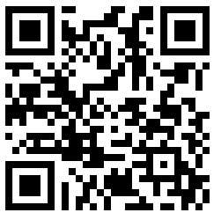
STUDENT PORTAL
All necessary information for Ghent Uni students:
  - academic calendar
  - menus UGent cafeterias and restaurants
  - all kinds of certificates (enrolment, public transport …)
  - UGent sport facilities
  - support: study, mental health, medical service…
  - UGent phone book
https://www.ugent.be/student/en

Slide 8

TASKs
Connect to Eduroam
Retrieve your individual schedule
Retrieve the schedule of the courses you are not yet registered for
Enroll in the course 'INFOSITE Gast- en exchangestudenten faculteit Ingenieurswetenschappen en Architectuur’ on Ufora

Slide 9
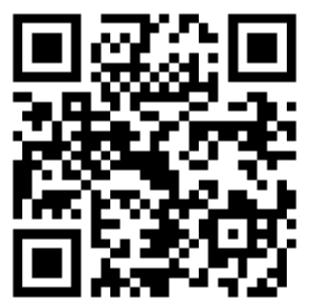
KEY TASK 1
Connect to Eduroam, the wireless UGent network.
1. Select the 'eduroam' network and enter your loginname@ugent.be or email address and your UGent password when asked.
  Make sure there are no spaces before or after your username.
  Don’t forget to add “@ugent.be” when using your login name.
2. Accept the certificate.
    The first time you connect, the question whether you trust the certificate that is presented by the network appears. This is a normal security question. The certificate authority (CA) is Sectigo RSA Organization Validation Secure Server CA and the "radius server" is radius.ugent.be.
Detailed info per device: https://helpdesk.ugent.be/eduroam/en/complete.php

Slide 10
TASK 2
Retrieve your individual schedule.

Slide 11
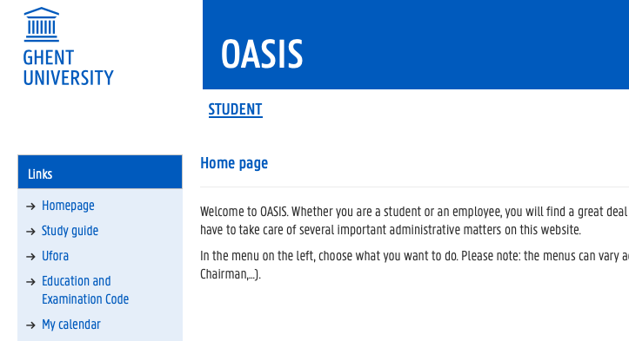
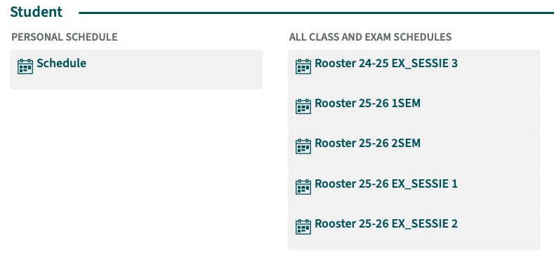
Key task 2
  Via http://oasis.ugent.be

Slide 12
TASK 3
Retrieve the schedule of the courses you are not yet registered for.

Slide 13
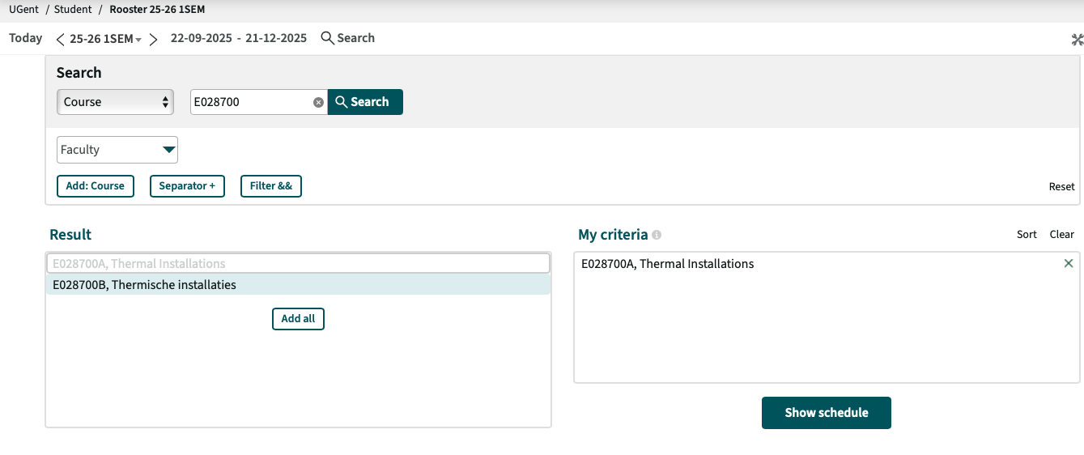
KEY TASK 3

Slide 14
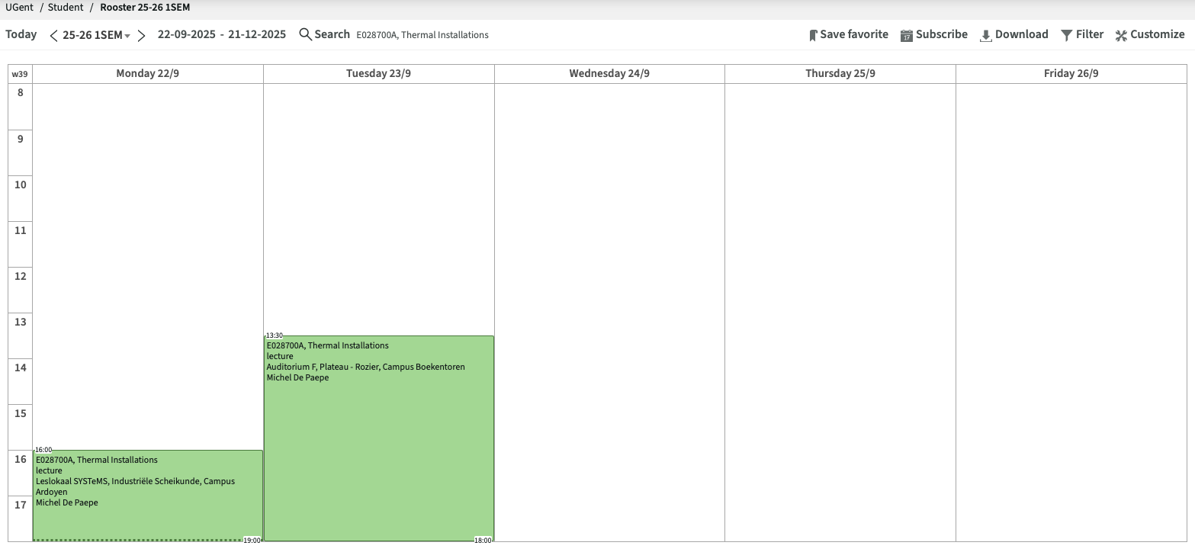

Slide 15

TASK 4
Login to Ufora and enroll in the course 'INFOSITE Gast- en exchangestudenten faculteit Ingenieurswetenschappen en Architectuur’

Slide 16
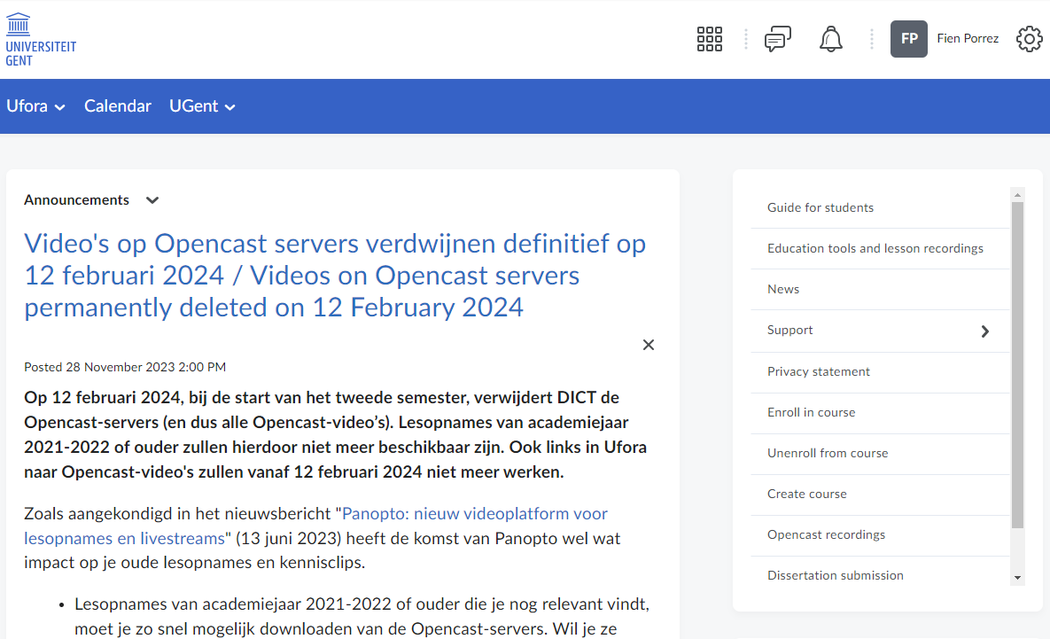
Key task 4
Via https://ufora.ugent.be

Slide 17
