Slide 2
Personal schedule
vakgroep < ... >
  onderzoeksgroep < ... >

Slide 3
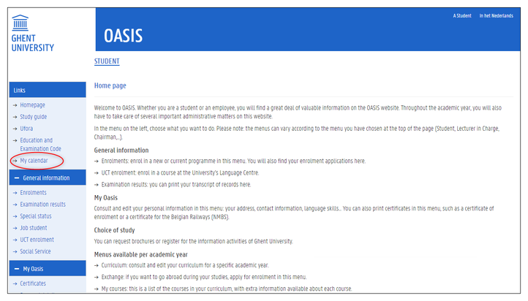
Notes:
Your personal schedule only shows the classes and exams of the groups to which you have been linked. Before you can consult your personal schedule, it is important that you are linked to a group for each course in your curriculum.
In order to see a personal schedule, your curriculum has to be either in the status ‘proposal’ or ‘approved’.
You are only linked to groups when you have submitted your curriculum, or when it has been approved. As long as your curriculum is in a ‘draft’ status, you will not be linked to course groups and your personal schedule will be empty.

Slide 4
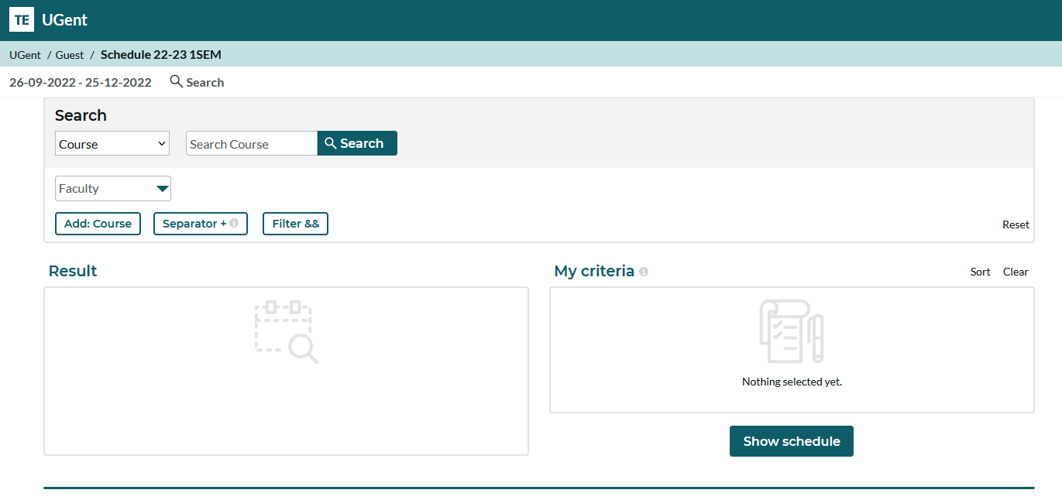

Slide 5
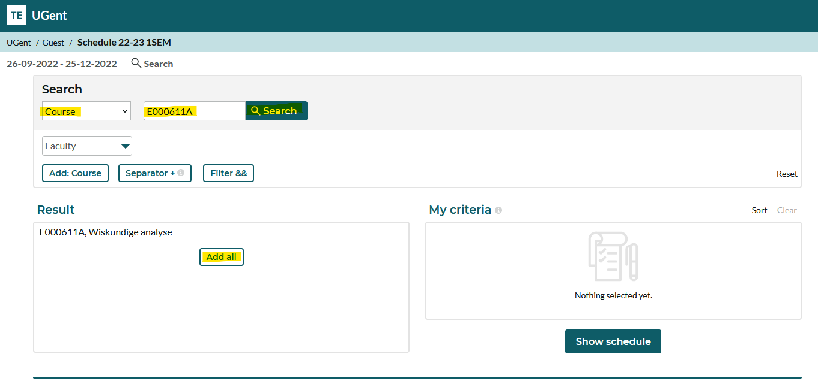

Slide 6
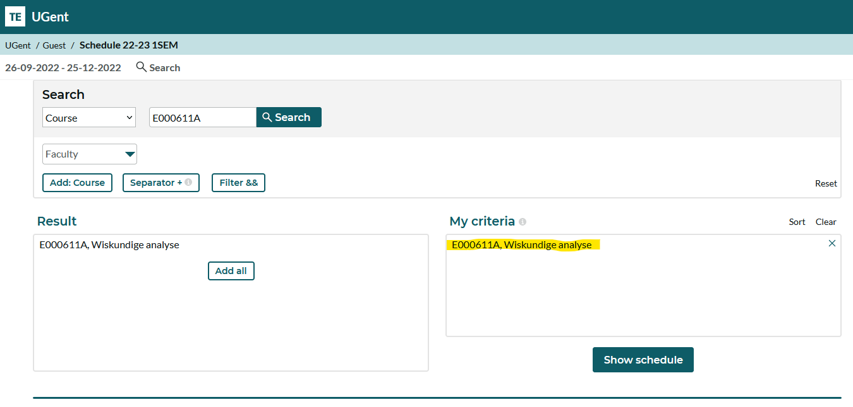

Slide 7
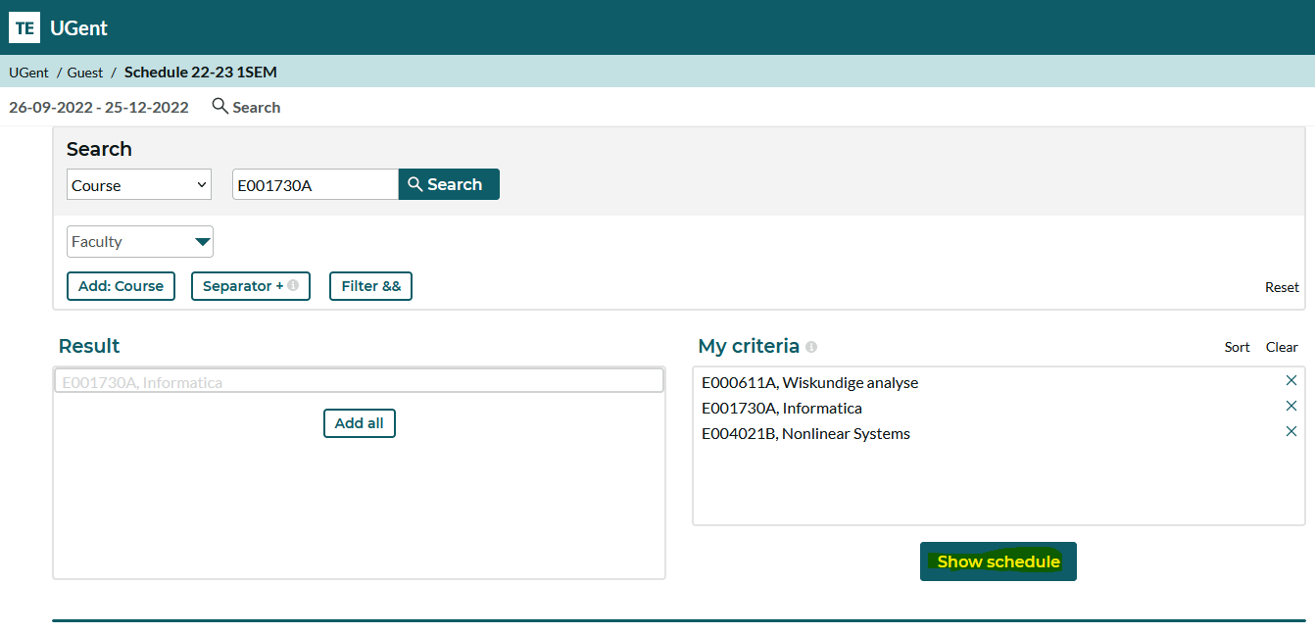

Slide 8
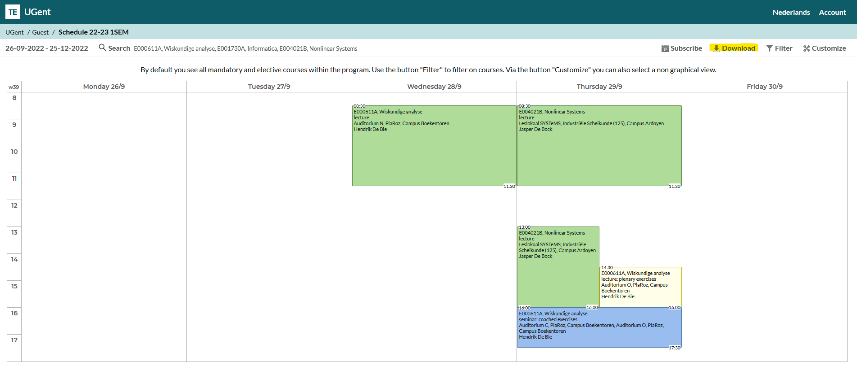

Slide 9
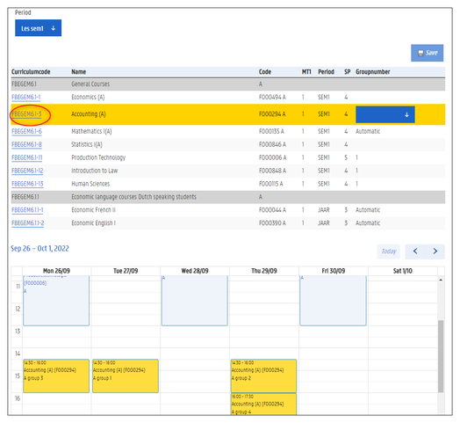
Notes:
After you have submitted your curriculum, you are linked to the groups of the courses in your curriculum. In most cases, this happens automatically. Sometimes, you can choose the group of a course yourself.
Go to oasis.ugent.be and log in with your UGent username and password.
Go to the menu AJ 20XX-20XX / Curriculum.
Select the menu Schedule groups.
Choose the period for which you want to see your groups: first or second semester, or first, second or third exam period.
A list of all the courses in your curriculum appears, for the selected period. A blue drop down menu is available next to the courses of which you can choose the group yourself.
Click on the curriculum code of the course in the left column. All the activities of all the groups of this course are shown in the calendar on the lower half of the screen.

Slide 10



Nele De Wolf
International relations officer - FEA
E international.ea@ugent.be
T +32 9 264 36 99 www.ugent.be
Universiteit Gent
@ugent
@ugent
Ghent University

