Slide 2
Changes to the Learning Agreement
iWISE of the Faculty of Engineering and Architecture

Slide 3
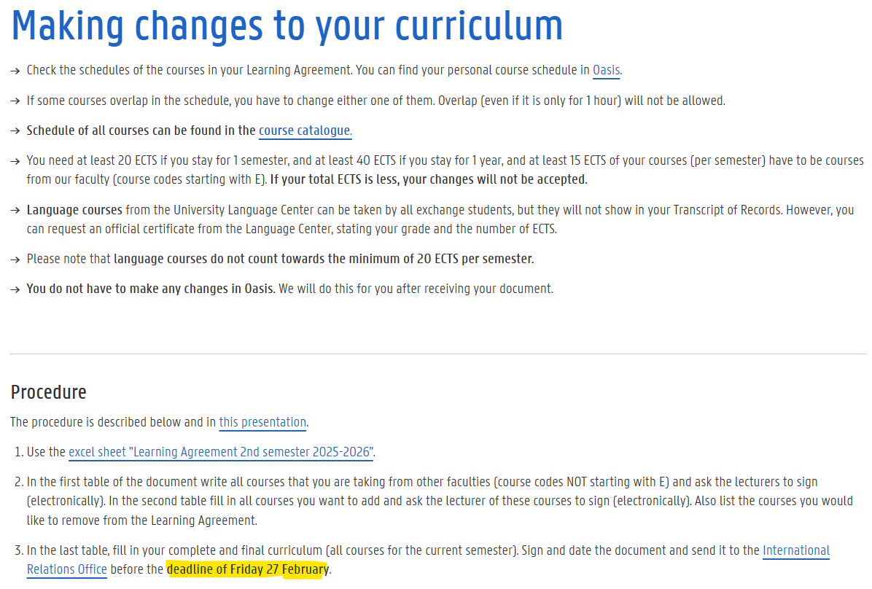
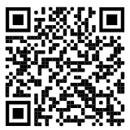
Notes:
When you initially applied, you composed a study programme based on the study guide.
Once the lessons start it could be that you want to make changes to your curriculum. Because of overlap or because the course does not match your field of interest etc.
Overlap is not allowed, so you will have to check your personal schedule. If some courses overlap, you have to change one of them. Even if two courses only overlap for one hour.
All the schedules can be found in the course catalogue. Please always take into account the minimum number of credits. For 1 semester you need at least 20 credits of which at least 15 credits must be from the Faculty of Engineering and Architecture. These course codes start with an E.
Please note that Language courses from the University Language Centure do not count for the minimum of 20 ECTS per semester.
Your curriculum is currently blocked in Oasis, so you cannot make changes yourself. So what’s the procedure?
This is described below. This information can also be found on the page for exchange students on the FEA website and the presentation will be shared with you on the Iwise webpage.
To request changes, use the Exel Sheet on this page. The sheet looks like this (Excel tonen) and we will look into it in detail in the coming slides.
Extremely important is the deadline. We need all changes by Friday 28 February at te latest. After this date, we cannot make any other changes. No exceptions will be made, so please keep this deadline in mind.

Slide 4
ATTENTION!
Learning Agreement = curriculum!
Any changes (earlier or now) must be reported
EWP- students: also change LA through EWP within home university
agreement LA/curriculum will be checked
not identical: curriculum cannot be approved → incorrect TOR
Notes:
Why is it so important to inform us about the changes?
Your curriculum must be an exact reflection of your Learning Agreement.
Any changes that you have already made on your own initiative must be sent to us. We will check whether your curriculum matches your Learning Agreement or your Changes to the learning agreement. If there is no match, your curriculum cannot be approved and you will eventually receive an incorrect Transcript Of Records.
Students whose home university works with the EWP tool must also change the Learning Agreement at their home institution through EWP. Otherwise, the curriculum cannot be approved.

Slide 5
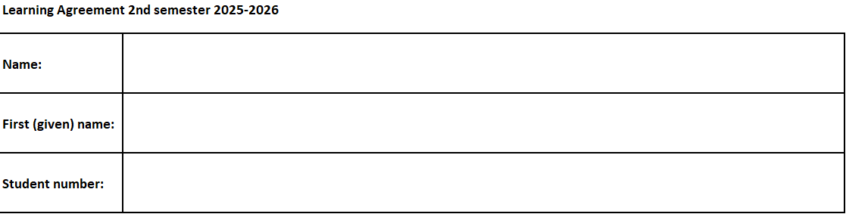
How to complete the form

Slide 6
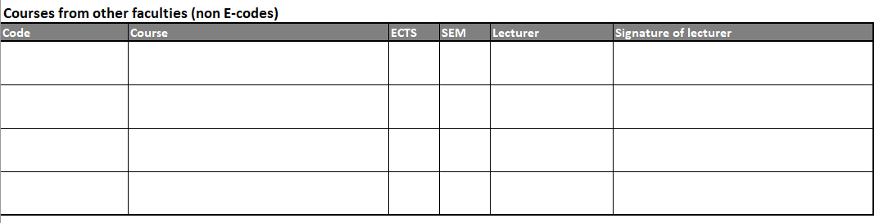
Notes:
Write all the courses from your original LA that don't have an E-code in the table "Courses from other faculties" and ask the permission of the lecturer in charge to follow the course.
So even if you don’t make changes to your original Learning Agreement, you need the permission of the lecturer from the other Faculty.

Slide 7
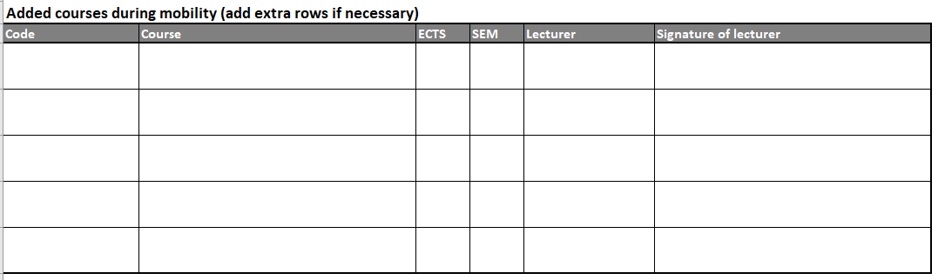
Notes:
Write all the courses that you want to add to your original LA in the table "Added courses during the mobility" both from our faculty (E-codes) or from other faculties.
Ask the lecturer of all these courses to sign in the column "Signature of lecturer" (electronic signature).
The easiest way to get the signature is that you go to the lecturer before or after class and ask the lecturer to sign your document. If this is not possible, you can also send an email to the lecturer, as we also accept electronic signatures, but this could take longer.

Slide 8
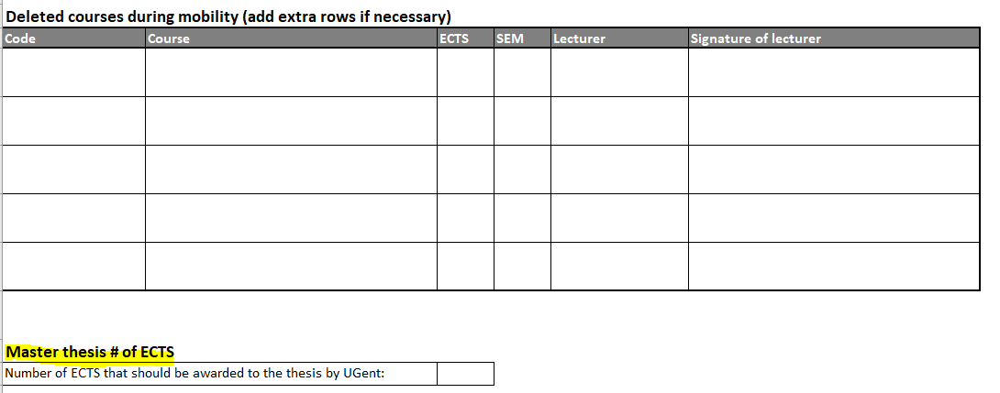
Notes:
Write all the courses that you want to add to your original LA in the table "Added courses during the mobility" both from our faculty (E-codes) or from other faculties.
Ask the lecturer of all these courses to sign in the column "Signature of lecturer" (electronic signature).
If your LA includes a Master thesis, clearly mention the number of ECTS credits that need to appear on your UGent Transcript of Records;
should be the same as the number of ECTS that your home university will award the thesis upon return. This number of ECTS must correspond with your Thesis Information Sheet.

Slide 9
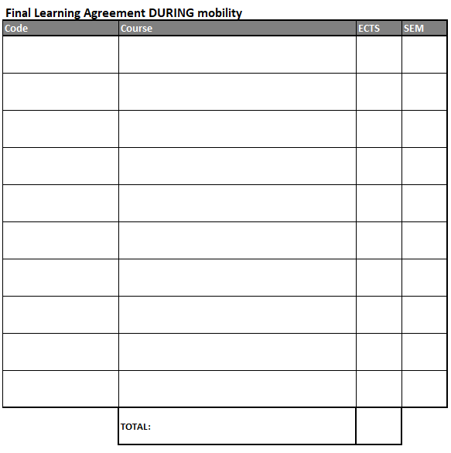
Notes:
Write all courses that are in your FINAL Learning Agreement (t.i. the courses that you will be taking this semester/academic year).
Make sure the total of ECTS is at least 20 per semester, and that at least 15 credits must be from the Faculty of Engineering and Architecture.

Slide 10
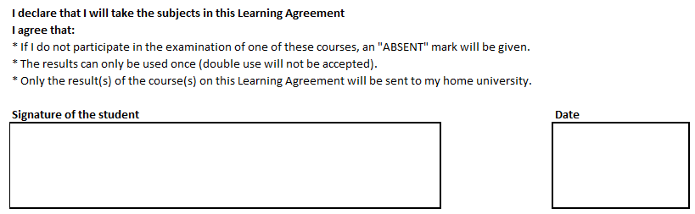
Notes:
Sign the document.
Send this document to the IRO (international.ea@ugent.be) by Friday 1 March at the latest.
If you haven’t received any answer from the lecturers close to the deadline, please let us know 1 day before the deadline. So we can see if it’s possible to make an exception and give you some more time.

Slide 11
Timetable Administrative process
You deliver the document with the changes to the Learning Agreement before 27 FEBRUARY (international.ea@ugent.be or at the office).
We check if all the signatures are there.
FSA (Faculty Student Administration) will make the changes in Oasis.
Within two weeks after the deadline, your curriculum in Oasis will be changed
Non-EWP students: have your new Changes to the Learning Agreement signed by your home university.
EWP-students: make the changes through your home university’s EWP portal.
Notes:
You deliver the document with the changes to the Learning Agreement before 28 February (international.ea@ugent.be or at the office). Preferably by email.
We check if all the signatures are there.
FSA will make the changes in Oasis.
Within two weeks after the deadline, your curriculum in Oasis will be changed and you’ll be able to download the adjusted Learning Agreement via Oasis. EWP students have to make the changes within their home university through the EWP portal in order to be able to retrieve a signed version of the Learning Agreement during mobility.

Slide 12
Certificate of arrival
Via email (international.ea@ugent.be)
At our office
During the iWISE
Notes:
If you need a signed arrival form for your home university, please send it to us by email, drop by our office or if you have it with you today, we can sign it now.
We need your exact date of arrival, but we cannot mention a date earlier than the welcome week. If you already arrived last week, the date we can mention on the document is 16 September.

