Slide 1
HOW TO DESIGN AN ACADEMIC POSTER
26/04/2022
SSHT topics
Evelynn Devos
Notes:
Good morning, welcome to this short session on how to design an academic poster.
-> My name is Evelynn Devos, I am a final year PhD student in consumer behavior
-> give tips and tricks to design a poster based on my own experiences, able to attend 2 offline conferences
-> Before we start, I have a short question for you: Anyone else who has experience?

Slide 2
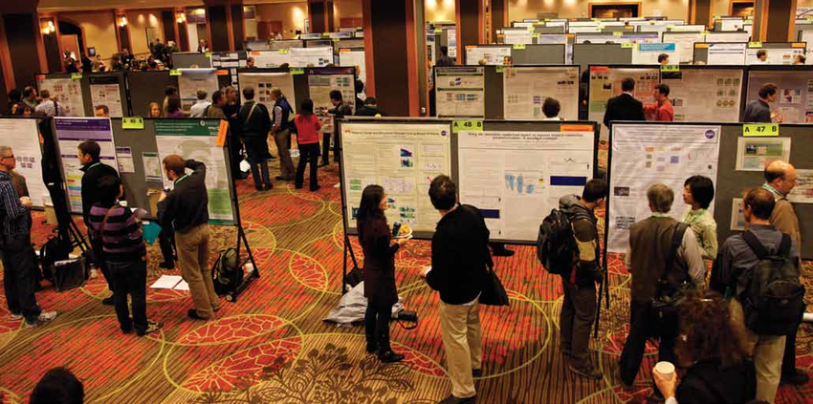
POSTER SESSIONS: WHAT TO EXPECT?
Notes:
So for the people who have never attended a conference:
Every year scientists flock to conferences to learn about the new research in their field & to present their own research.
One format to do that are poster sessions. Posters sessions are where researchers present findings that did not fit in bigger sessions or presentations. Usually, to present a new idea or finding that you have not explored into detail.
A poster session usually looks like this: it takes place in a large room with billboards with posters, where you and your fellow presenters stand side by side while others walk by looking left and right to find a topic that interests them. As a presenter you are directly competing for attention to get participitants to stop at your poster.
If they stop, participants may start discussing your research with you, typically to ask for a pitch or to ask a specific question. So, eventually you engage in an informal discussion that is mostly one-to-one.

Slide 3
POSTER DESIGN PROCESS
Often skipped, yet essential
Notes:
So let’s imagine that you have submitted an abstract about your research, which got accepted into the conference! After a short celebatory period, you will start right away with doing all the administrative work: arranging hotels, plane tickets, registering for the conference. Maybe even booking a holiday afterwards.
The final thing you do is design the poster.
Usually
What people usually do (including me) is ask for a template of a senior coworker, who has already presented at that conference and copy that poster design. Because, that makes you feel safe. You do whatever they did. If they have a wall of text, then you just replace that text with sentences that are relevant for your research.
This of course is not a good approach because you skip the “Think” part. Why is it problematic? Most of these designs are outdated: they have been handed through the years! Plus, it highlights the know hows of totally, different paper!

Slide 4
Conference instructions
Audience
Poster functions

Slide 5
1. READ POSTER INSTRUCTIONS
Specific requirements for posters:
Dimensions, orientation, font, logo, handouts, photos, etc.
Where is it happening?
Schedule, location, etc.
Judging criteria if available
Best poster award
Notes:
First thing first: check the guidelines of the conference about:
The specific requirements for posters: how big can your poster be, should it be portrait or landscape oriented, does the poster need to mention references? Your funding? Order of authors, Etc… -> conferences usually provide rules about this. If no rules are mentioned -> free to choose
Details about where the session will be held:
-> Schedule: different poster session formats!
Format A: 2 hours during reception at the end of the day
Format B: 2x15 min during breaks of presentations -> poster will hang up all day
It is worthwile to take these conditions into account.
For instance, this already tells you that attendees will be mentally tired: poster should be easy accessible
Another example: if your poster will hang all day -> may be interested to provide more details (for instance, link your paper with a QR code) than in a session where you stand next to the poster all day
C) Judging criteria if available -> usually conferences grant a ‘best poster award’. Criteria for these can be communicated: usually has to do with conference theme. E.g. conference theme is about the good & positive effects of marketing -> relevant to reflect how your poster contributes to these topics

Slide 6
2. AUDIENCE
Who are they?
Level of assumed knowledge?
Knowledge gap
Used content/
terminology
SAME FIELD
OTHER FIELD
BUSINESS
GOVERNMENT
INDIVIDUAL
Notes:
Think about your audience, it is your research but you have to sell it to your audience:
Who is the intended message for?
Coworker/competitor from the same field? Or same field but using other techniques?
Audience from other disciplines? Are they familiar with your techniques?
Are you on a conference meant for business?
Or for governmental institutions?
What is their age, education, nationality, ….
Use these insights to determine the level of assumed knowledge of your audience:
Expert (high level of knowledge)
Related (specialist in an overlapping field: e.g. Psychology & marketing)
General (little to no familiarity with subject area)
Based on this you can get a better idea of your audience’s knowledge gap:
E.g., what do they already know and what do they want to know? What do you think should be on the poster for them to understand your work?
=> The answers to these questions have important implications for the content and terminology of your poster

Slide 7
3. FUNCTIONS OF A POSTER?
?

Slide 8
3. FUNCTIONS OF A POSTER:
Grab attention
Inform
Network

Slide 9
GRAB ATTENTION
FIRST FUNCTION

Slide 10
ATTENDEE’S EXPERIENCE
Notes:
Just to give you an idea of what it is like to be an attendee….
Do you remember any title? Which poster drew you in?

Slide 11
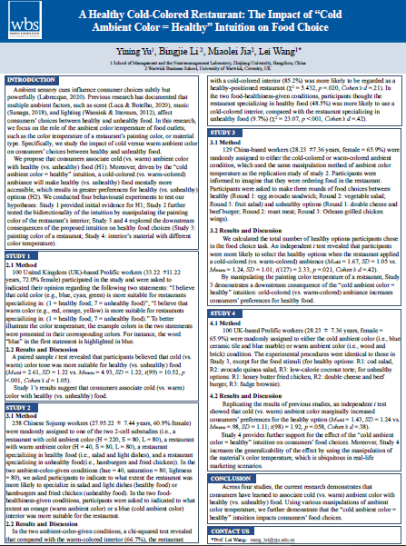
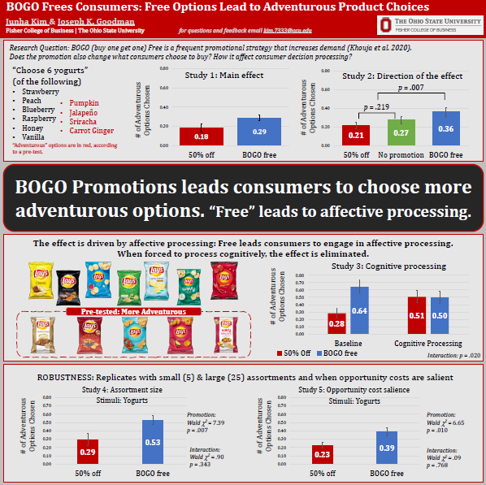
WHICH POSTER DO YOU PREFER?
A
B
Notes:
I want you to imagine that you are on a poster session and that you found two posters next to each other on the same topic you are interested in.
You have only time left to view one poster -> which poster do you select?
Raise your hand if that is poster A
Raise your hand if that is poster B
-> can you tell me why?
Less texts, images, main message in 5 seconds, colors, data in figures

Slide 12
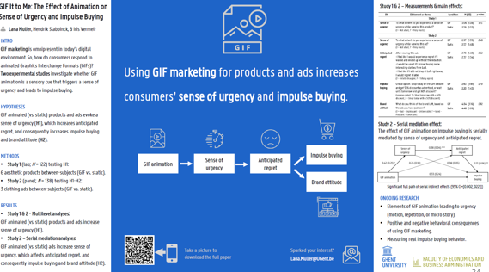
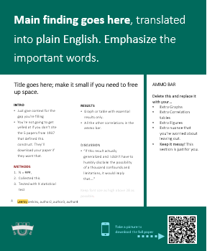
POSTER SIZE
Follow poster size restrictions:
Not too small
Not too big
Notes:
The most obvious thing to do is to make sure your poster can be seen -> follow the rules of the conference.
Diverting from these = problematic!
Too big -> part is hidden by poster next to you
Too small -> stands out but in a negative way (your poster is lost in between giant posters)

Slide 13
FONTS
Everything readable from 1.5m
Font sizes as large as possible (within reason)
Recommended minimum sizes for A0 poster:
72 points for titles
48 points for headings
24 points for body copy
Fonts: easy-to-read, sans-serif fonts
Arial, Helvetica, Ugent Panno, Calibri
Emphasize by putting words in bold
Avoid using too many different formats, sizes and colors
FONT SIZES:
24 32 48 60 72
Is this easy to read?
Is this easy to read?
Notes:
Considering the items on the poster, there is one rule of thumb: the smallest text on your poster should be clearly legible from 1,5 to 2m away!
So try to make your type as large as possible (within reason), here are some numbers indicating the minimum recommended size
For the fonts: use easy-to-read fonts, that are sans-serif (so avoid those that are curly and have wings). I listed some fonts that are good fonts (e.g., Arial).
You can use different sizes/formats to emphasize some words but avoid overusing too many and too different formats, sizes and colors

Slide 14
TITLE = SELLING POINT
Visible from 5m
Concise
Catchy
To-the-point: keywords!
Can be a question or summarize main finding
BOGO Frees Consumers: Free Options Lead to Adventurous Product Choices
(When) Are Online Friendships Real and Influential? An Evaluative Context Model
Notes:
Title = CRUCIAL! The audience will browse posters looking for keywords in the title -> viewers use this to decide whether or not they will talk to you about your research.
Titles should be ….
Sometimes people use a semi-colon to break their title into two pieces: first piece to intrigue the reader, second piece tells the reader what the research is about
=> Ok to use as long as it does not make the tiltle unnecessarily long.
Keep in mind: you want to lure people from a distance!

Slide 15
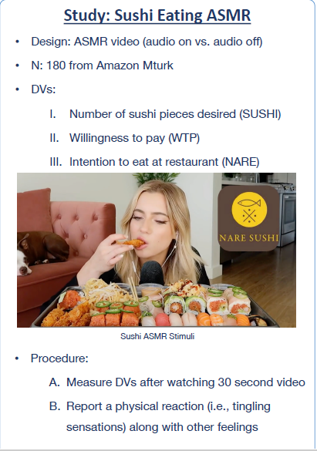
TEXT
The Do’s
1
Use bullet points & emphasize words with bold font
2
Pictures = 1000 words
3
Plain language: no jargon, abbreviations
Notes:
The biggest mistake I see people make is putting too much information on their poster! Remember people walk past your poster, they need to know what your poster is about in a glimpse.
Too long texts can make people no longer read the poster! Too often, I see posters that include sections of the manuscript.
Your poster does not need to stand on its own, you are next to it: it is an extension of you. A backup for you when you lost your line of thought or to illustrate your point.
Remember: the attendants are tired -> they want a simplified, straightforward story of your research.
You can attain that by including:
Instead of copying your manuscript, put bullet points of the main messages -> no full sentences needed
Include images, figures, tables. Remember a picture is worth a thousand words. A picture is the heart & soul of your poster. Do not bury them with large blocks of tekst no one will read.
Avoid using jargon. In a paper that is fine because people can go back and look up terms they do not know. But in a poster session there is no time. People are walking by and need to know the message in 10 seconds.

Slide 16
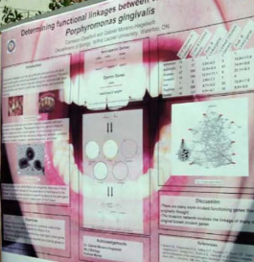
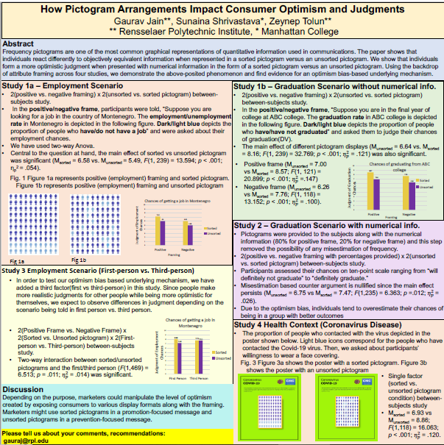
COLORS
Simple & pleasing to the eye
Contrasting colors work well
Light colored background, dark font
Do not use an image as background
Avoid multiple (3+), vibrant, gradient, transparent & pale colors
Consider color blindness! http://www.vischeck.com/vischeck/vischeckImage.php
Use the UGent template
Notes:
Using too many colors drastically reduces effectiveness -> MAXIMUM 3 different colors (but not always possible think about pie charts -> substitute pattern for color)

Slide 17
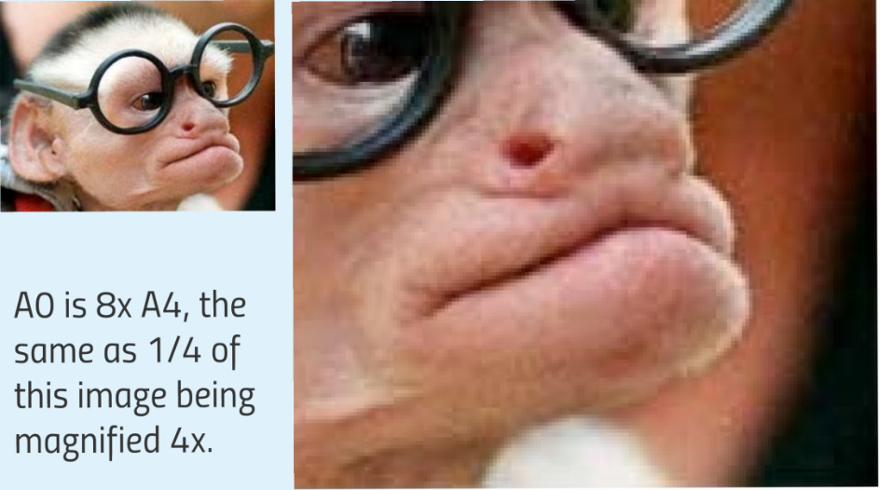
IMAGES
Ensure images are of high enough resolution (300-600px/inch)!
Lock aspect ratio – no distortions
Remove all unnecessary information/detail
Number and label all tables and figures
Link the figure to the text (e.g., see Table 1)
Represent as much as possible visually
Notes:
What may look good on screen may not look as good at actual size in print! If you print on A0 the image will be magnified -> easy to get unclear images. Make sure to download your images with high resolution (e.g. 200-300 px/inch)

Slide 18
GRAPHS & CHARTS
https://www.ugent.be/doctoralschools/en/doctoraltraining/courses/transferableskills/all/effective-slides.htm

Slide 19
INFORM
SECOND FUNCTION

Slide 20
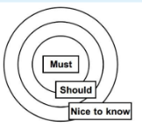
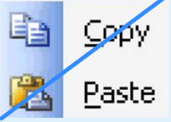
GOOD POSTER PRACTICES
NEED TO KNOW
NICE TO KNOW
< 800w
4-6
Every line & image is both relevant & necessary
TEXT
IMAGES
Notes:
How to start designing your poster?
The purpose of a poster is to display graphically the main points of your work. Compare it to a trailer of a moovie: it should highlight some of the best bits and make people want to find out more!
Your poster is different from a paper! No copy & pasting -> ask yourself: what is the most important/interesting/part of my work?
Break down your work into the following: what are must – should – nice to knows? Leave out the nice to knows & focus on the must & should knows: information that is worth reasing
Do not worry about the details (you can tell them if needed) -> on the poster only info to grasp the bigger picture
Maintain a good balance of tekst, table, and images. Content depends on the poster sizes: ideally content under 800 words and max 4-6 figures and tables.
Build your work around your main, most important findings: can be in form of a graph, chart or summary statement
Make sure that every line of tekst and each image on the poster is both relevant & necessary

Slide 21
A POSTER SHOULD INCLUDE MOST ITEMS:
Title + authors and affiliations (+ contact info)
Introduction + objectives
Methods
Data and Results
Conclusions and Future Work
Reference and Acknowledgements

Slide 22
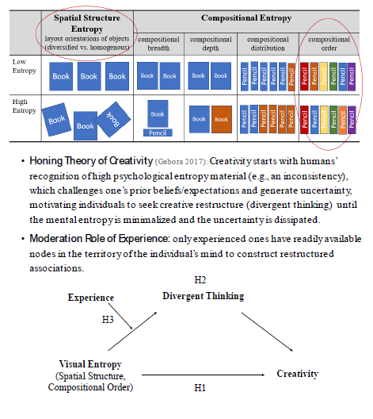
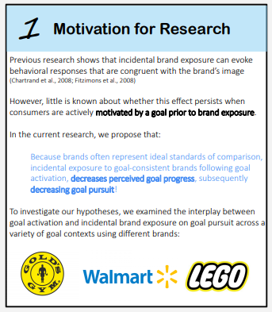
INTRODUCTION + OBJECTIVES
Section should clarify:
Research question
Significance of study (so what?)
Previous work on similar lines
May have hypotheses embedded
Maximum 200 words

Slide 23
METHOD SECTION
Section should include:
Basic parameters:
Study design, target sample, setting, key interventions, variables, data source, ….
No details!
Use visual elements
Flowcharts, photos, …
Notes:
The next section that is typically included is the method section. That’s method not methods. Refrain from getting lost in the details. This is not a manuscript, and no one in their right mind will attempt to replicate your work by remembering what they read while standing in front of your poster a little wasted. Remember, you can always send them the paper at a later date (if you ever finish writing it). Again, pictures and diagrams are your friend. It is much more pleasant to quickly look over a flow chart describing a series of events than it is to read about those events unfolding in sentence form, that’s booooooring. Also, I hate to belabor this point, but you will be STANDING right there, so if a visitor has a question about a reagent dilution, an eye-tracker calibration routine, the stability of your carbon dating isotope, or which library in Calcutta you found your ancient manuscript, you will be there to tell them all about, in great, probably hugely boring, detail. They’ll probably regret ever asking.

Slide 24
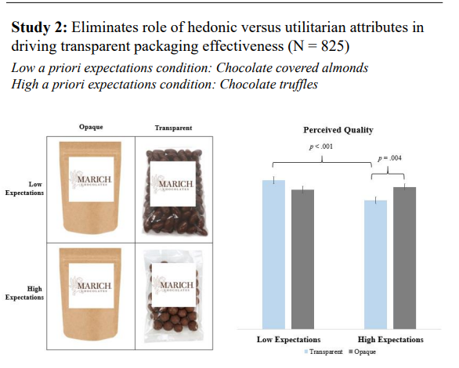
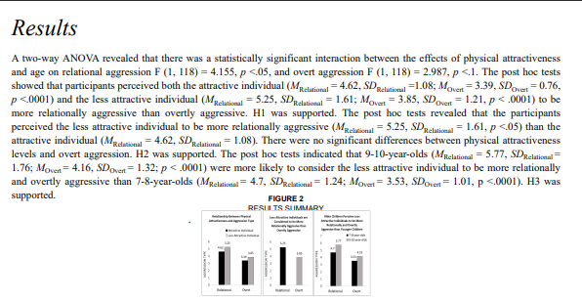
DATA AND RESULTS
= findings presented in figures/table, highlights key findings, links to hypotheses
Notes:
The results section should include data analysis and stratification and should only include the results which answer the stated hypothesis. Moreover, essential to the results section is the inclusion of pertinent and key graphs, graphics, images and tables. These need to be large enough for the audience members to see and be as attractive and clutter-free as possible.

Slide 25
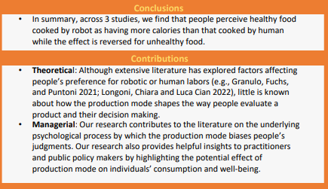
CONCLUSIONS AND FUTURE WORK
= summary of findings, implications for research & directions for future research

Slide 26
REFERENCE AND ACKNOWLEDGEMENTS
References:
Most crucial ones in-tekst and/or full references at the bottom
Often disclaimer (“references available upon requests”) -> preferred
Acknowledgements:
Funding: FWO, BOF, … -> show the logo
Acknowledge others who was helping out with your research -> rare
Notes:
(e.g., FWO, BOF, …)

Slide 27
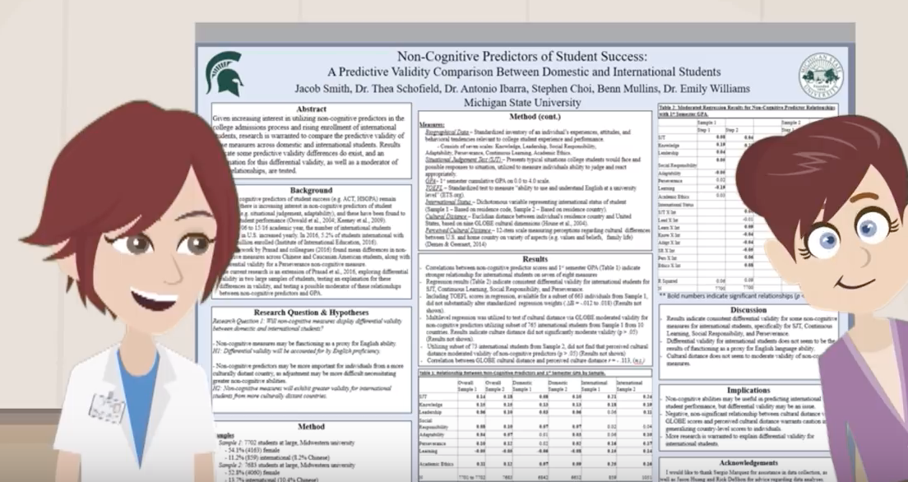
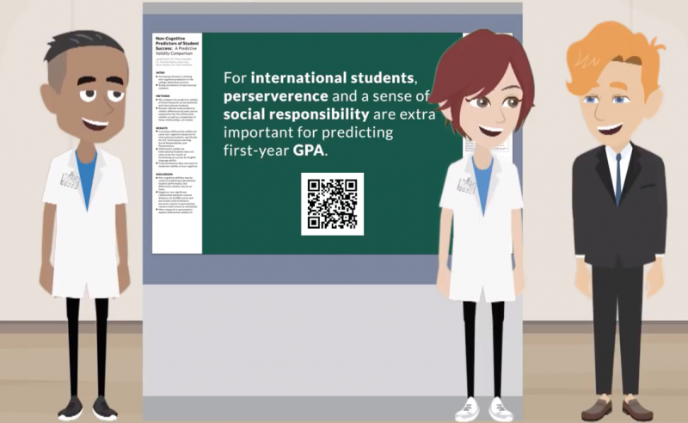
POSTER STRUCTURE
From this…
To this!
NEED TO KNOW
NICE TO KNOW
Check out the YouTube #betterposter video
Notes:
Three essentials:
Main finding in big type and plain language
Ammo bar of data for presenters to use while they're talking to conference attendees
Silent presenter bar with bullet points introducing the study, its methods and results
To achieve the big three conference poster goals:
Maximize insight transmitted to attendees
Keep it easy to make
Include what people "need to know”, not necessarily what's "nice to know”

Slide 28
POSTER STRUCTURE (CONT.)

Slide 31
NETWORK
THIRD FUNCTION

Slide 32
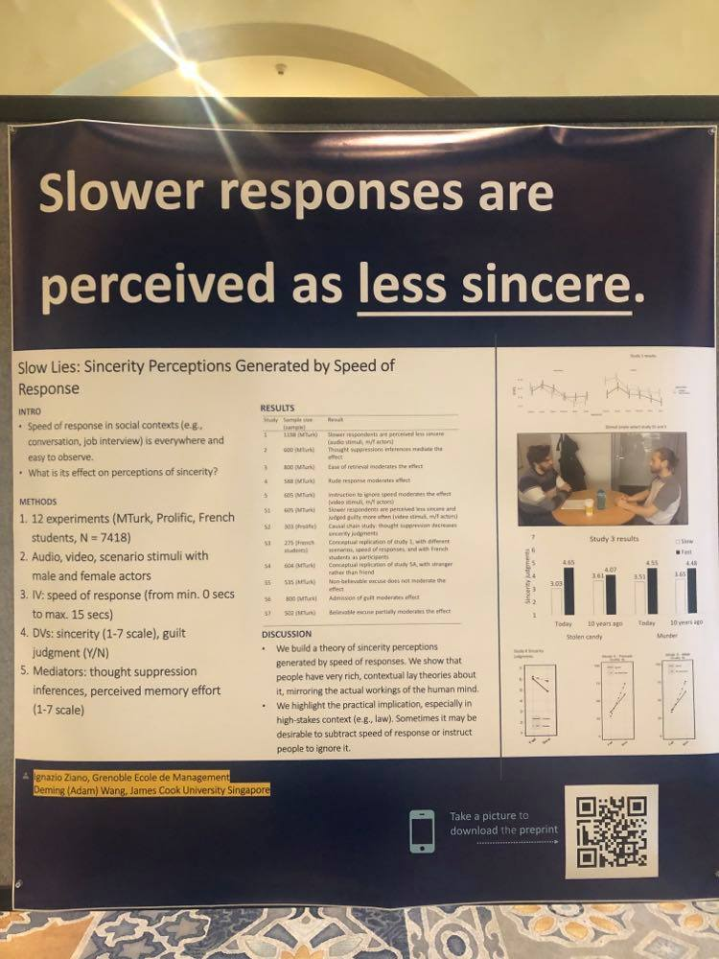
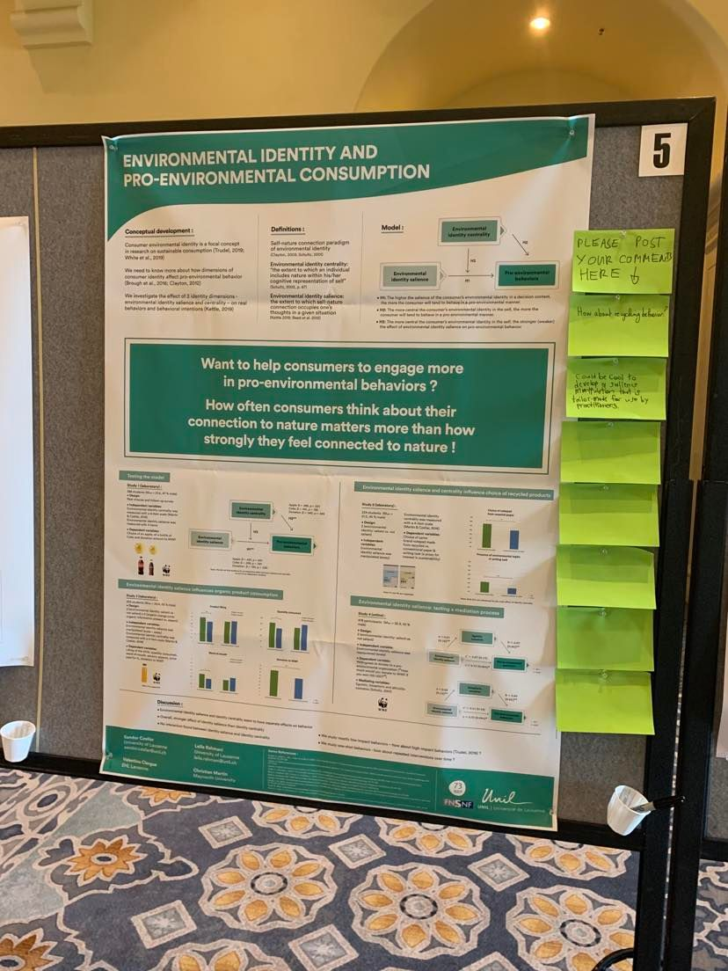
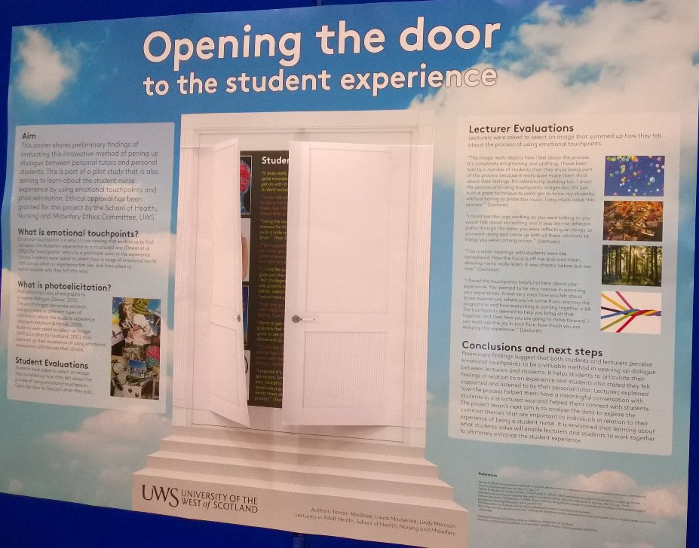
INCREASE INTERACTION!
Only when relevant!

Slide 33
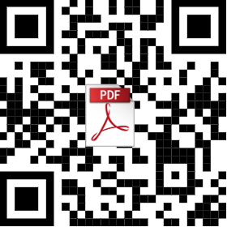
QR-CODE
https://me-qr.com/
Many more options (image, videos, etc…)

Slide 35
BETTER POSTER TEMPLATES
CREDITS TO Mike Morrison

Slide 36
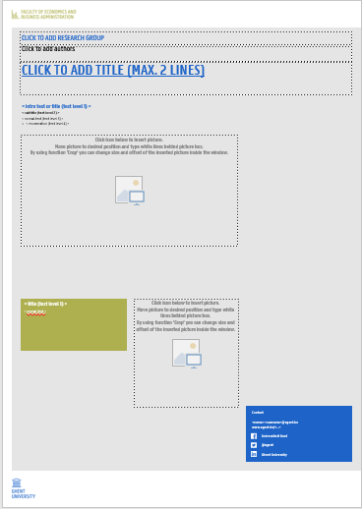
U-GENT TEMPLATE
https://styleguide.ugent.be/templates/print.html#poster
Adjust the template according to the conference’s guidelines!

Slide 37
Main finding goes here, translated into plain English. Emphasize the important words.
Non-Cognitive Predictors of Student Success: A Predictive Validity Comparison Between Domestic and International Students
Title: Subtitle
AMMO BAR
Delete this and replace it with your…
Extra Graphs
Extra Correlation tables
Extra Figures
Extra nuance that you’re worried about leaving out.
Keep it messy! This section is just for you.
PRESENTER:
Leeroy Jenkins
BACKGROUND: Who cares? Explain why your study matters in the fastest, most brutal way possible (feel free to add graphics!).
METHODS
Collected [what] from [population]
Tested it with X process.
Illustrate your methods if you can.
Try a flowchart!
RESULTS
Graph/table with essential results only.
All the other correlations in the ammo bar.
Visualize your findings with an image, graphic, or a key figure.
Leeroy Jenkins, author2, author3, author4, author5, author6, author7, author42
Take a picture to download the full paper
Notes:
Notes:
In Powerpoint, click View > Guides
Keep text within gutter guides.
Author list: Don’t split names onto two lines (e.g., “Jimmy [break] Smith”). If that happens, use a new line, unless you need the space. Bold the first names of anybody who’s presenting in person.
Intro/methods/result: Do not drop below font size 28, but if you have extra space, jack up the font size until the space is full.
Do not use color in the sidebars except in graphs/figures. It’ll pull attention from the center and slow interpretation for passersby.

Slide 38
Main finding goes here, translated into plain English. Emphasize the important words.
Non-Cognitive Predictors of Student Success: A Predictive Validity Comparison Between Domestic and International Students
Title: Subtitle
AMMO BAR
Delete this and replace it with your…
Extra Graphs
Extra Correlation tables
Extra Figures
Extra nuance that you’re worried about leaving out.
Keep it messy! This section is just for you.
PRESENTER:
Leeroy Jenkins
BACKGROUND: Who cares? Explain why your study matters in the fastest, most brutal way possible (feel free to add graphics!).
METHODS
Collected [what] from [population]
Tested it with X process.
Illustrate your methods if you can.
Try a flowchart!
RESULTS
Graph/table with essential results only.
All the other correlations in the ammo bar.
Leeroy Jenkins, author2, author3, author4, author5, author6, author7, author42
Take a picture to download the full paper
Notes:
Notes:
In Powerpoint, click View > Guides
Keep text within gutter guides.
Author list: Don’t split names onto two lines (e.g., “Jimmy [break] Smith”). If that happens, use a new line, unless you need the space. Bold the first names of anybody who’s presenting in person.
Intro/methods/result: Do not drop below font size 28, but if you have extra space, jack up the font size until the space is full.
Do not use color in the sidebars except in graphs/figures. It’ll pull attention from the center and slow interpretation for passersby.

Slide 39
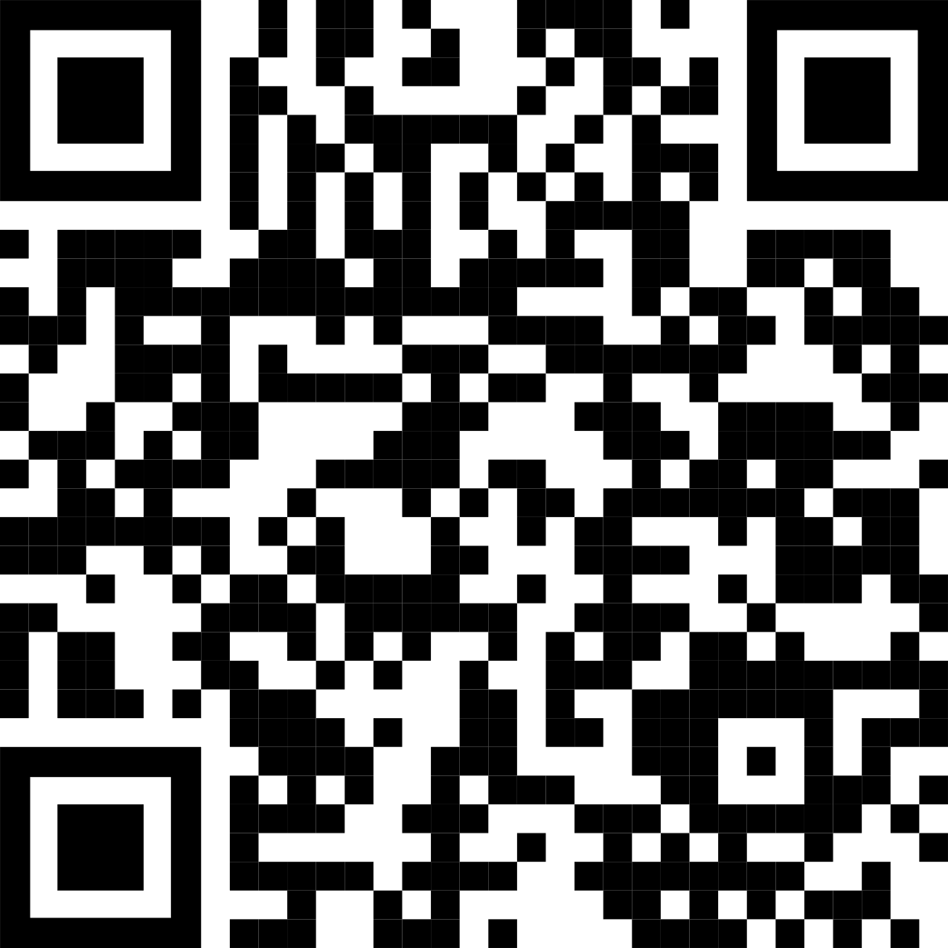
Main finding goes here, translated into plain English. Emphasize the important words.
Title: Subtitle
Leeroy Jenkins, author2, author3, author4
Title goes here; make it small if you need to free up space.
AMMO BAR
Delete this and replace it with your…
Extra Graphs
Extra Correlation tables
Extra Figures
Extra nuance that you’re worried about leaving out.
Keep it messy! This section is just for you.
INTRO
Just give context for the gap you’re filling
You’re not going to get yelled at if you don’t cite the 5 papers from 1937 that defined this construct. They’ll download your paper if they want that.
METHODS
N = ###,
Collected this
Tested with X statistical test
RESULTS
Graph or table with essential results only.
All the other correlations in the ammo bar.
DISCUSSION
“If this result actually generalized and I didn’t have to humbly disclaim the possibility of a thousand confounds and limitations, it would imply that….”
Keep font size as high above 28 as possible.
Leeroy Jenkins, author2, author3, author4
Take a picture to download the full paper

Slide 40
HOW TO PITCH MY RESEARCH (POSTER)
https://www.screencast.com/t/cWYxY4xSfe6
Or
https://www.ugent.be/eb/en/services/library/short-sessions-on-hot-topics-ssht

Slide 41
SOURCES

Slide 42
CONSULTED SOURCES
Asper, N. (2010). Instructions for poster presentations. Retrieved 1 June, 2011, from http://www.tcnj.edu/~asper/posterrules.html
Colorado State University (2010). Poster Design Tips and Techniques. Consulted on 19/04/2022 via: https://extension.colostate.edu/docs/staffres/poster.pdf
Enago (2019). Most Effective Tips When Presenting Your Scientific Poster, Consulted on 19/04/2022 via: https://www.enago.com/academy/wp-content/uploads/2019/06/ScientificPosters2_changes.pdf
Gundogan, B., Koshy, K., Kurar, L., & Whitehurst, K. (2016). How to make an academic poster. Annals of medicine and surgery, 11, 69-71.
Stuckey, M., & Hoyer, T. (2022). How to make an effective poster. Consulted on 19/04/2022 via: https://urc.ucdavis.edu/sites/g/files/dgvnsk3561/files/local_resources/documents/pdf_documents/How_To_Make_an_Effective_Poster2.pdf
Tulpesh, P. (2014). Creating an Academic poster. Consulted on 19/04/2022 via: https://prezi.com/pcovkdvojahz/creating-an-academic-poster/

Slide 43
Thank you for your attention! Evelynn Devos Any further questions? Contact: evelynn.devos@ugent.be https://www.linkedin.com/in/evelynn-devos-3711521a3

