Slide 1

Reducing environmental impact in labs

Slide 2
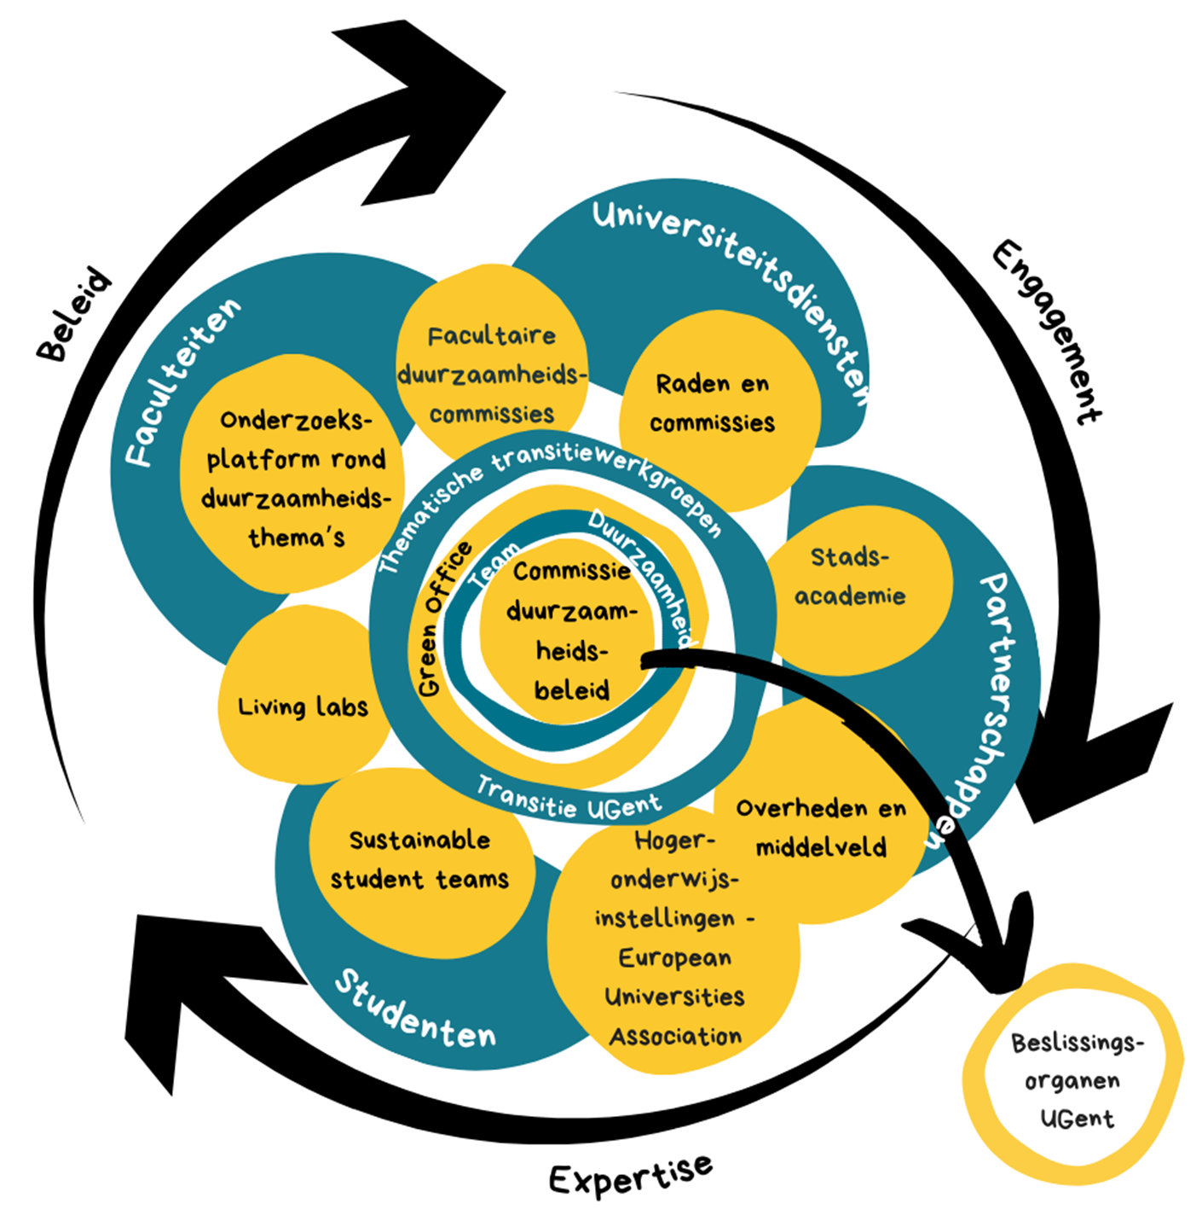
aanpak
‘Whole institutional approach’
Close collaboration met
academics,
students,
policy officers,
alumni, partners and citizens
to come to
sientifically based answers,
concrete measures and enthousiastic and inspiring stories.

Slide 3
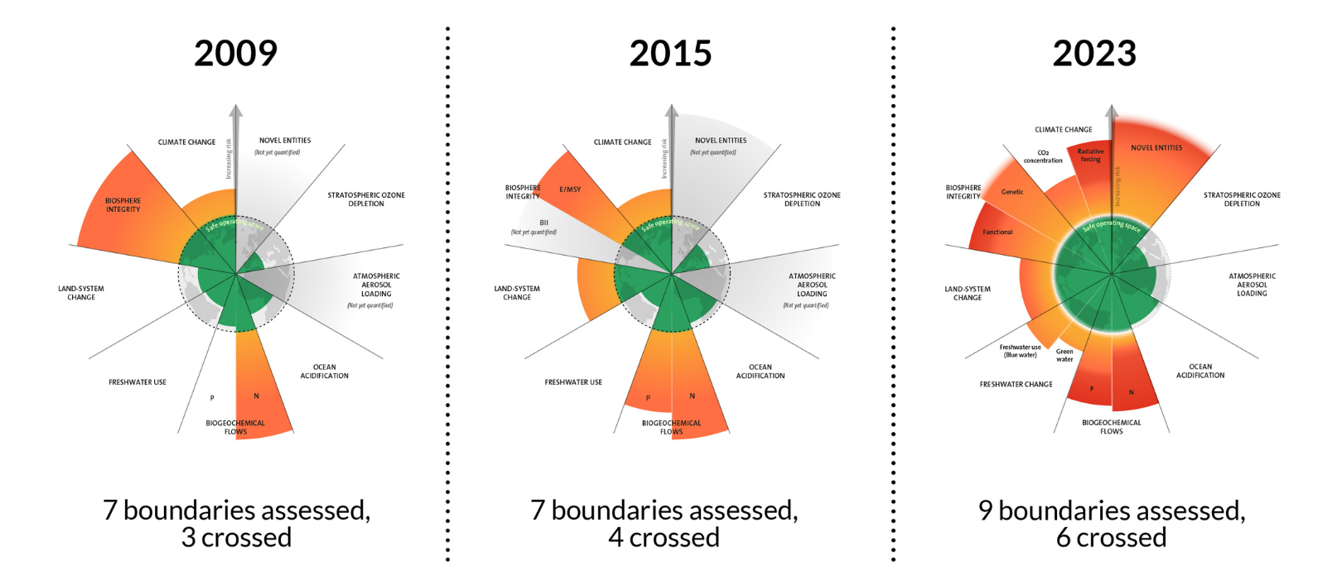
Why?

Slide 4
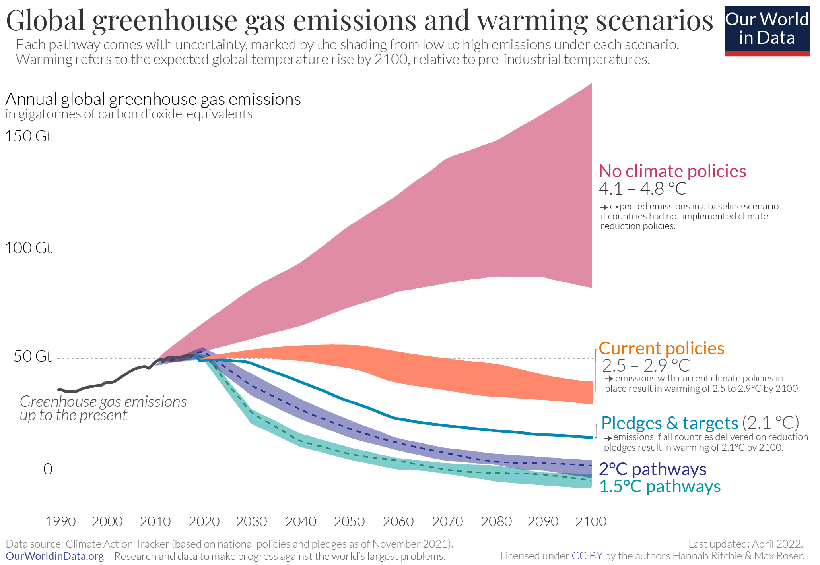
Notes:
Vorige keer hebben we ons als Ugent uitgesproken over de hoogdringendheid van de klimaatproblematiek en hebben we ons geëngageerd om de duurzaamheidsvisie van 2013 en het huidig duurzaamheidsbeleid straffer te gaan invullen.

Slide 5
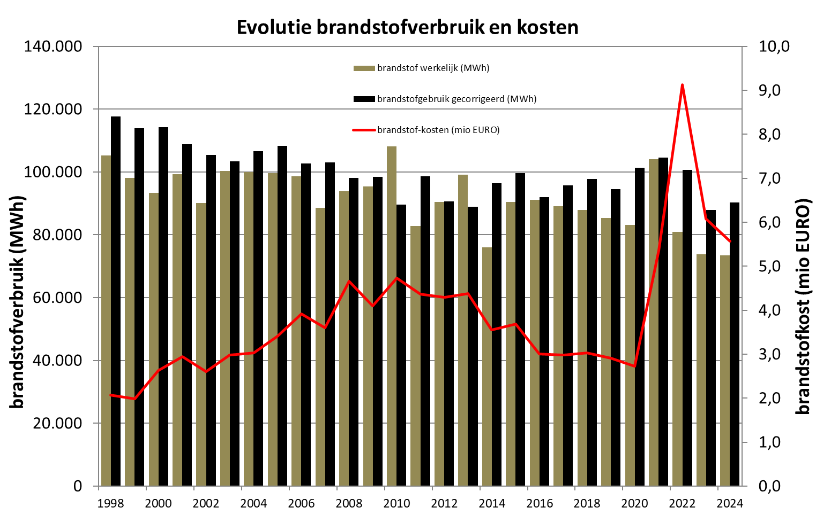
Where we are now? heat

Slide 6
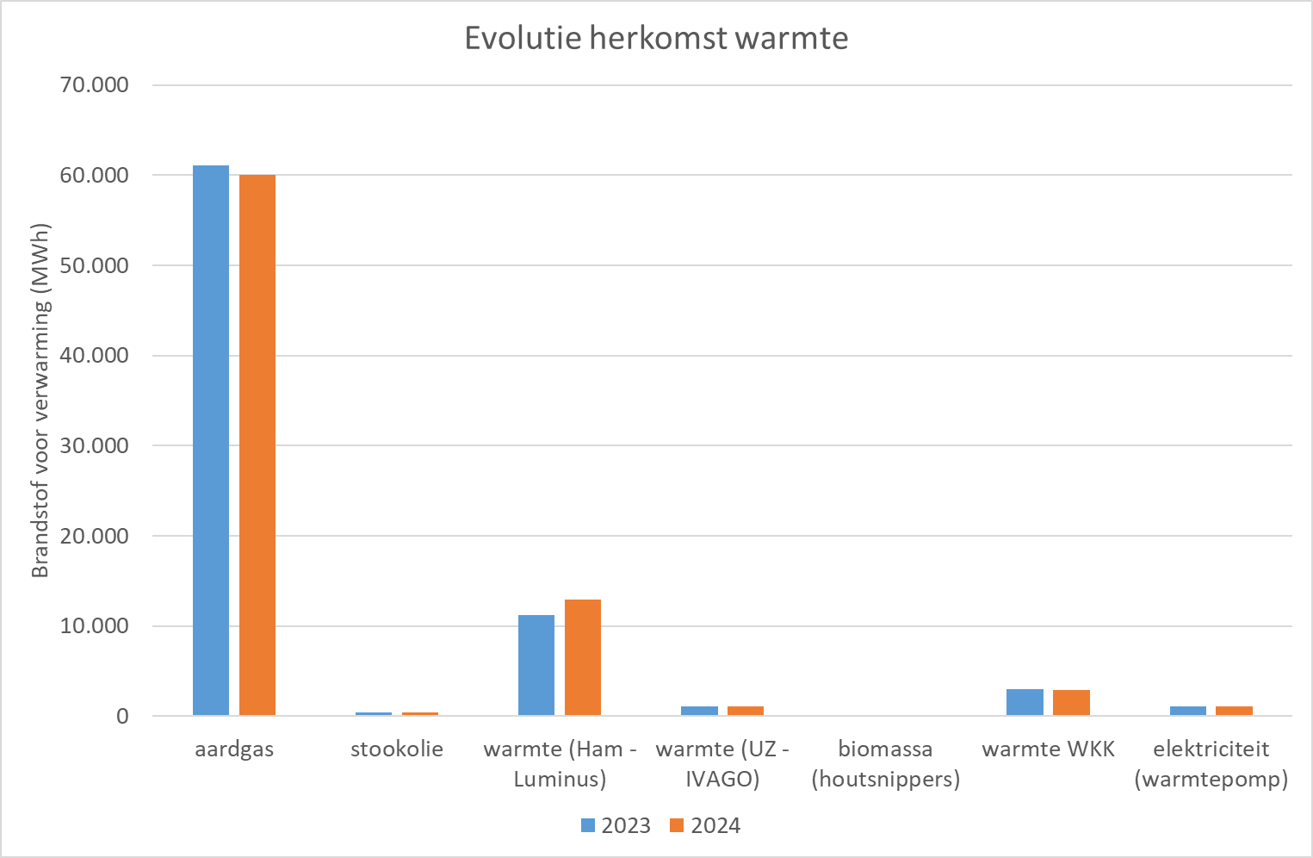

Slide 7
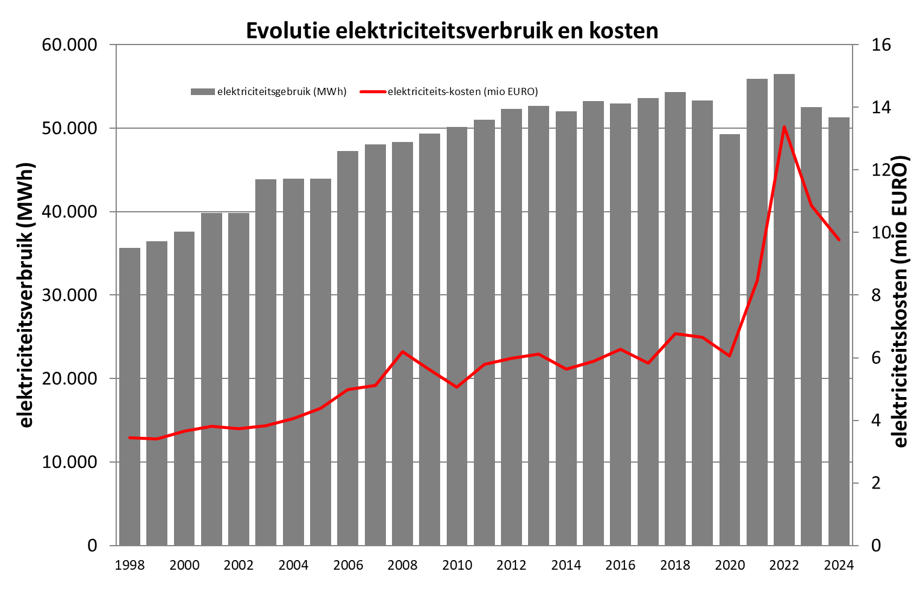

Slide 8
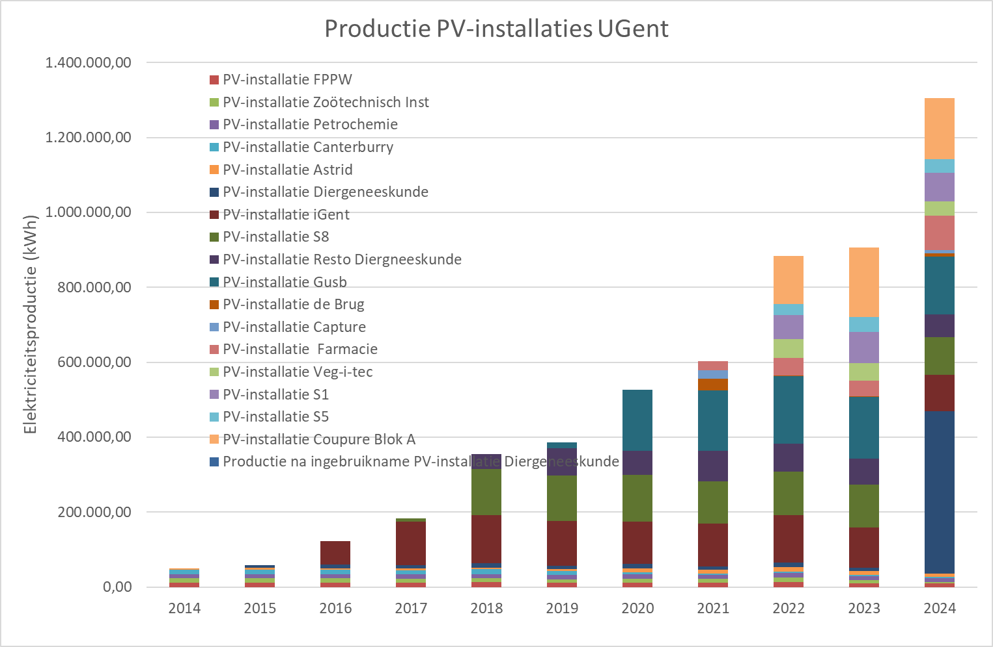

Slide 9
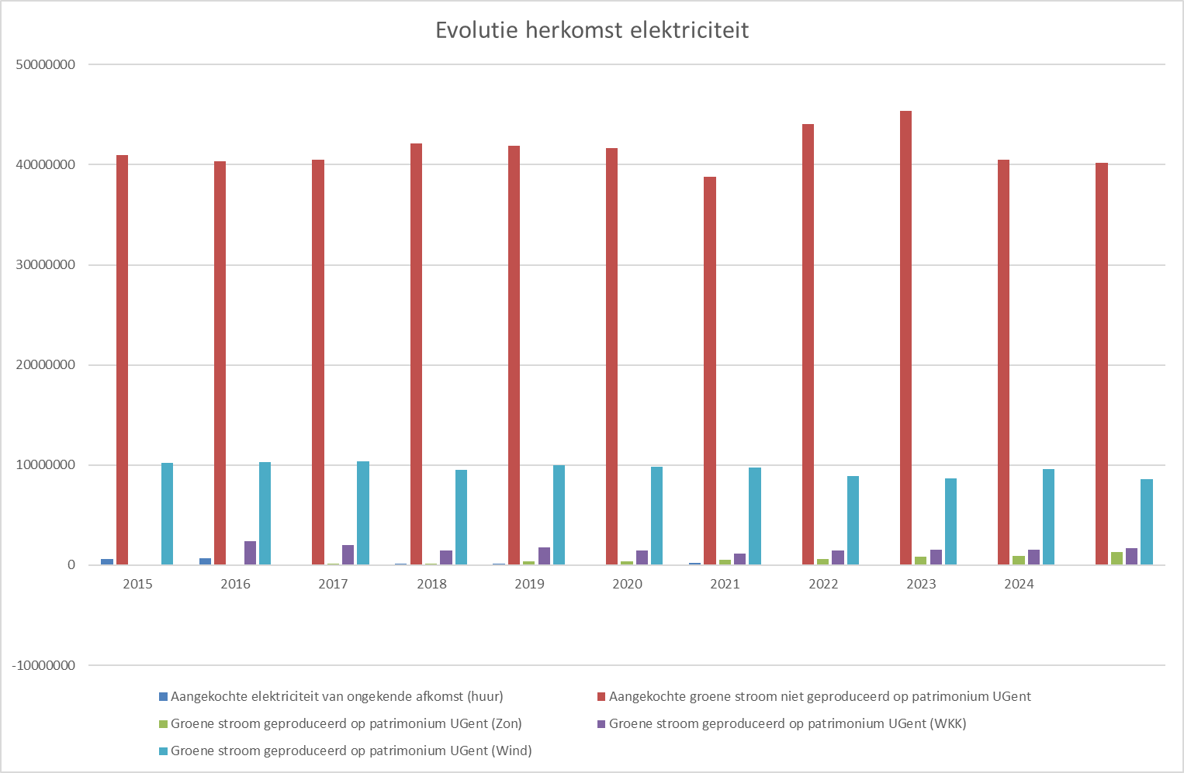

Slide 10
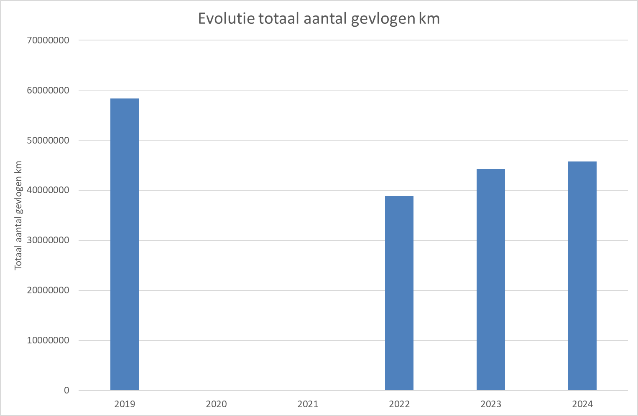
Where we are now? Flights

Slide 11
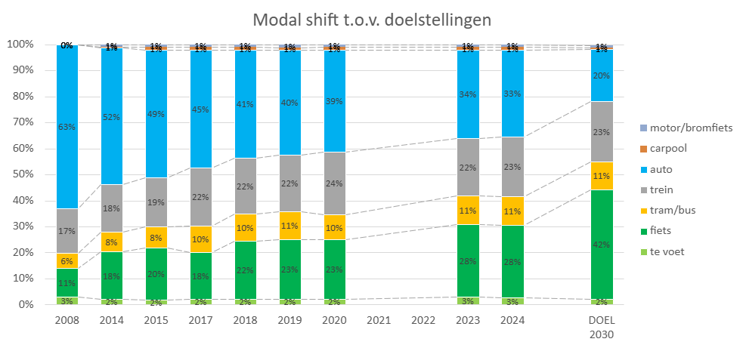
Where we are now? commuting

Slide 12
Where we are now? Water use

Slide 13
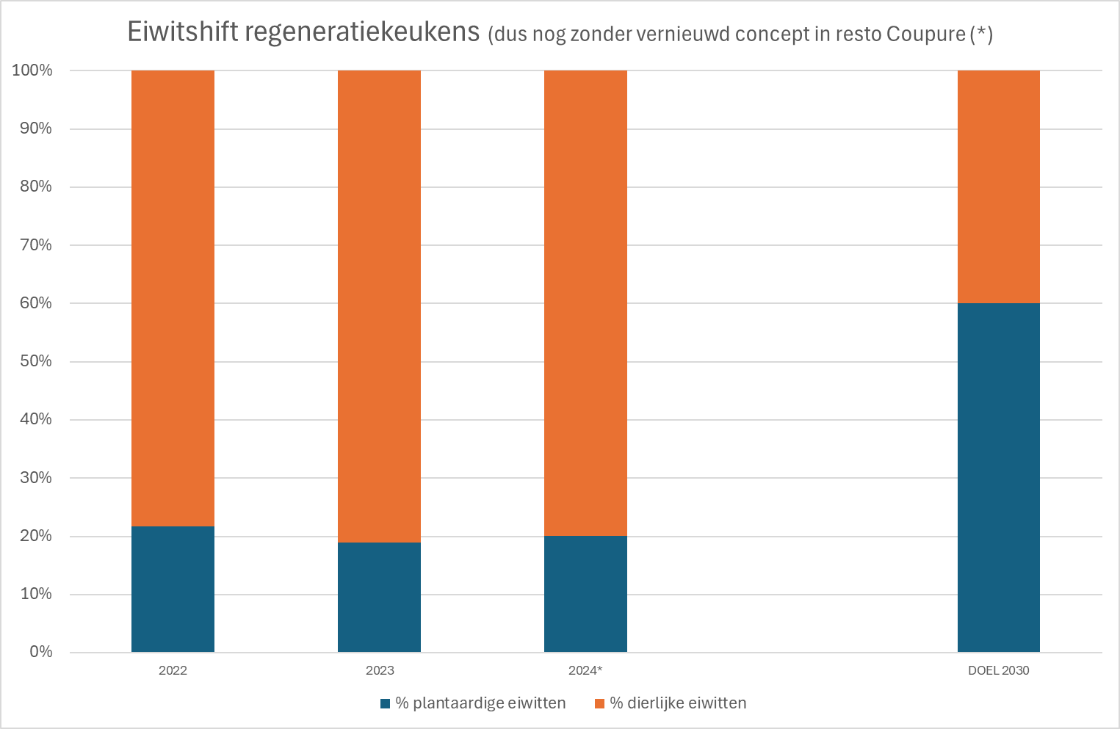
Where we are now? food

Slide 14
Where we are now? waste

Slide 15
Where we are now? waste

Slide 16
Where we are now? Waste

Slide 17
Indicators per faculty
www.UGent.be/duurzaam
www.UGent.be/sustainability

Slide 18
What is a good practice in your lab that you would like to share with other?
what are you struggling with?

Slide 19
ENERGY

Slide 20

Ultra freezer
From -80 to -70°C > 25-30% less energy consumption.
Okay for organisms, DNA/NA en most proteins. Here a a list of 119 biological samples that can be stored at -70°C or even warmer.
Ultrafreezer with a stirlingmotor (e.g. Stirling Ultracold Model SU780XLE) are better. More expensive but uses up to 25%-30% less electricity. The overall cost of a stirling ultrafreezer is much lower than that of a conventional model.
A backup freezer can be kept at -50°C.
Defrost every ultra-freezer annually. The ice formed takes up space
and increases energy consumption.
This saves about 20% in energy consumption.
When defrosting each year, take the opportunity to organise
everything and get rid of unknown or unnecessary products.
For long-term storage, use the central UGent biobank.

Slide 21

Fumehoods
Every hour an estimated 900 m³ of heated air per running metre of pull cabinet is extracted from the laboratory and discharged outside. In the newest buildings there is a heat exchanger between these, in older buildings there is not.
Do not use the fumehood as a storage area for hazardous substances or waste. There are safety cabinets or storage areas for these.
Fumehood with a constant flow rate.
Closing the sliding window has no effect. Therefore, switch off the fumehood (if possible via the on/off button) completely after use.
Fumehood with variable flow rate.
Closing the sash does have an effect. Keep sliding window closed as
much as possible.
Switch fumehood off completely (if possible via the on/off button)
after use.
Use the maximum setting only if really necessary.

Slide 22


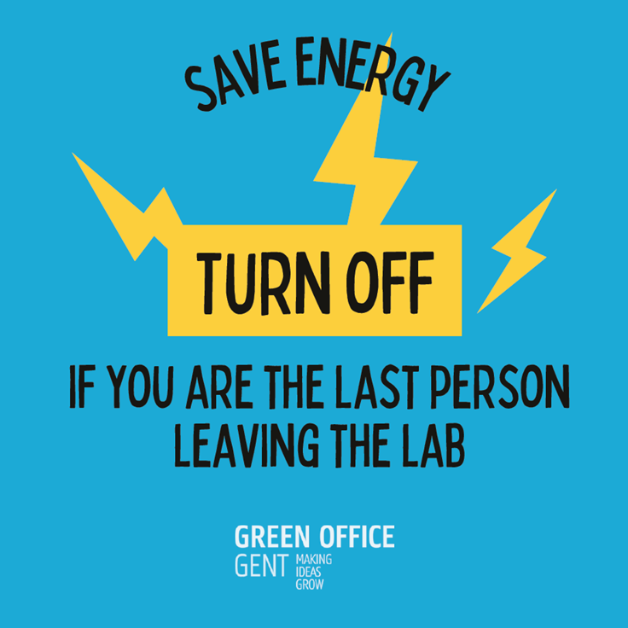

Others
Autoclaves: Make sure the autoclave is full when you run it. It uses a lot of heat, water and pressure, and thus a lot of energy.
Heating differently: choose the most sustainable heat source. Bunsen burners use gas to open fire. It is modular and works faster, but is unsafe and you are working with a fossil fuel. An oil bath is also no longer preferable. It allows better temperature control, but can cause spills. So opt for safer and more sustainable electric heat sources, such as electric Bunsen burners, heating blocks, ovens or dryers. The UGent provides green electricity.
Swith off apparatus
Swith off lights

Slide 23
Water

Slide 24
WATER quality
General, sectoral and specific thresholds for standard parameters
Reporting for all parameters
Prior (hazardous) substances: https://navigator.emis.vito.be/detail?woId=32326 bvb cadmium, kwik, nonylfenolen, PAK's, pentachloorbenzeen, PFOS, dioxinen, heptachloor,…
Contact milieu@ugent when in doubt!

Slide 25
WATER quality
Specific attention for:
Nonylfenolen: above the threshold at almost every campus: unknown source (mixes, commervial products, …): nonylfenol, octylfenol, p-cresol
Flowclean Cleaning agent Beckman Coulter, NP-40
Who knows more?
Specific communication or actions planned in the coming months
PFAS/PFOS
Dichloormethaan
Too deluted waste water

Slide 26
WATER: quantity
Maximal flow per per campus/discharge point
Each campus has its specific water system
BAW discharged together with HAW or not (deluting)
Discharging per campus of one building volledige campus versus per gebouw (mixing)
Admixing of 'technical’ waste streams (spuiwater, condens water,…)
Avoiding discharge of deluted waste water streams

Slide 27
Green chemistry

Slide 28
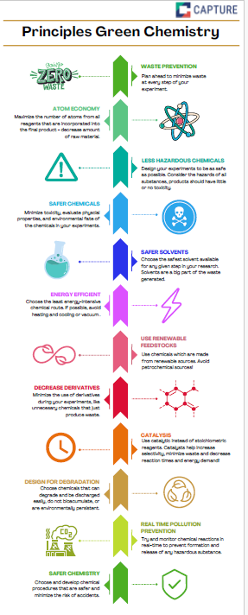
Green chemistry
Selection of less hazardous, more benign chemicals

Slide 29
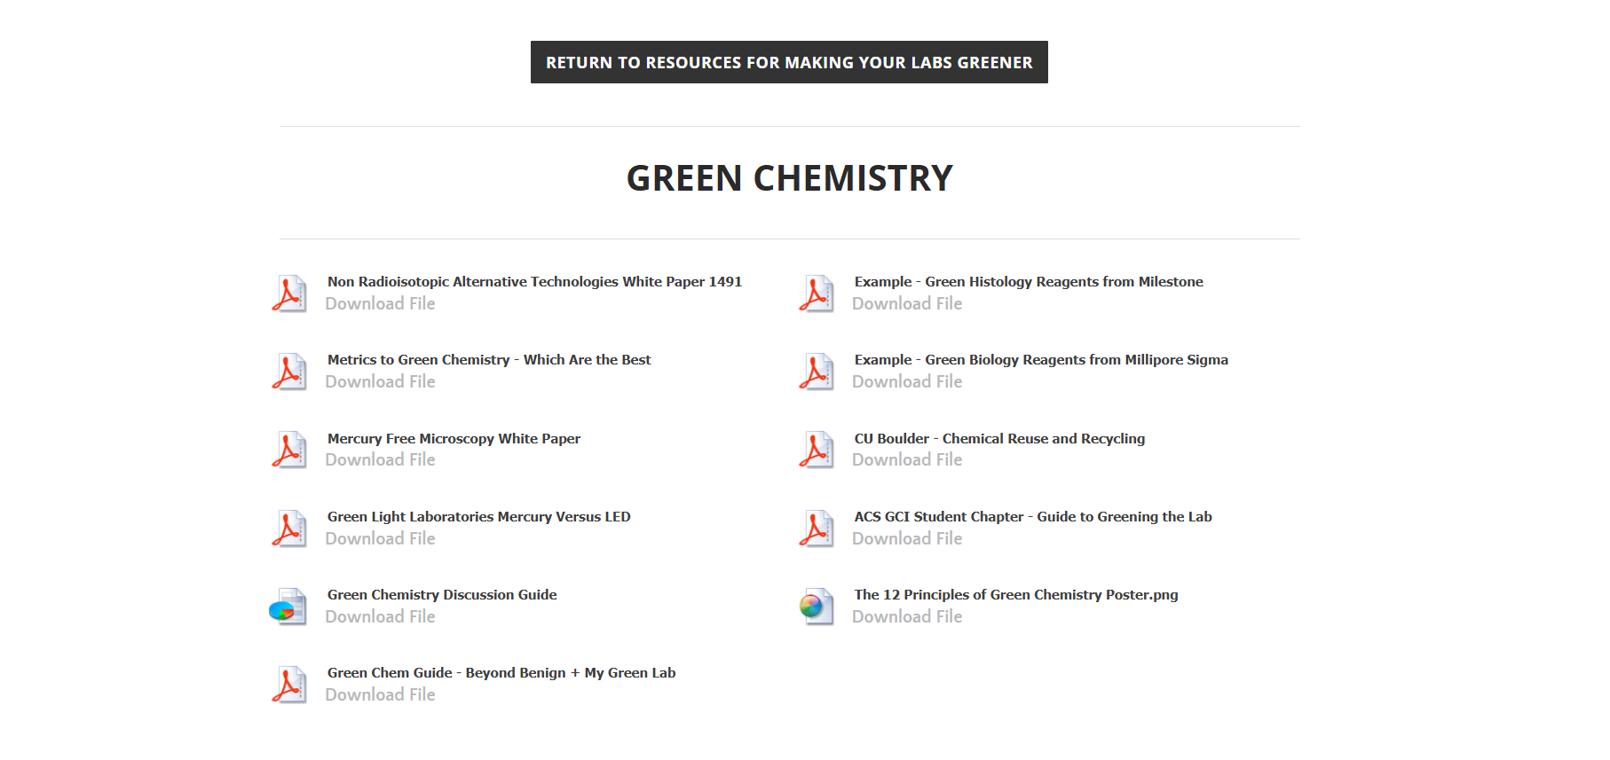
Green chemistry
Uit My Green Lab:
Purchase

Slide 30
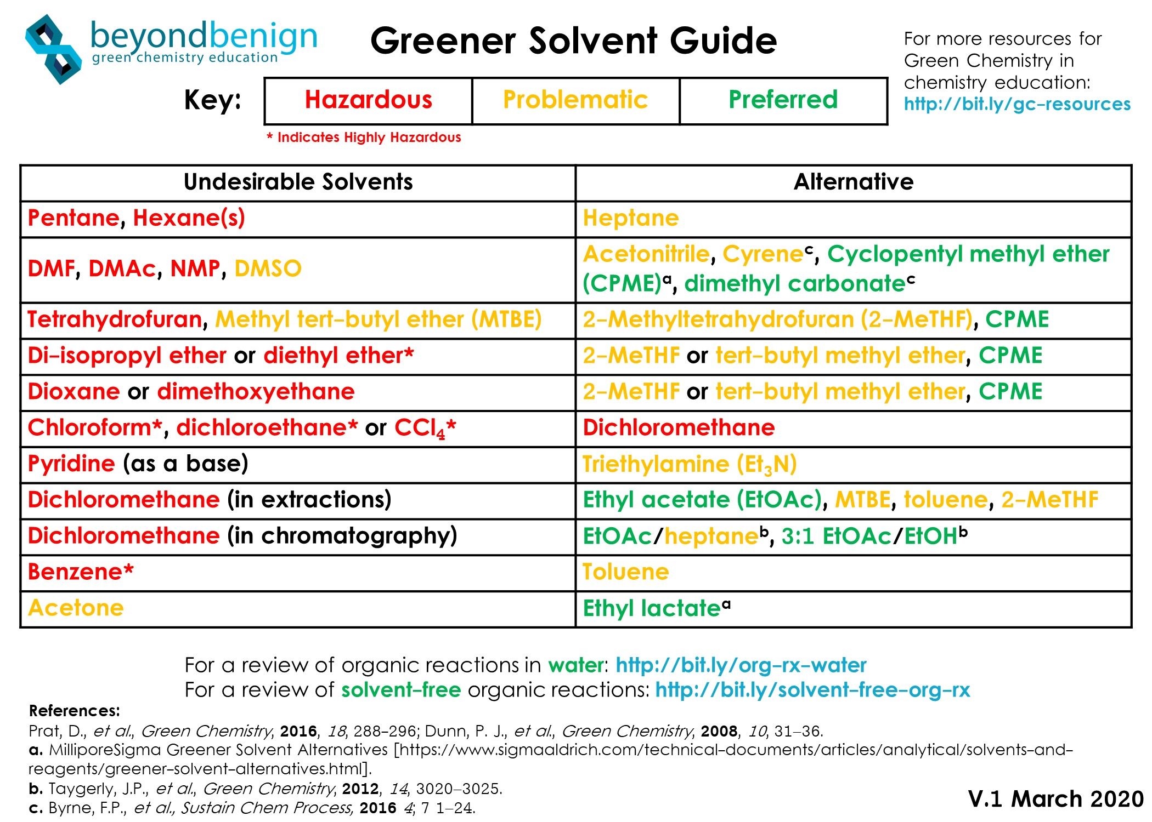
Green chemistry: solvents
Often low hanging fruit
More safe, less toxic, less hazardous alternatives
Overview of Greener Recommendations to Common Synthetic Techniques (distillation, chromatography, extraction, …): https://www.mygreenlab.org/uploads/2/1/9/4/21945752/gc_-_green_chem_guide-_beyond_benign___my_green_lab.pdf

Slide 31
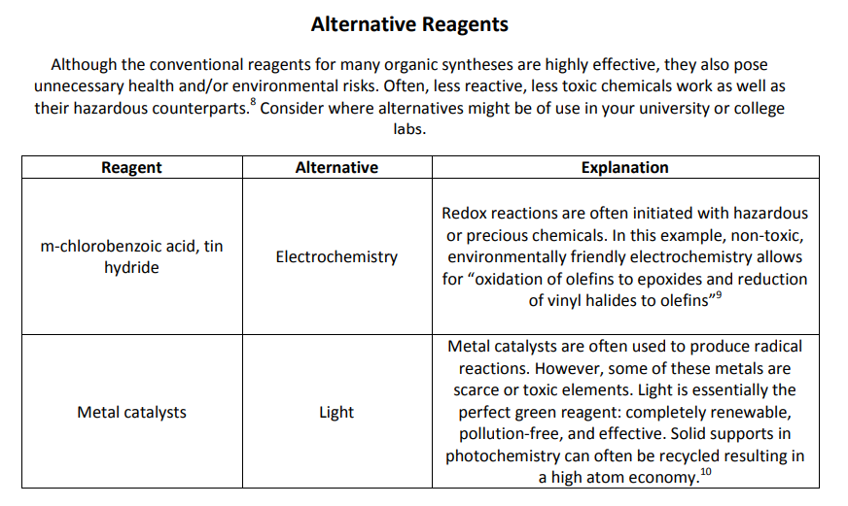
Green chemistry: reagents

Slide 32
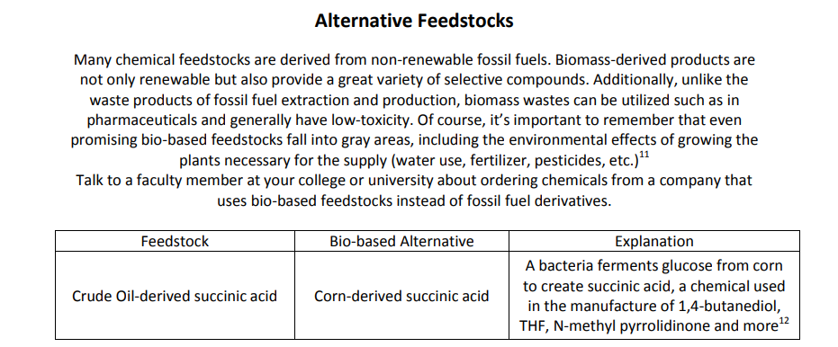
Green chemistry: feedstocks

Slide 33
Reduce volume
Scale reduction: carry out the test on a smaller scale. This way, fewer lab products and energy are needed and you produce less waste. With snap cap vials, filter cartridges, ... this is now quite possible.

Slide 34
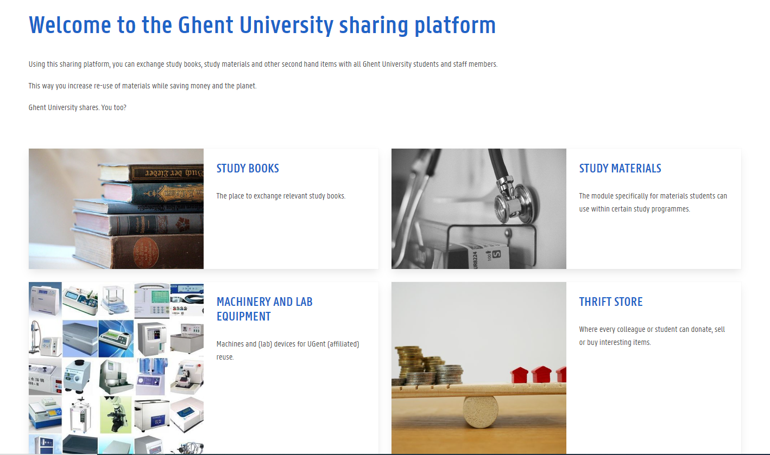
Purchase necessary?
Reuse old products for technical applications: citric acid, sodium chloride...
Check stock via M-CHEM
Sharing platform: ugent.deelt.be

Slide 35
Charge of 1/3 of the waste cost
Chemically contaminated solid waste
Lab products
Medicines
Chlorated solvents
Animal waste (70%)

Slide 36
Plastics
Non-hazardous contaminated plastics can be recycled!
Not in residual fraction, nor hazardous (packaging) waste, nor chemically contaminated waste
> Foil collection bags
> Containers for hard plastics

Slide 37
communication

Slide 38
Communication, information, inspiration
Advocating for sustainable science. Convincing people to care.
You: what can you do in your ‘zone of impact’?
Ecoteams
Intake of new staff, check out of leaving staff
Guidelines, information session
Link with central polity (WMD, Transitie UGent, sustainability commissions)

Slide 39
more?

