Slide 2
Ghent
& its university

Slide 3
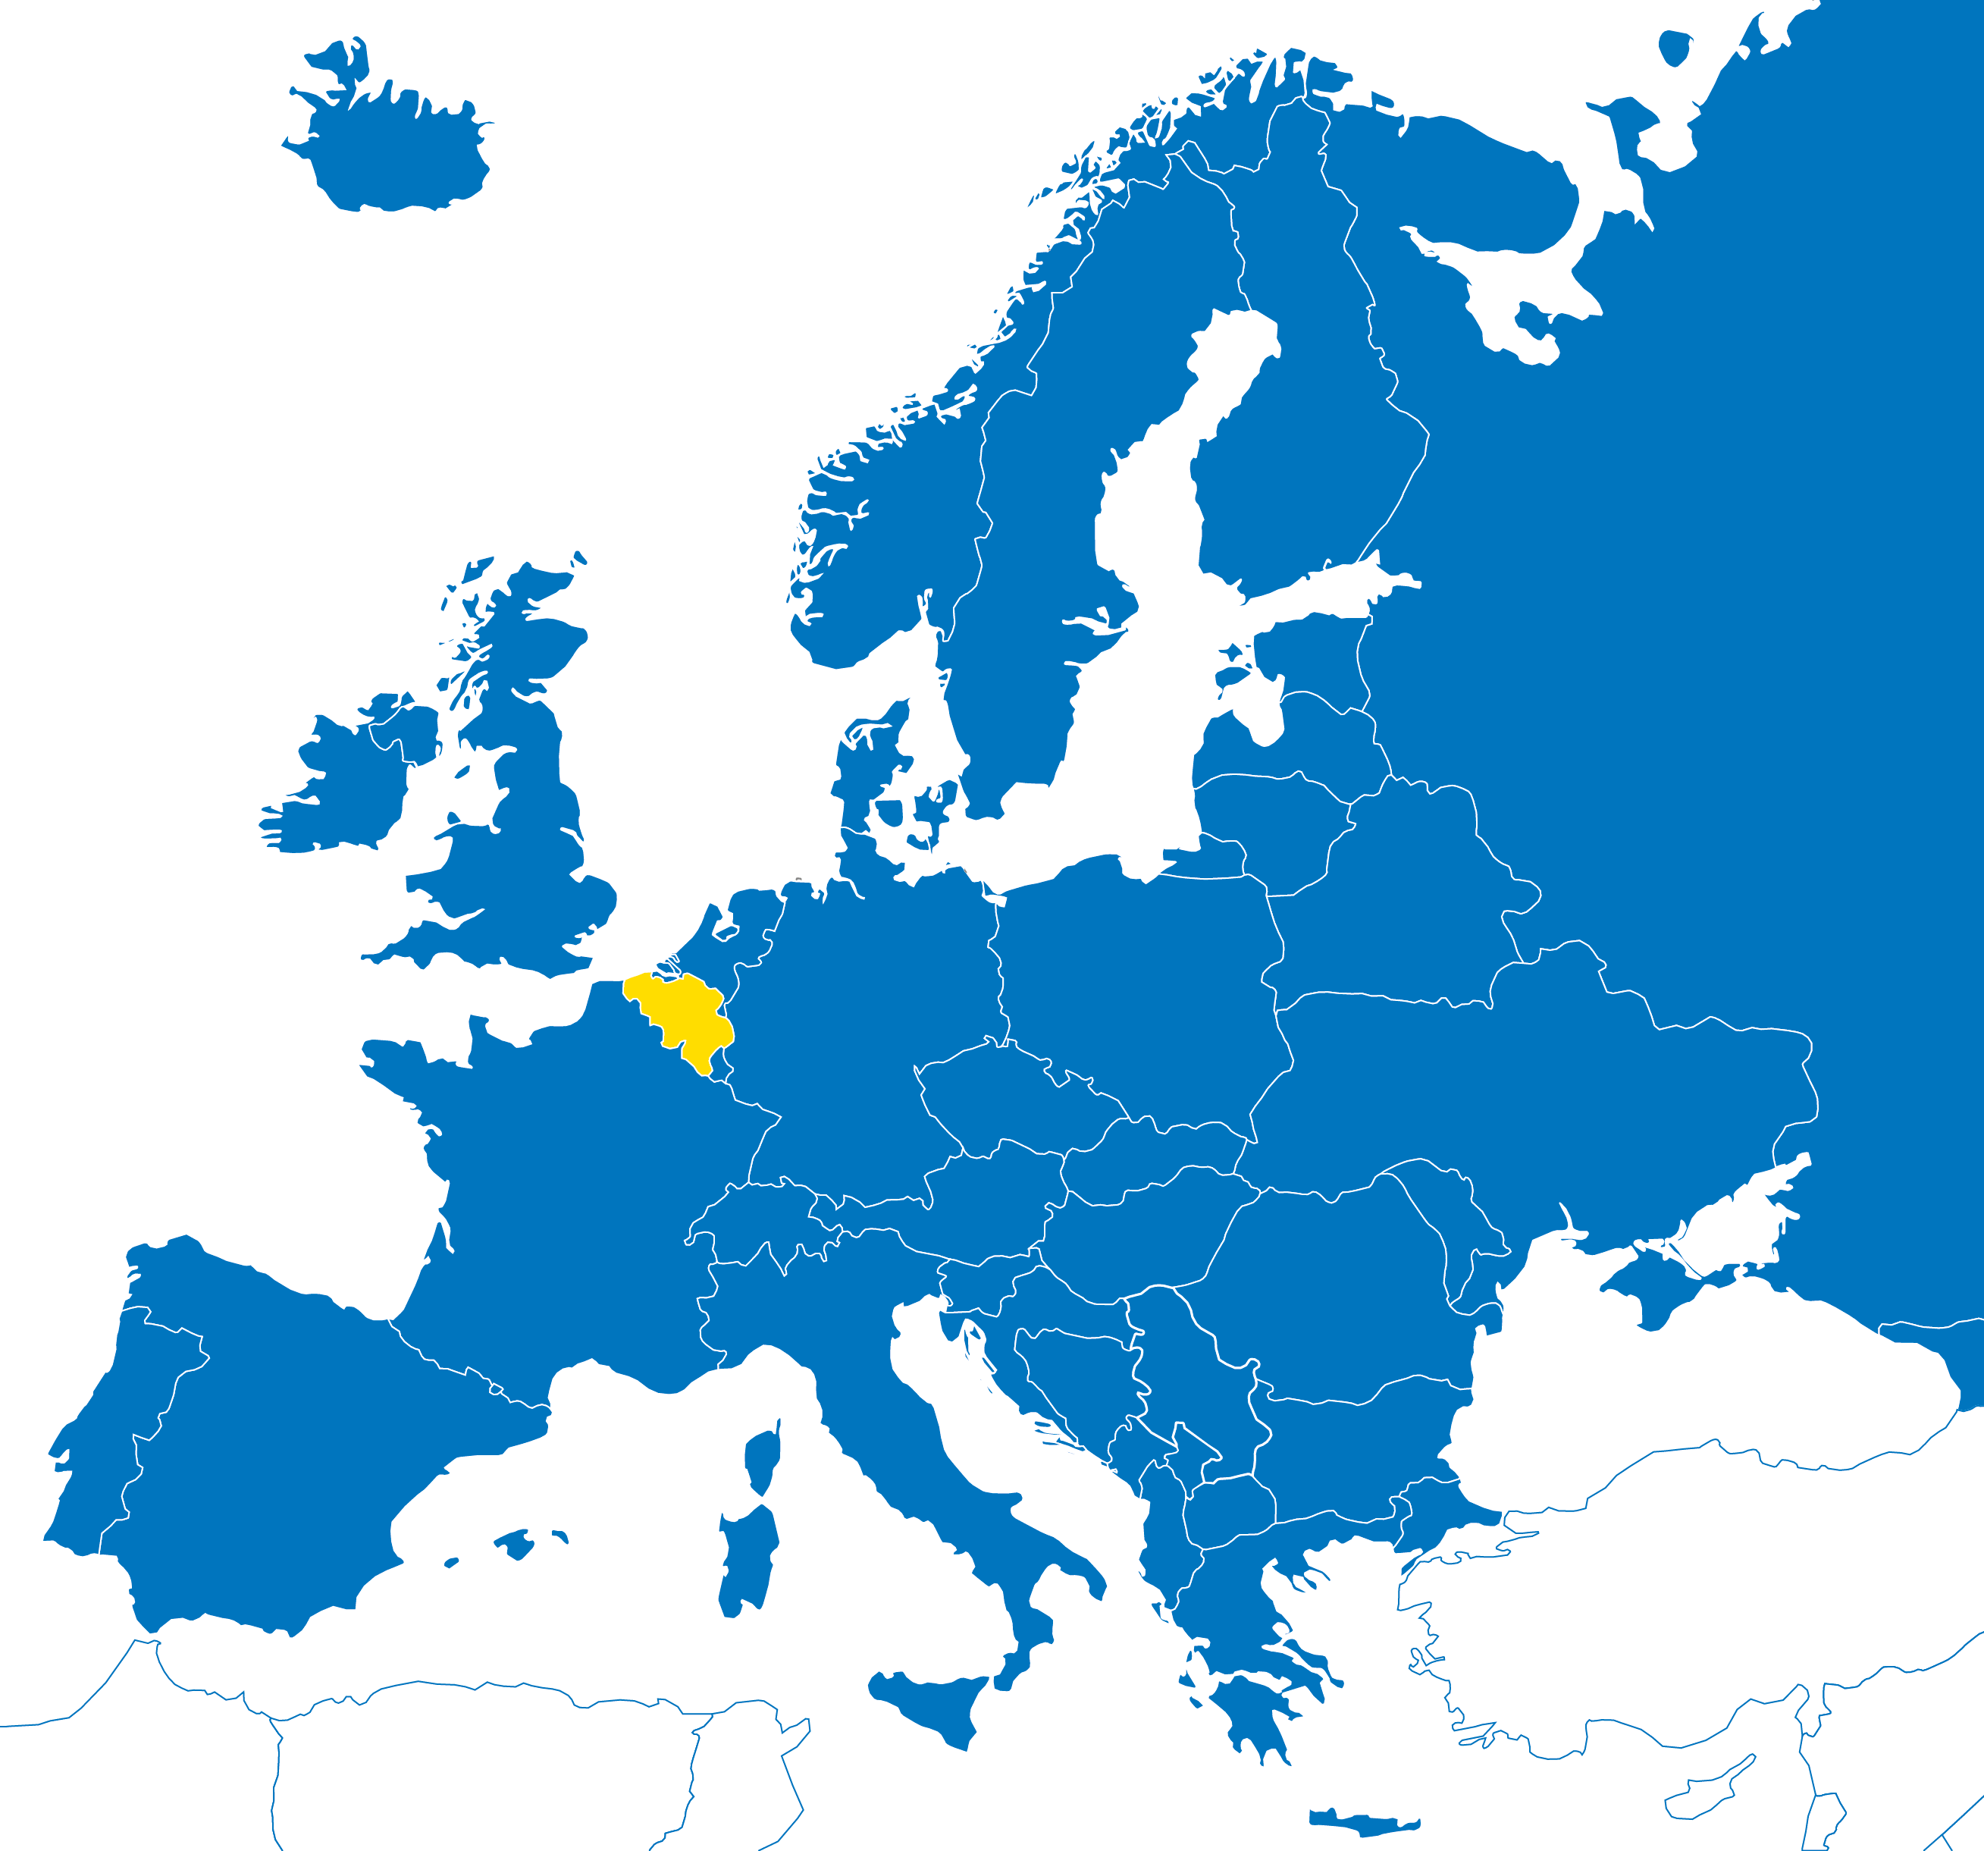
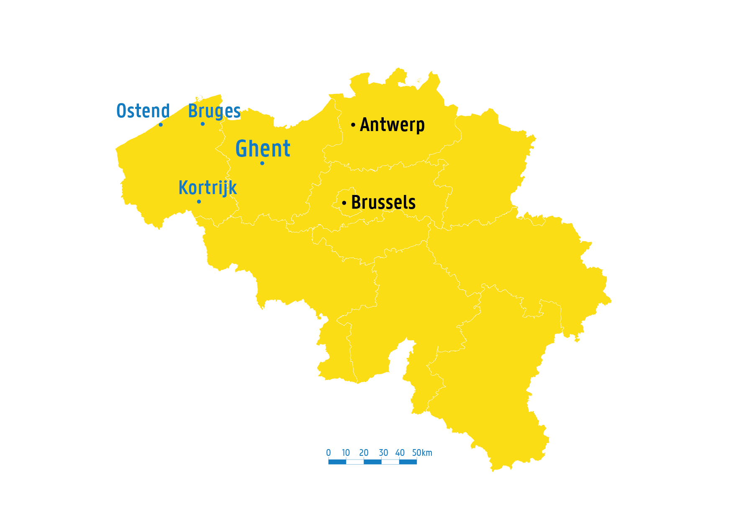
in belgium
In the heart of Europe
Amsterdam
200 km
London
350 km
Berlin
800 km
Paris
300 km
Notes:
Ghent is located in Flanders, Belgium. The city is close to a few major European cities like Brussels, Paris and Amsterdam.

Slide 4
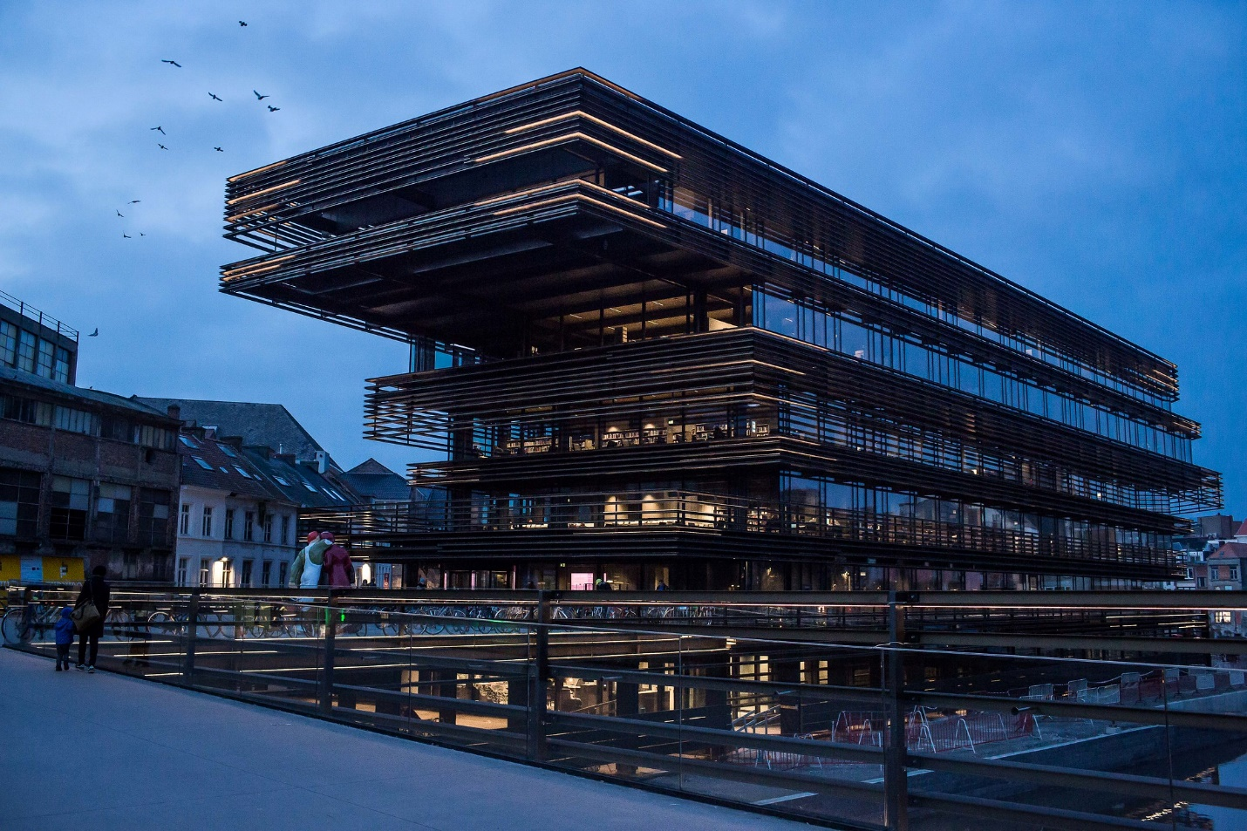

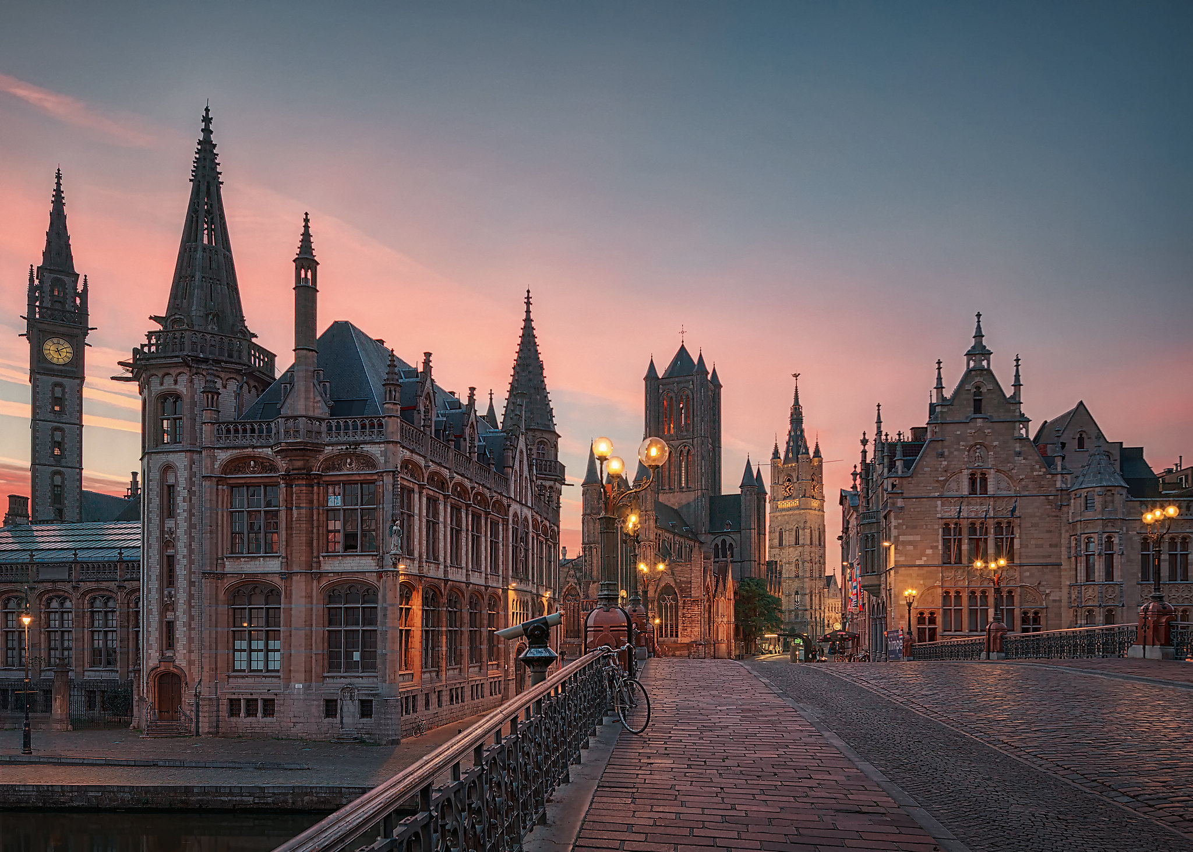
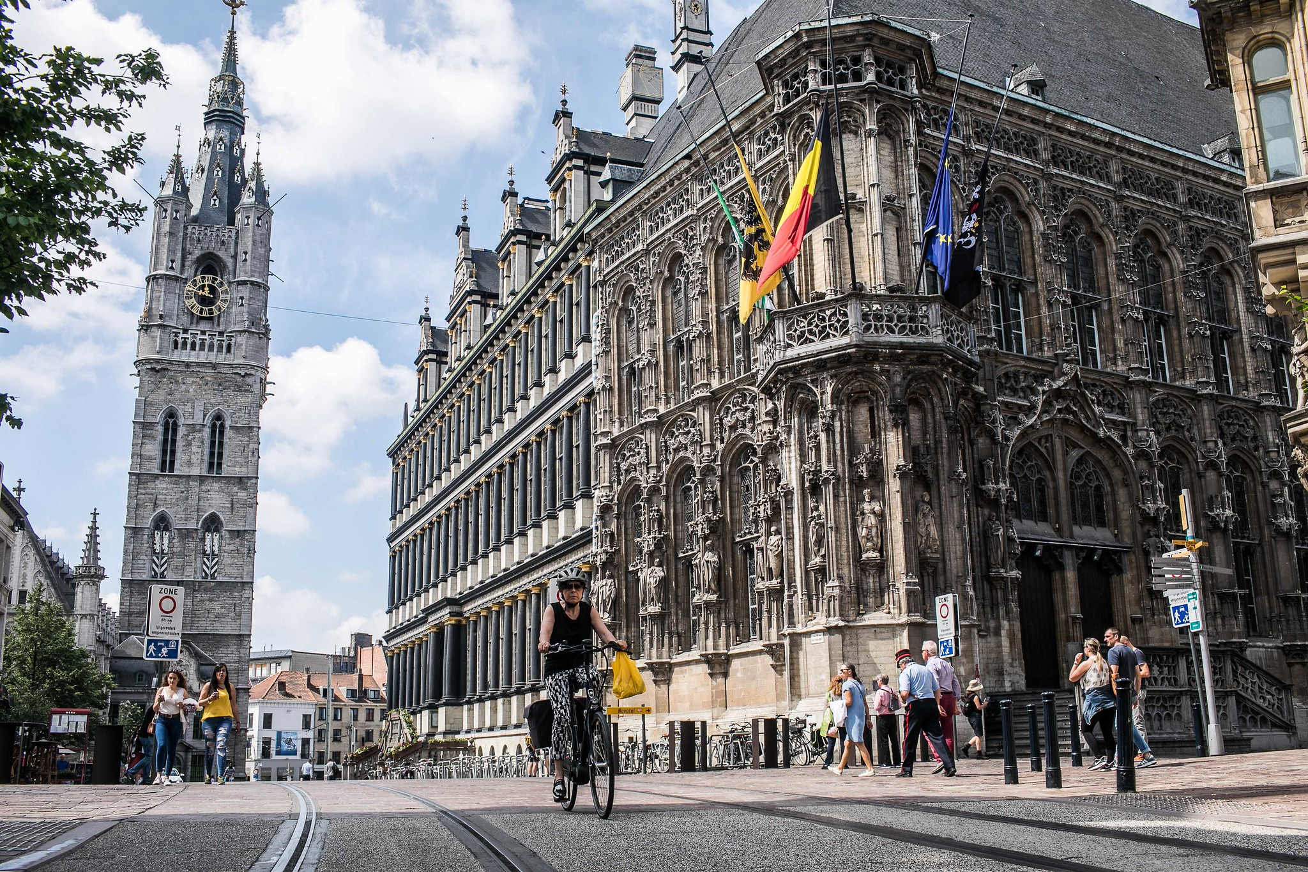
© Stad Gent - Dienst Toerisme, Bas Bogaerts
Ghent: Medieval city
>272.000 inhabitants
>87.000 students
>160 nationalities
1.200 restaurants & cafés
3.600 startups per year
Bron: gent.buurtmonitor.be/dashboard
© Flickr, Robert Schüller
© Stad Gent - Dienst Toerisme, Bas Bogaerts

Slide 5
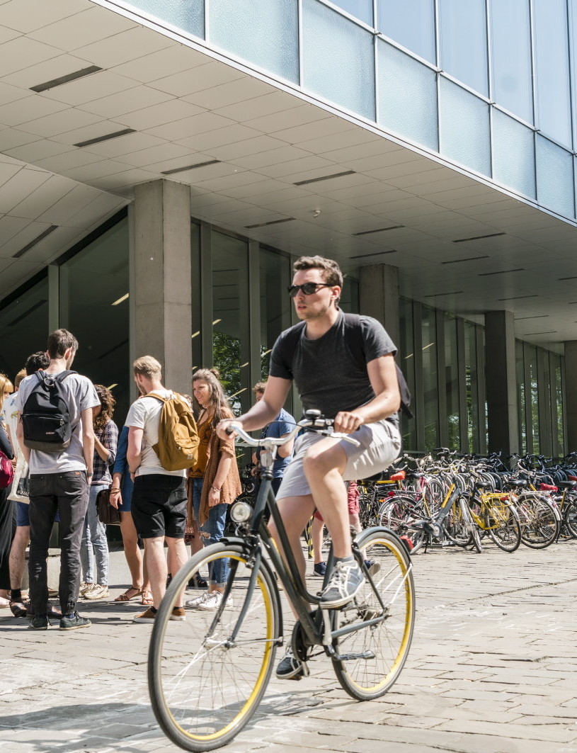
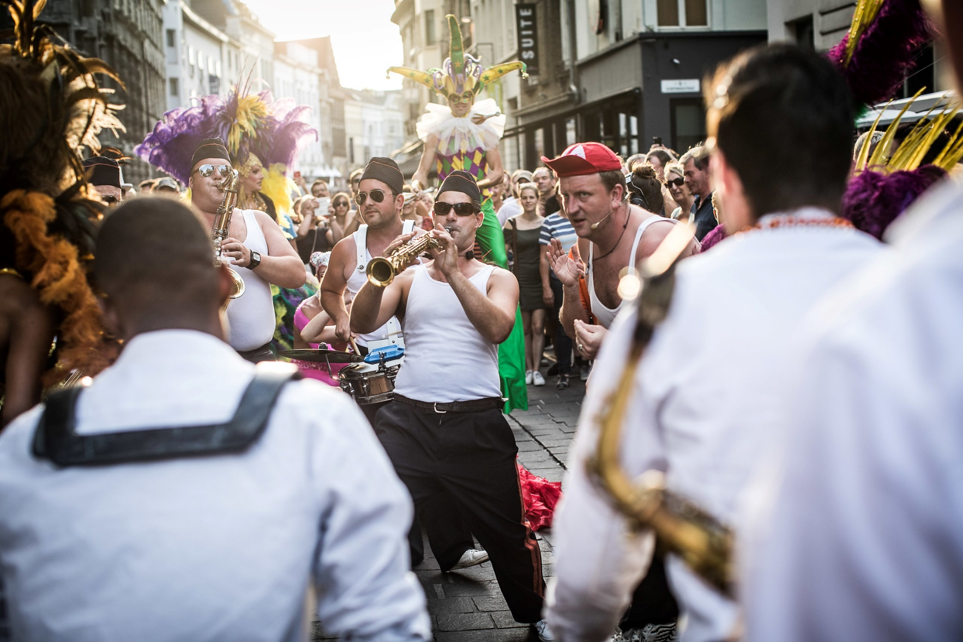
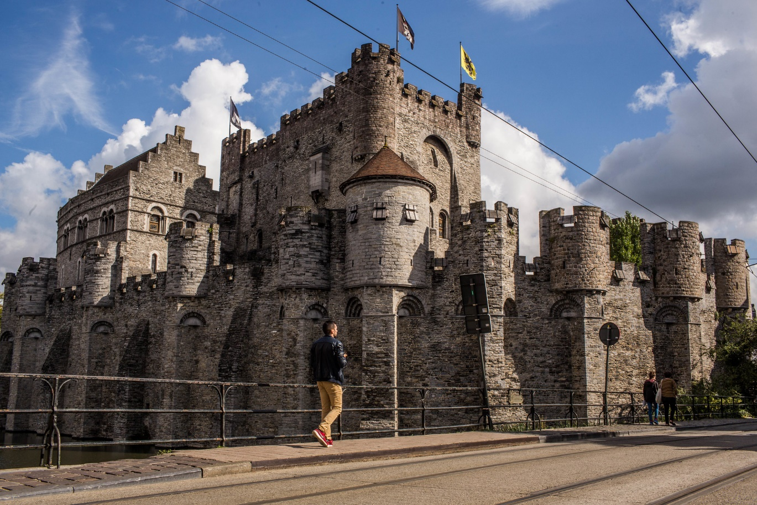
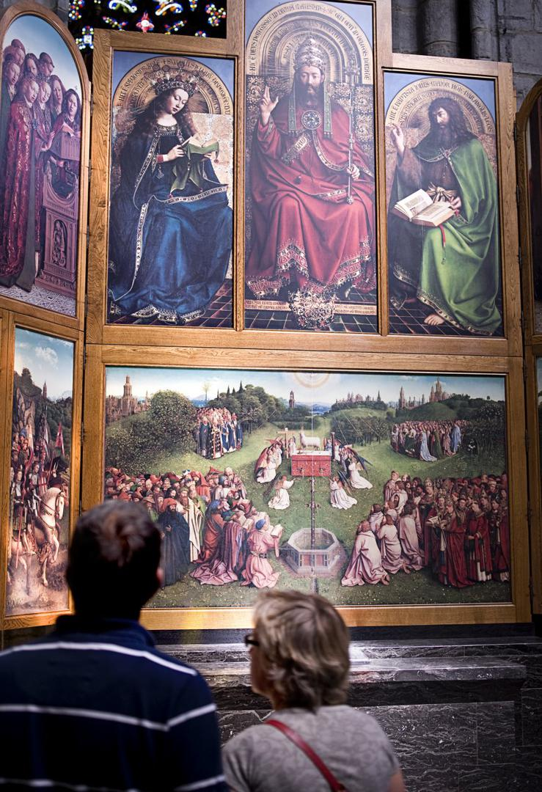

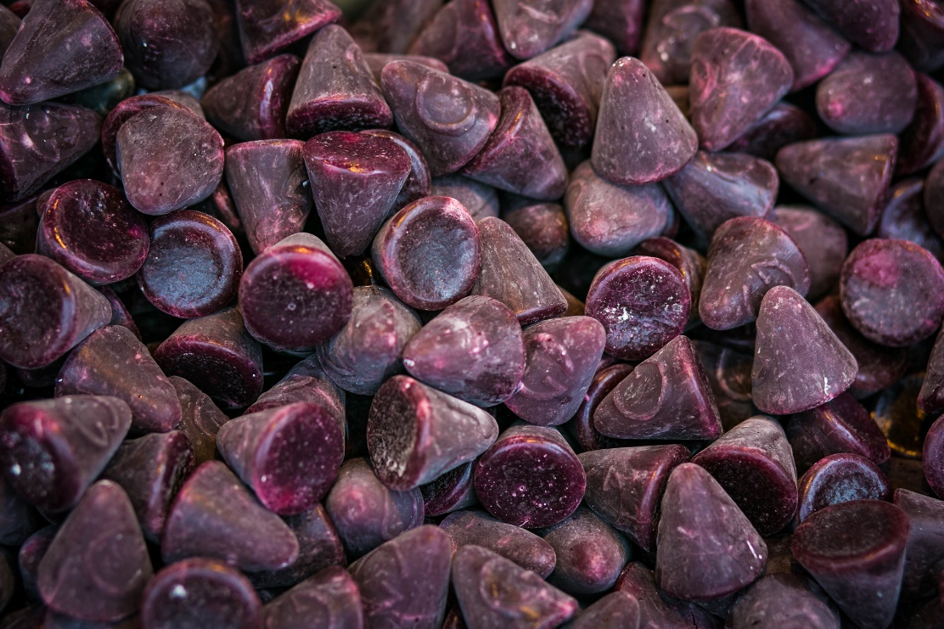

Bike-friendly city
Castle of the Counts
Festival of Ghent & other festivals
© UGent – Christophe Vander Eecken
© Stad Gent - Dienst Toerisme, Bas Bogaerts
© Stad Gent - Dienst Toerisme, Bas Bogaerts
Cuberdons
‘Neuzekes’
GHENT IS …
Veggie capital
of Europa
Mystic Lamb
Van Eyck
© Stad Gent - Dienst Toerisme, Bas Bogaerts
© Stad Gent - Dienst Toerisme, Bas Bogaerts
© www.lukasweb.be - Art in Flanders vzw, Hugo Maerten
Notes:
Gent is a true festival city: Ghent Festival, Light Festival, Ghent Jazz Festival, ...

Slide 6
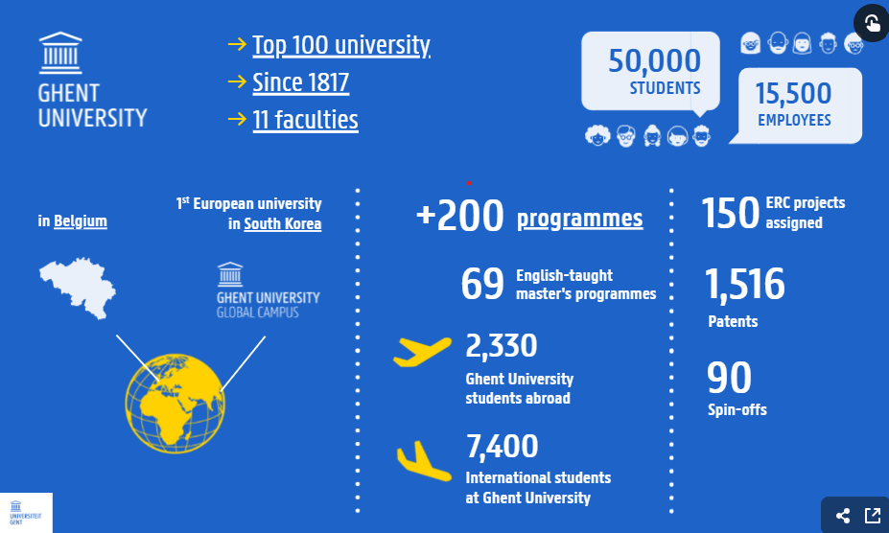
Notes:
Ghent University is a top 100 university, founded in 1817, and one of the major universities in Belgium with more than 48,000 students and 15,000 employees. Our 11 faculties offer more than 200 courses and conduct in-depth research within a wide range of scientific domains. Our credo is ‘Dare to Think’, challenging everyone to question conventional views and to dare to take a nuanced stand. We are a pluralistic university open to all, regardless of their ideological, political, cultural or social background. Ghent University Global Campus is also the first European university in Songdo, South Korea.
www.ugent.be
#ugent

Slide 7
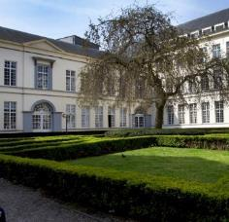
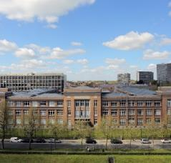
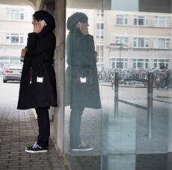
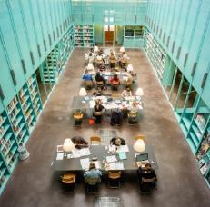



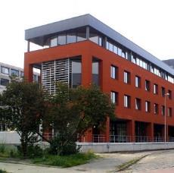

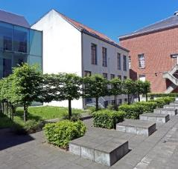


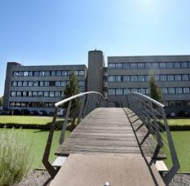

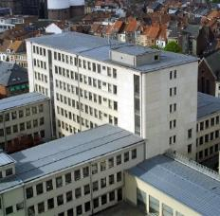
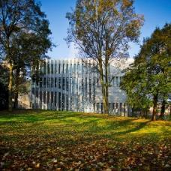

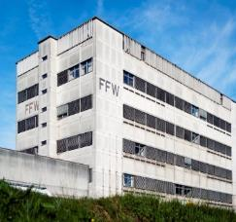
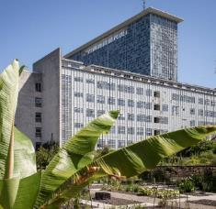




11 faculties
Notes:
Ghent University established in 1817
Top 100 or 150 in most common rankings
The university counts 11 faculties and our research and education therefore covers all thinkable disciplines. There is no central campus, the faculties are spread over various campusses in and around the city => nice blend of student and city life

Slide 8
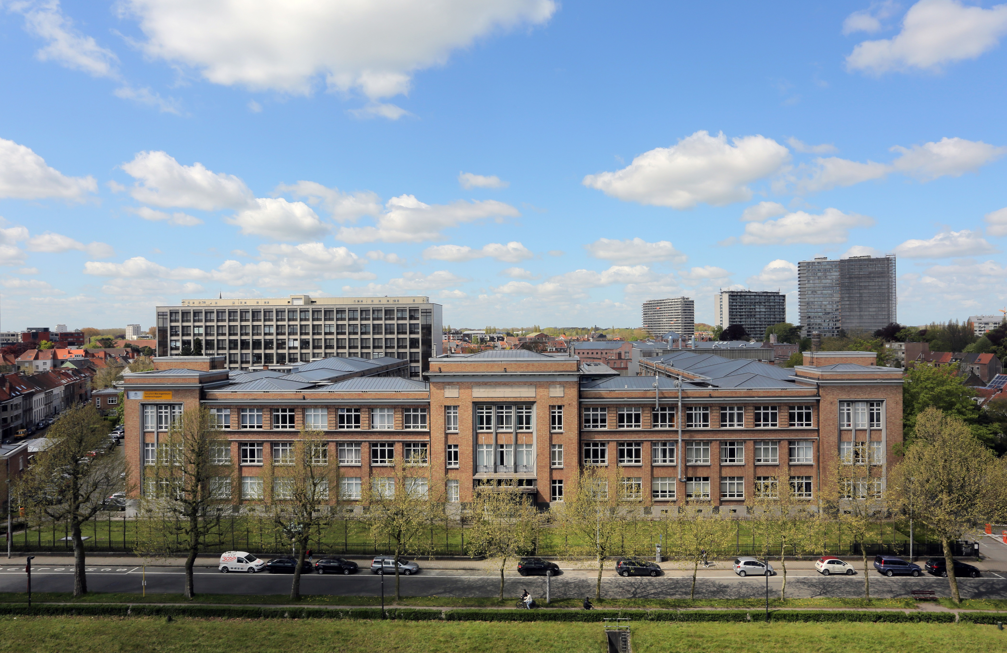


Slide 9
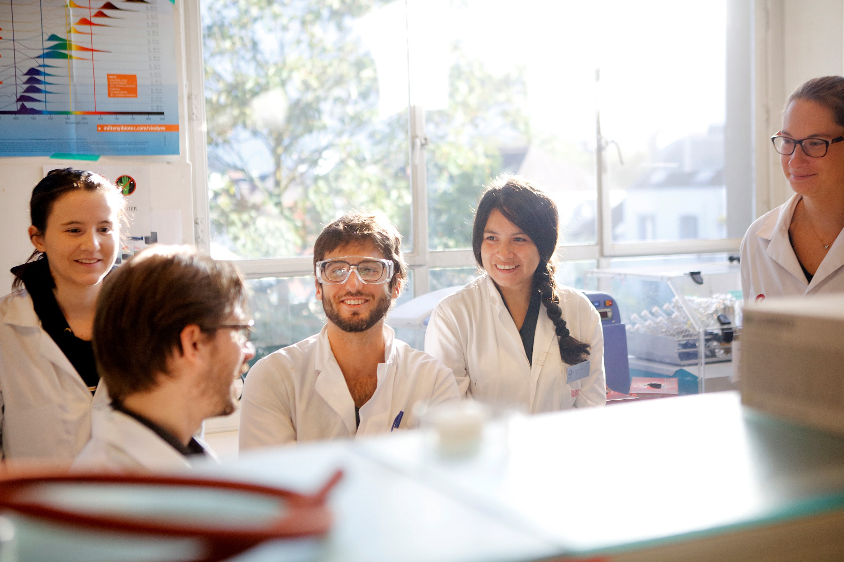
FACULTY OF BIOSCIENCE ENGINEERING
Ambition
to empower learners as globally engaged citizens with state-of-the-art knowledge, skills, and innovation potential
to address major societal transitions and to promote equitable quality of life and sustainability.
Agriculture & forestry
TOP
10
Biological Sciences, Environmental Sciences
& Chemical Engineering
TOP
100
Nutrition and Food Science
TOP
100

Slide 10
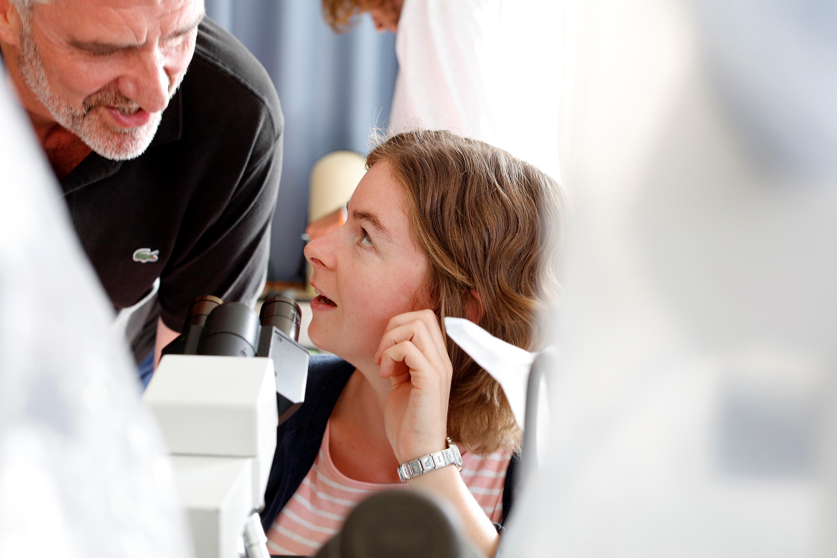
education

Slide 11
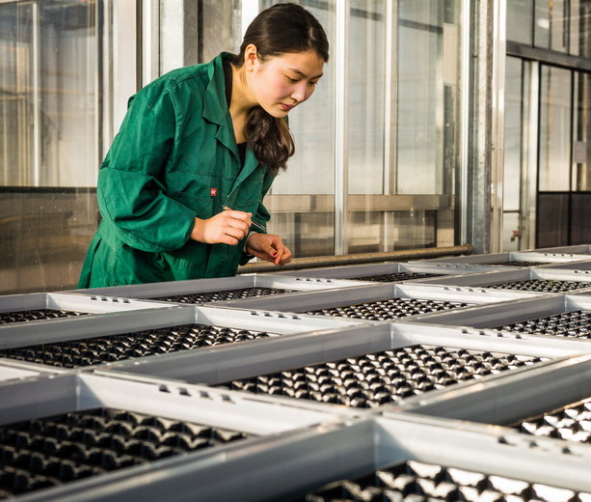
students
> 3.000 students
400 international students in graduate programmes
500 international students in doctoral training programmes
200 international students in exchange programmes
More than 100 nationalities
Notes:
Nationality
Our faculty has the highest number of international students of all Ghent University faculties.
The highest diversity is found in the group of English master students and PhD students.

Slide 12
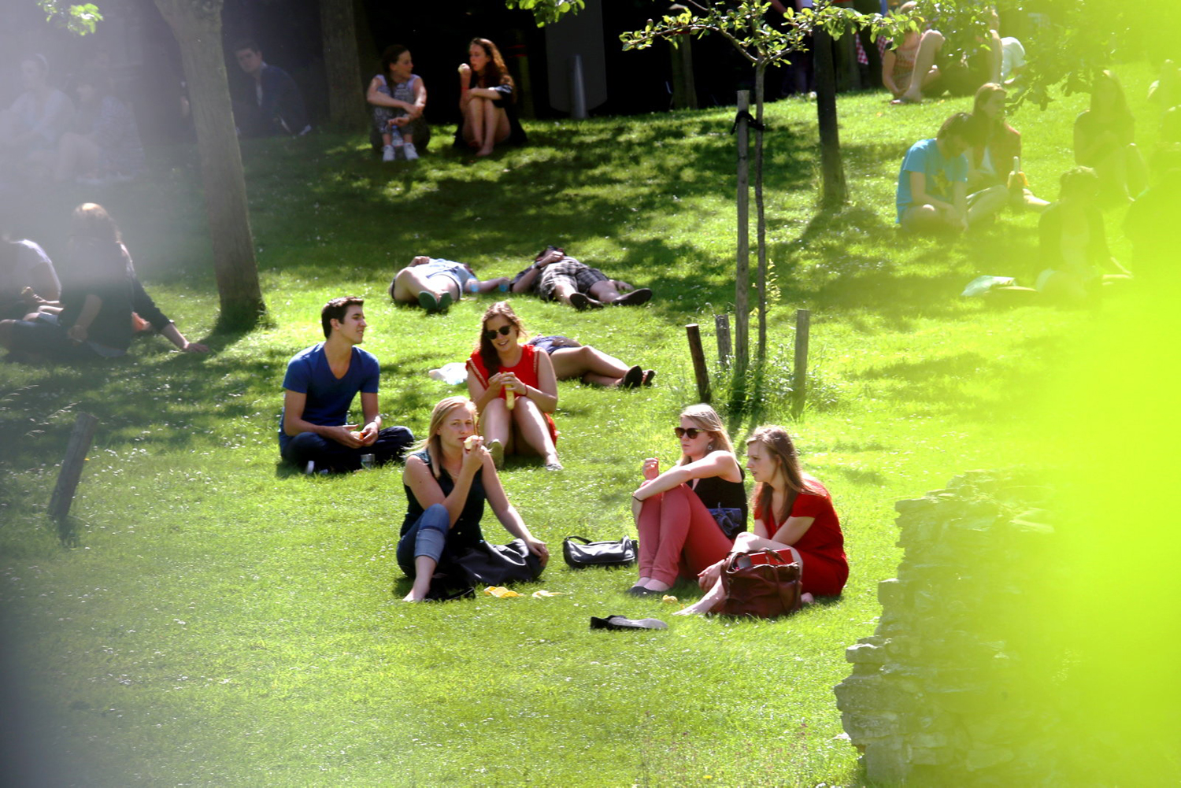
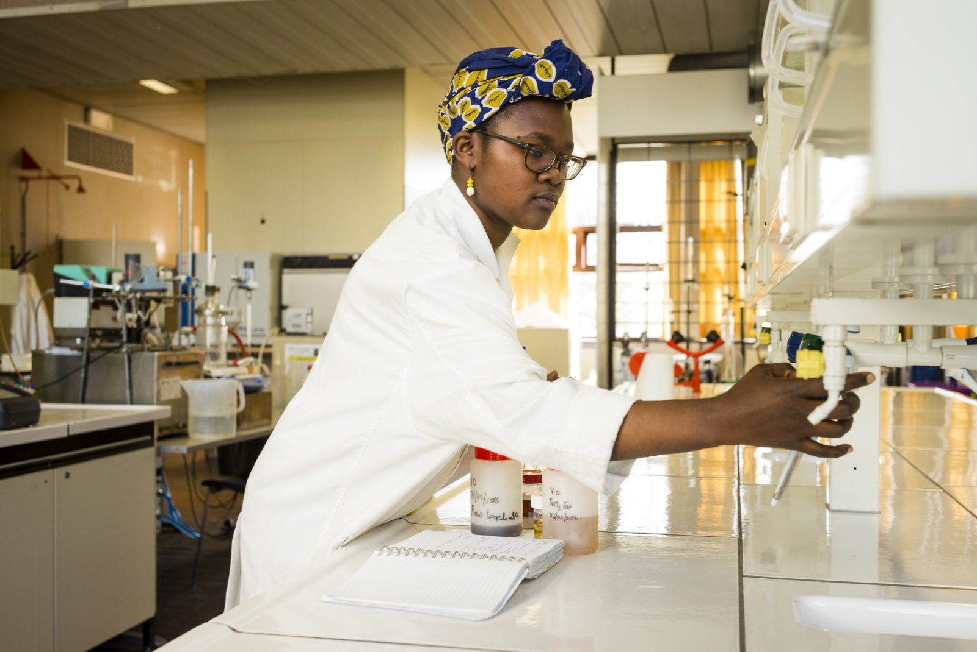
STUDENTENAANTAL
Students 3170
Bioengineer 938
Industrial engineer 533
English master students 533
Doctoraat 878
Creditcontract, gast- en uitwisselingsstudenten 242
Figures: academic year 2025-2026. The sum of the number of students per program is not equal to the total number of unique students because some students are enrolled in multiple programs at the same time.

Slide 13
PhD
Belgian
Number of PhD’s per nationality
not Belgian
Where our PhD students come from:
Notes:
Every year about 120 PhD students obtain their doctoral degree at our faculty.

Slide 14
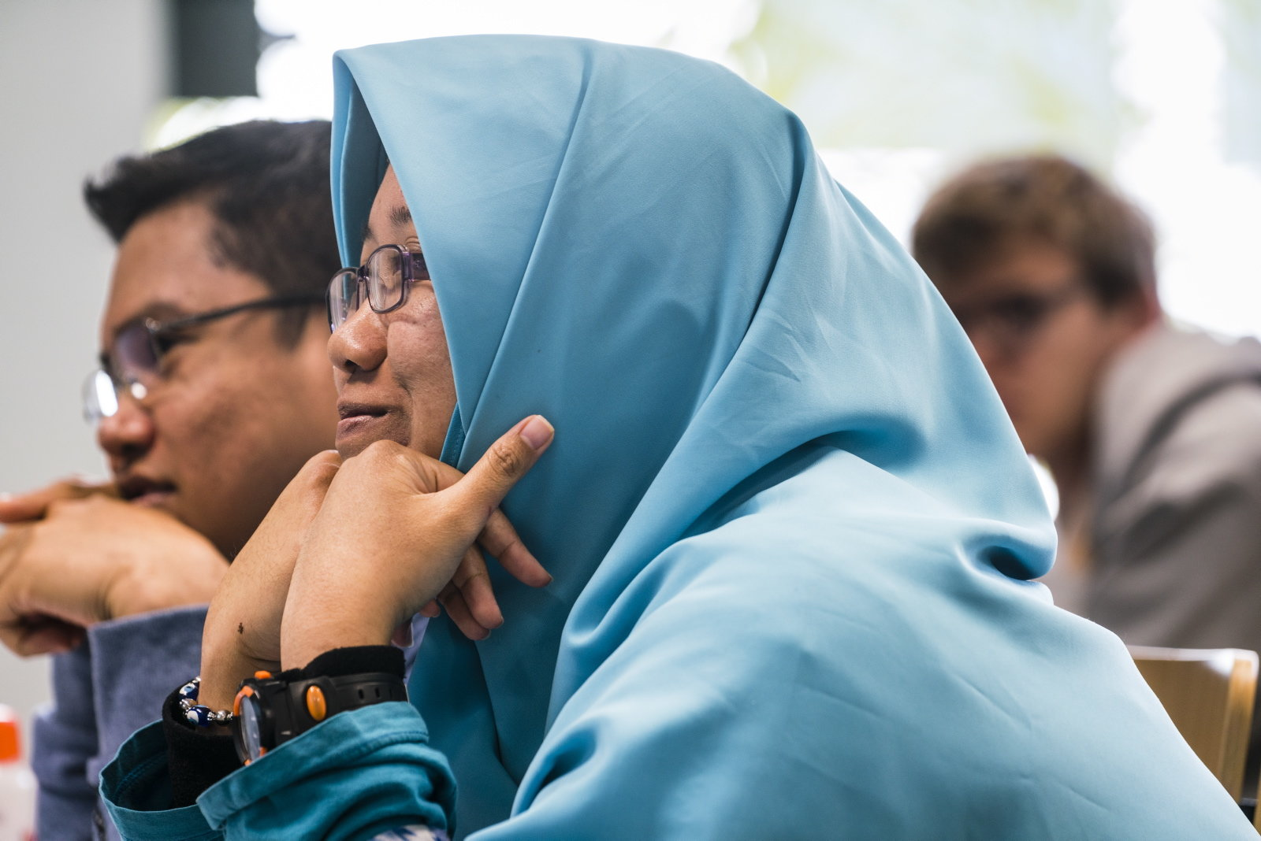
All programmes
Bachelors
Dutch taught: 7
English taught (in South Korea): 3
Masters
Dutch taught: 9
English taught: 12
Summer courses -
tailor made trainings -
consultancy

Slide 15
Bachelor programmes
3 years
BIOSCIENCE ENGINEERING
Campus Coupure, Ghent
Agricultural Sciences
Cell and Gene Biotechnology
Chemistry and Food Technology
Environmental Technology
Forest and Nature Management
Land, Water and Climate Management
IN DUTCH
BIOSCIENCE ENGINEERING TECHNOLOGY
Campus Schoonmeersen, Ghent

Slide 16
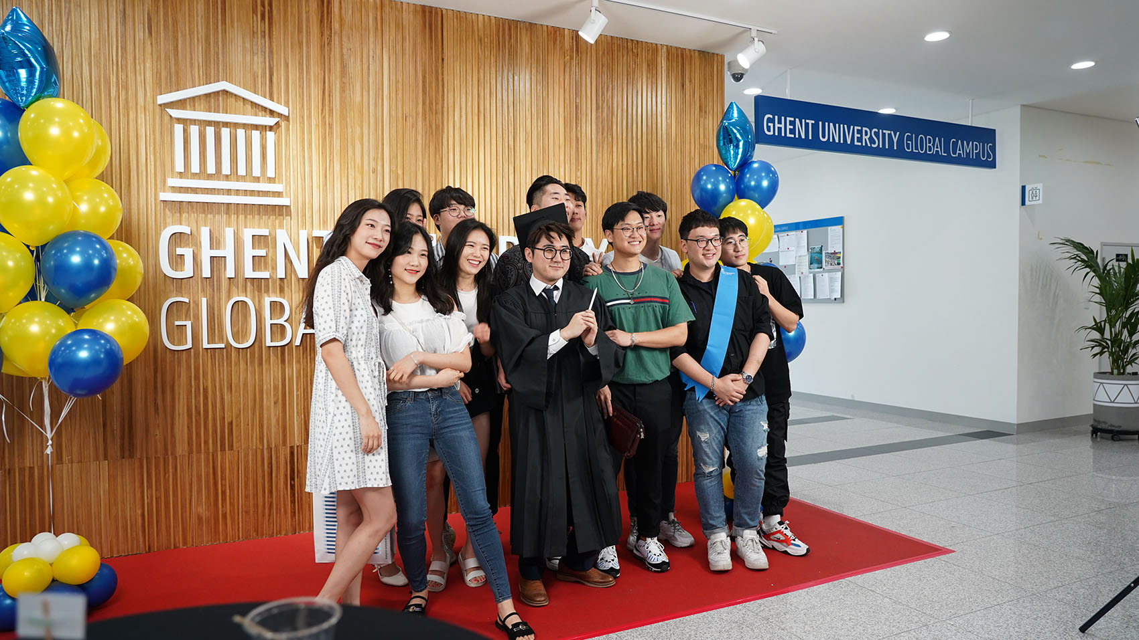
Bachelor programmes
4 years
BACHELOR OF SCIENCE
Global Campus, Incheon, Korea
Food Technology
Environmental Technology
Molecular Biotechnology
IN ENGLISH
Notes:
English-taught courses
The same degree as the main campus - Graduates of Ghent University Global Campus will receive the same “Bachelor of Science” degree as the main campus
Academic staff - The academic staff of Ghent University Global Campus consists out of professors who are permanently located at the Global Campus to teach and conduct research. Next to these permanent professors a number of specialized courses will be taught by highly-acclaimed professors assigned from the home campus (the flying faculty). Postdoctoral assistants and teaching assistants are present to help students with acquiring the course.
Interconnected operation three departments - Fundamental courses applicable to all students from the three departments will be taught as common courses. Particularly, the curricular for 1st and 2nd year students will consist entirely of common courses to help them prepare for advanced studies in their major.
STEM Education - All three educational programs are focused on the fields of study in the categories of science, technology, engineering, and mathematics. From day one, students focus on these fields of study which will give them a competitive advantage in their future careers in industry or as master student and researcher.
Theoretical background with hands-on practical experience - Unlike many institutions focusing only on lectures, Ghent University Global Campus offers both theoretical grounding in the material and practical techniques applicable to the real world. Theoretical lectures are taught to all students at the same time and practical exercises are organized in relatively small groups.
One semester at the main campus - Students in their third year will mandatory spend one semester at the main campus.
Intensive internship opportunities - Students will have internship opportunities at companies located in Songdo Bio-Cluster and other multinational companies and research centers in Korea and Europe.

Slide 17
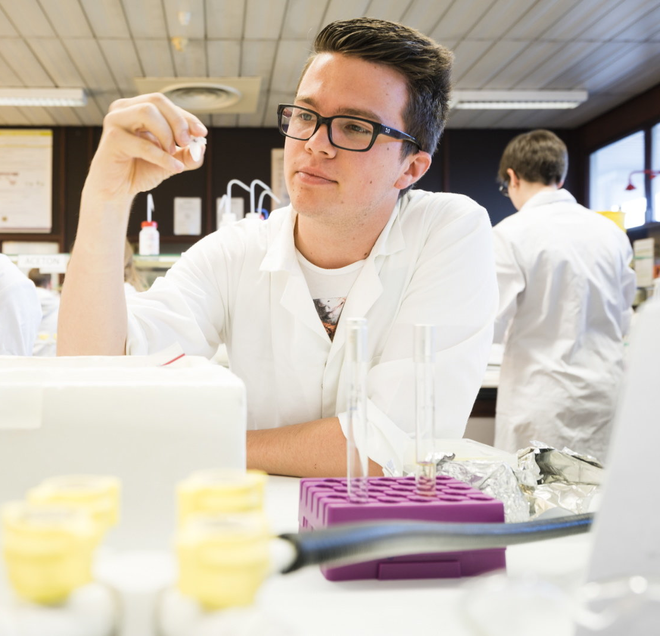
Master programmes
2 years
BIOSCIENCE ENGINEERING
Campus Coupure, Ghent
Master of Science in Bioscience Engineering:
Agricultural Sciences
Chemistry and Bioprocess Technology
Environmental Technology
Forest and Nature Management
Food Science and Nutrition
Land, Water and Climate Management
IN DUTCH
Notes:
De masteropleidingen Bio-ingenieur duren 2 jaar

Slide 18
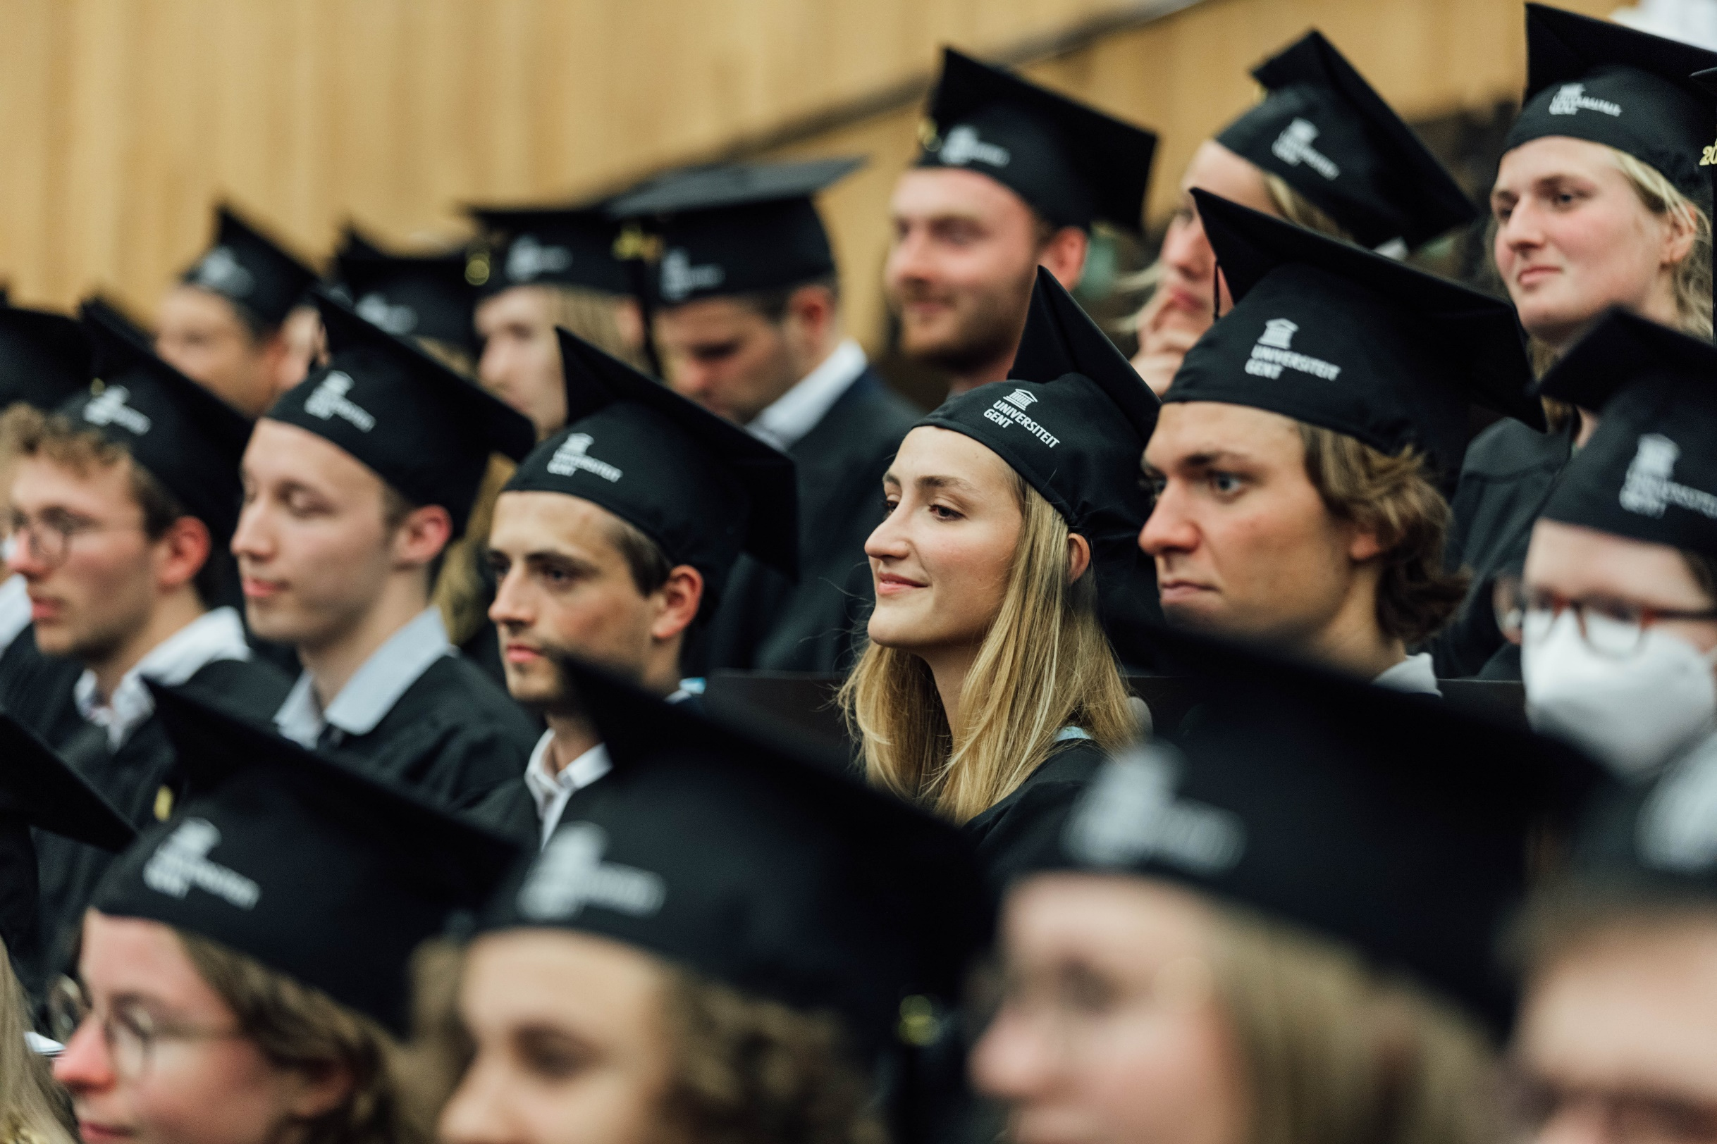
Master programmes
1 year
IN DUTCH
BIOSCIENCE ENGINEERING TECHNOLOGY
Campus Schoonmeersen, Ghent
Agriculture and Horticulture
Food Industry
Biochemical Engineering Technology
Notes:
De masteropleidingen Industrieel ingenieur duren 1 jaar

Slide 19
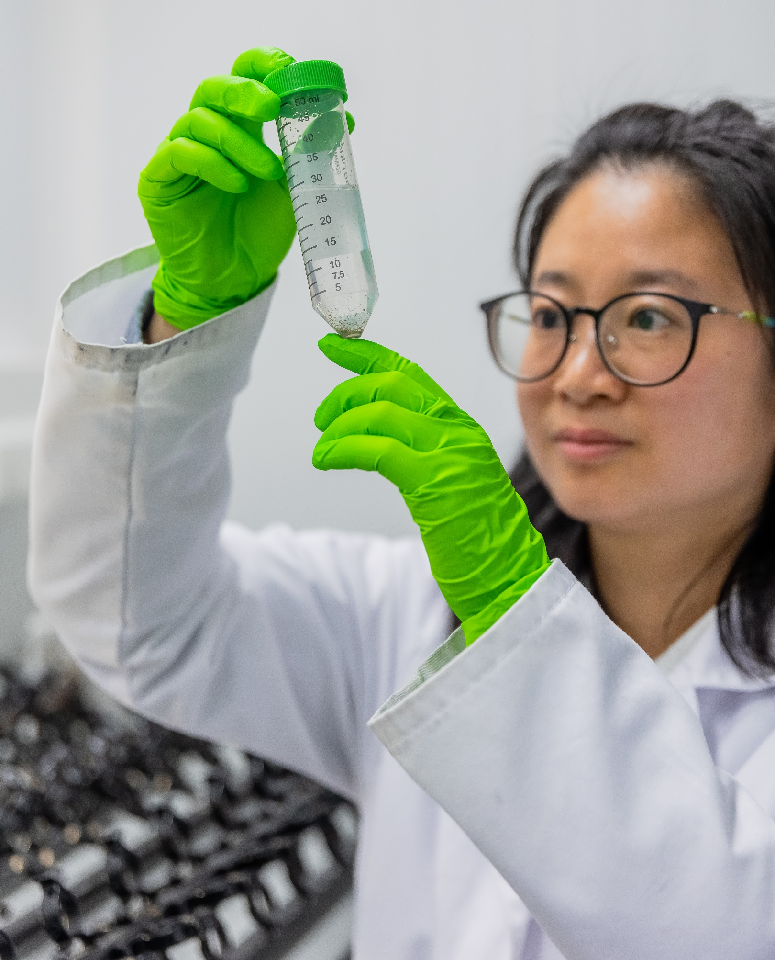
Master programmes
2 years
MASTER OF SCIENCE
Campus Coupure, Gent
  Aquaculture
  Bioscience Engineering: Cell & Gene Biotechnology
  Environmental Science & Technology
  Food Technology
  Bio-informatics: track Bioscience Engineering
  Nutrition and Food Systems
  Pharmaceutical Engineering
IN ENGLISH
Notes:
Every year, more than 250 students from more than 80 countries come to study at our faculty, spread over different international master programmes.
These programmes (except of the Master of Science in Cell & Gene Biotechnology and Bio-informatics) are supported by the International Training Centre of the faculty. The programmes are based on development cooperation (VLIR-UOS) or Erasmus Mundus cooperation programmes. Unlike in the Dutch master programmes, students don’t obtain the title of engineer when studying these programmes.
Partners for internationalisation:
VLIR UOS
Erasmus Mundus
Erasmus+
Industrial partners (e.g. Nestlé, Taminco, Agrimex/Nutrex)

Slide 20
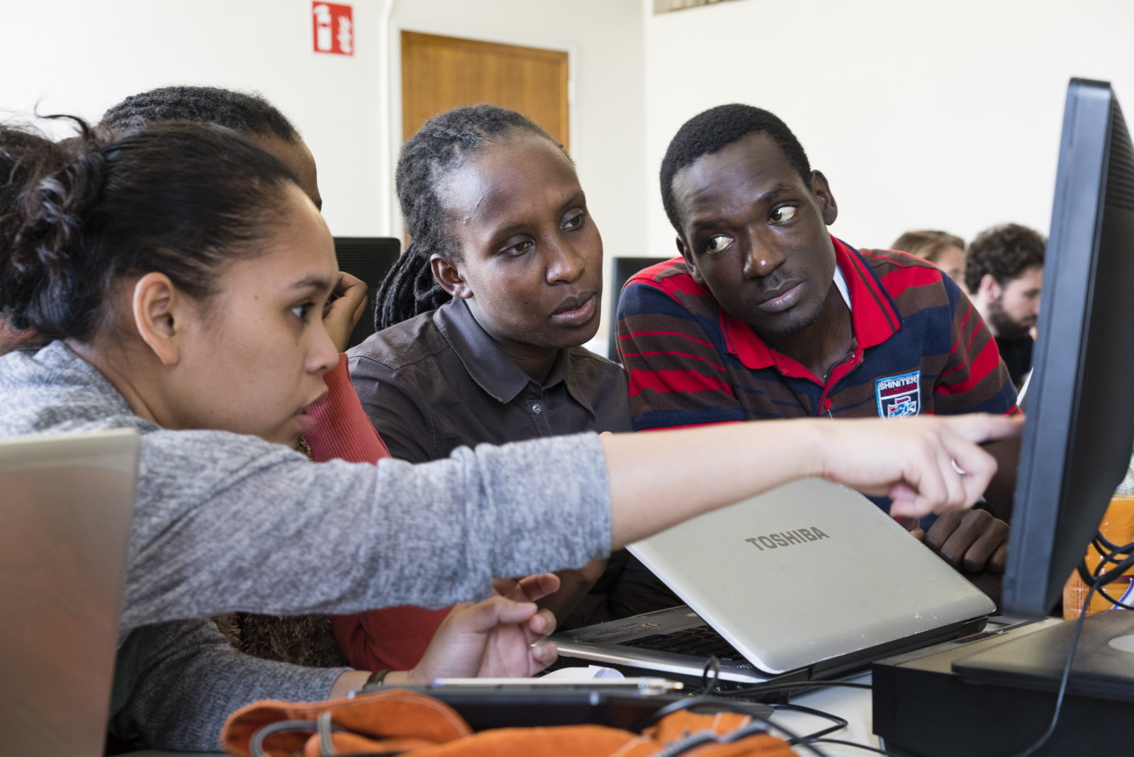
Master programmes
IN ENGLISH
2 years
INTERNATIONAL MASTER OF SCIENCE / ERASMUS MUNDUS - Campus Coupure, Gent
  Environmental Technology and Engineering
  Health Management in Aquaculture
  Rural Development
  Soils and Global Change
  Sustainable and Innovative Natural Resource Management

Slide 21
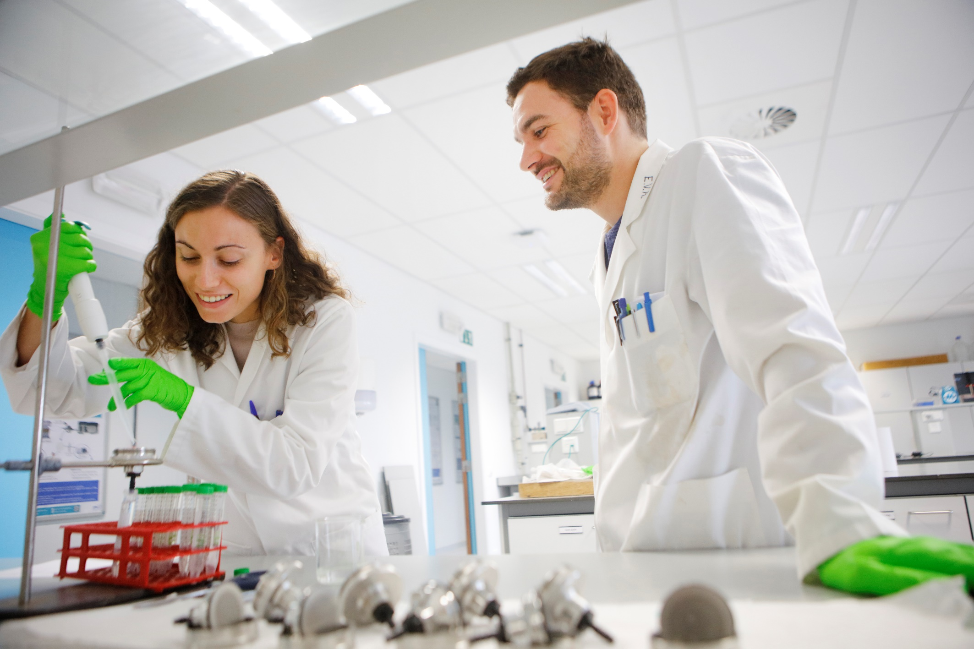
Other programmes
SHORT TRAINING
  Summer schools
  Introduction courses
  Welcome programme
  Training programmes (14 days up to 3 months)
  Refresher courses
DOCTORAL TRAINING
  (Bioscience) Engineering
  Life Sciences and Medicine

Slide 22
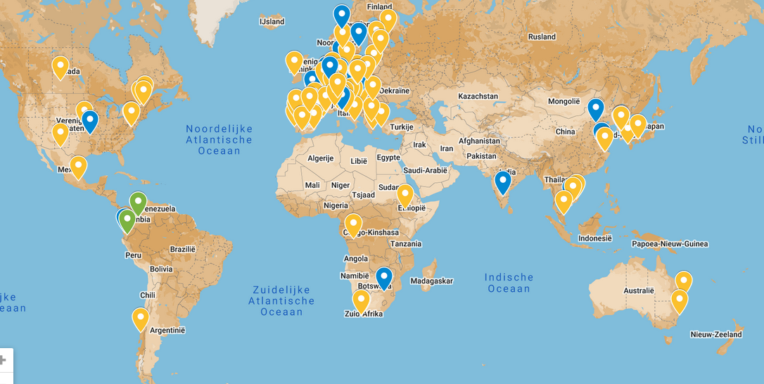
INTERNATIONAL NETWORK
More than 160 cooperation partners
Staff mobility
Course units
PhD programmes
Internships
Master dissertation
Notes:
Overview of our partner universities: http://www.ugent.be/bw/en/faculty/cooperation/projects-south

Slide 23
research

Slide 24
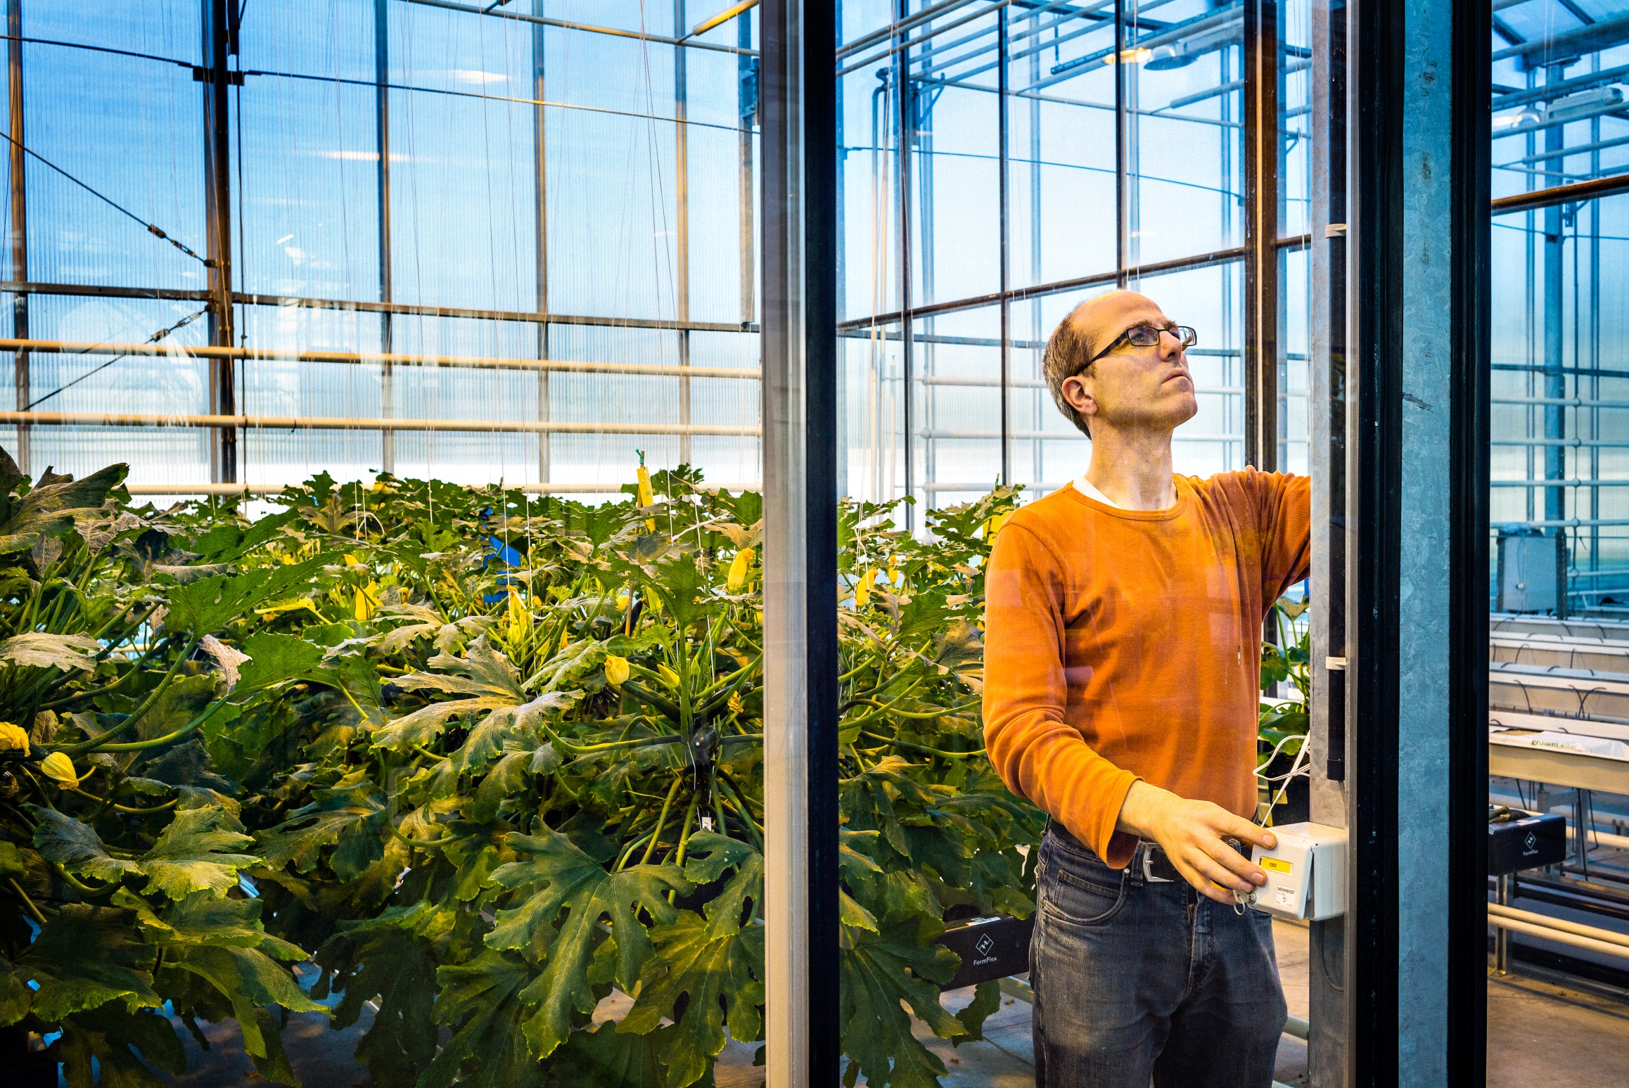
research
Innovative and sustainable solutions for global challenges
European Top 5
51,4 million
euros per year Investment
in research
Collaborations with over 300
organisations
1.000 researchers
110 professors
900 A1-publications
a year
120 PHD’s
A year
Notes:
In our research, we seek solutions in the areas of natural capital, nutrition, health, waste processing, the environment, and climate change.
Our faculty ranks among the top five European research institutions in the field of life sciences.
With approximately 700 A1 publications per year, we score higher than the general UGent average.
We focus strongly on collaboration with external companies and organizations, both nationally and internationally. In international research collaboration, we focus on partners in both the North and the South.

Slide 25
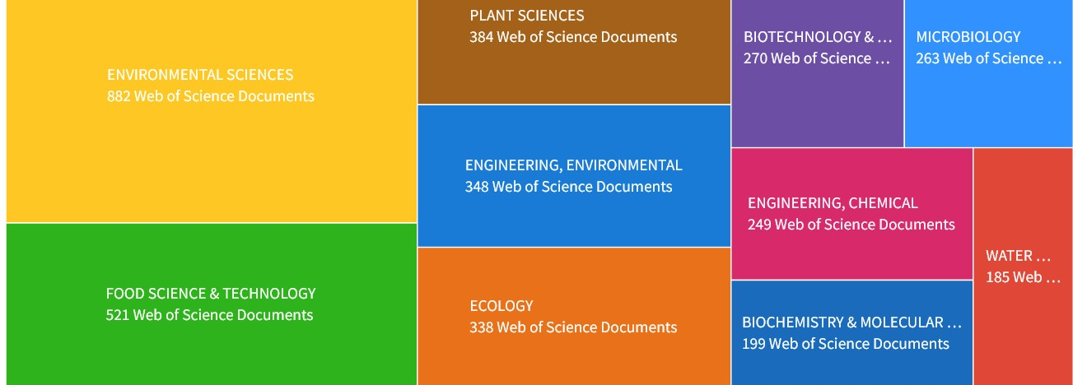
Research areas

Slide 26
Research finance

Slide 27
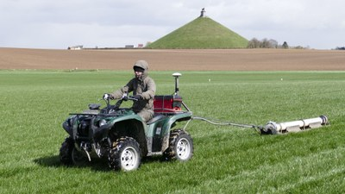
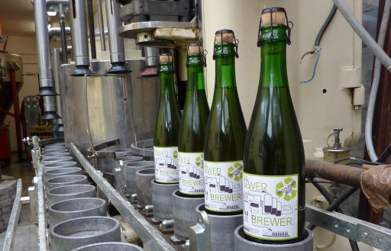
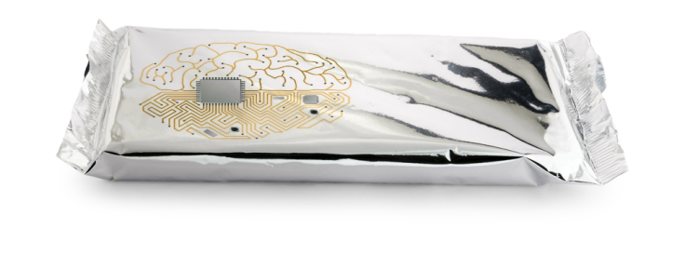
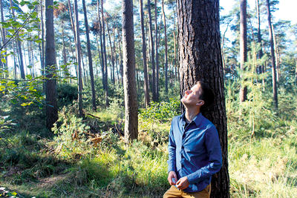
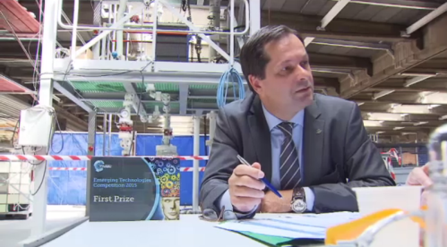
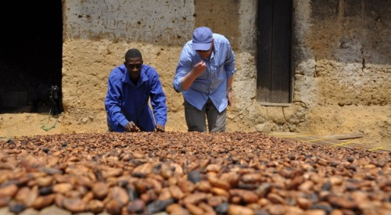
impact
Soil scan: precision farming technology that can also be used more broadly
Beer made from recycled wastewater
Smart packaging with sensors
Innoveren van cacaoproductie Ghana
Trees remove fine dust
Chemical heat pump
Innovating cocoa production in Ghana
Notes:
Precision farming techniques that can also be used more widely (Soil scan, Stonehenge) -> primary production
Beer from wastewater -> clean environmental technology; we also have our own brewery (Schoonmeersen campus: Bijlokebier)
Smart packaging for food -> engineering & food waste (food & health)
Forests remove particulate matter -> Natural Capital; health
Chemical heat pump -> green chemistry, clean environmental technology
Cocoa agroforestry and chocolate production -> primary production, food processing

Slide 28

knowledge transfer
Knowledge transfer centres
To improve business performance through scientific innovation and new collaborations
Exchange knowledge between supply and demand sides with high-quality, easy-to-use services
To give companies the opportunity to expand their national and international network
Notes:
Various Knowledge Transfer Centers connect our faculty's research with society.

Slide 29
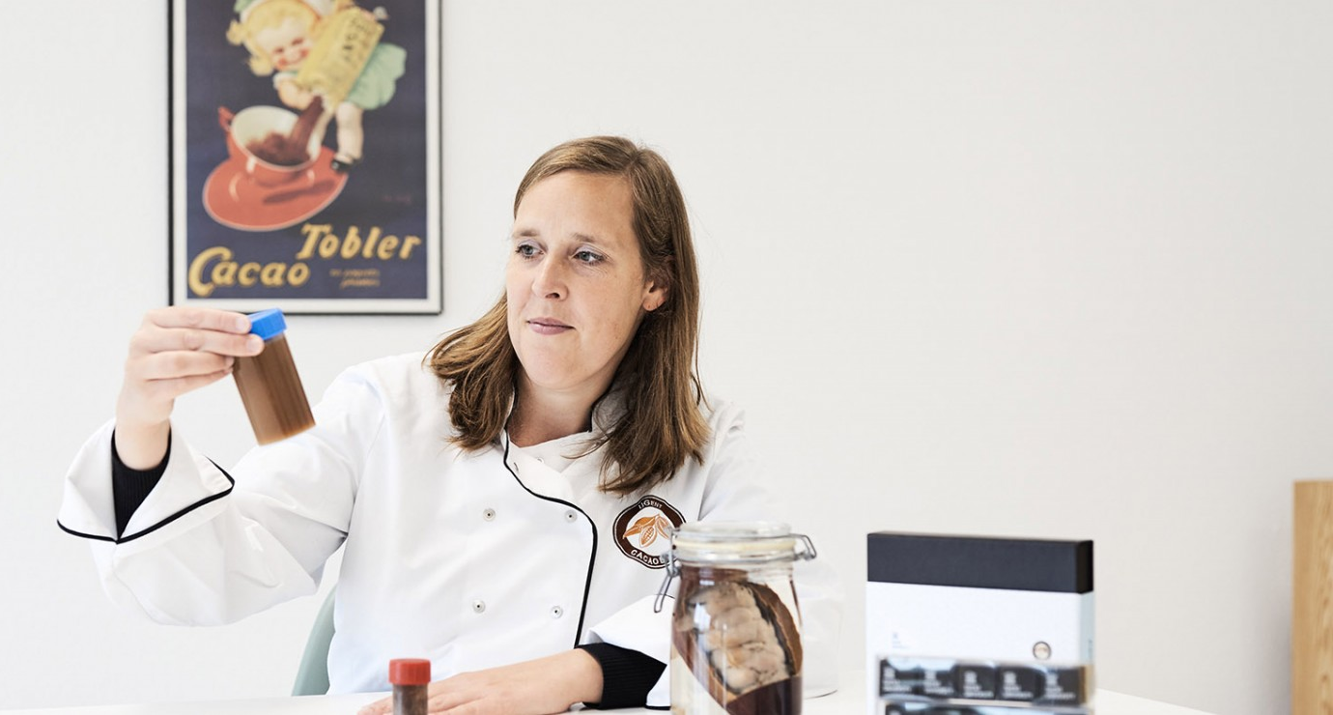
Spin-offs
AM-TEAM
Designs advanced modeling for process optimization, design, and accelerated upscaling.
Amphistar
Ecological production of surface-active substances of microbial origin.
Avecom
Controls and optimizes microbial processes.
Biotim (acquired by Waterleau)
Wastewater treatment technology
Cacaolab
Creates innovative chocolate products and processes; stimulates export of chocolate products
e-Coast (acquired by Eurofins)
Marine and maritime research
EPAS (acquired by Seureca Veolia)
Eco-process assistance
Hydrohm
Renewable electrochemical treatment of water
Imaqua
Contract research for aquaculture
Inbiose
Produces specialized carbohydrates
Innolab
Provides services related to biogas production, wastewater treatment, and biomass analysis
Kytos
Microbiome screening in various industrial processes
Notes:
Spin-offs ensure that research developed at the Faculty of Bioengineering Sciences is converted into applications that are useful for industry.

Slide 30
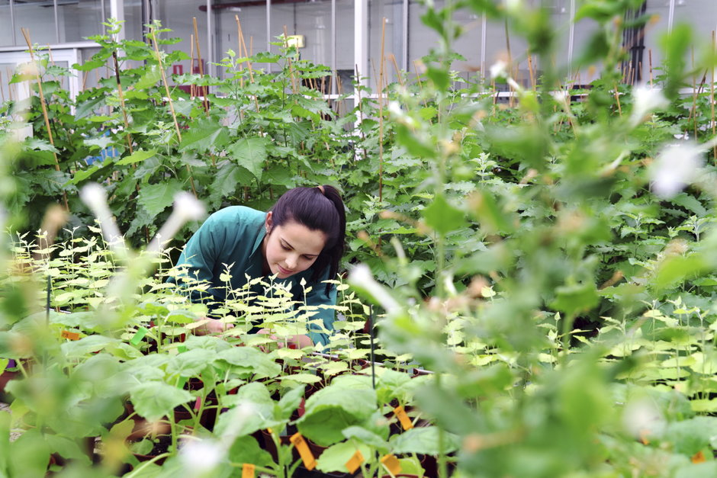
Spin-offs
MRM Health
Develops medication based on the microbiome
Olfascan
Develops solutions for odor problems
Shelfion (formerly I-Challenge)
AI-driven shelf-life optimization to reduce food waste
Phyto-IT
Develops software for botany in agriculture and horticulture.
Primoris
Analyzes pesticide and mycotoxin residues in food and animal feed.
Prodigest
Develops testing platforms in the field of gastrointestinal transit, bioavailability, and metabolism of food and medicines.
Progeno
Develops software for qualitative crop crossing and selection methods
Qpinch
Converts residual heat into energy
Statter
Design, statistical data analysis, and reporting
Terracottem
Soil condition technology
Obulytix
AI-engineered lysins combating antibiotic-resistant bacteria.
Notes:
Spin-offs ensure that research developed at the Faculty of Bioengineering Sciences is converted into applications that are useful for industry.

Slide 31
departments

Slide 32
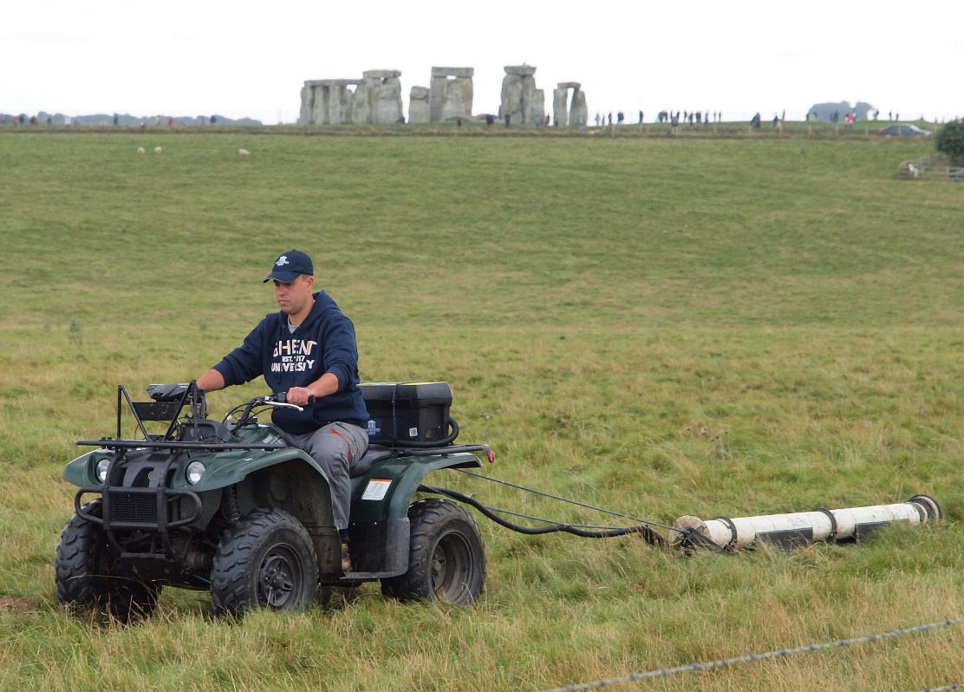
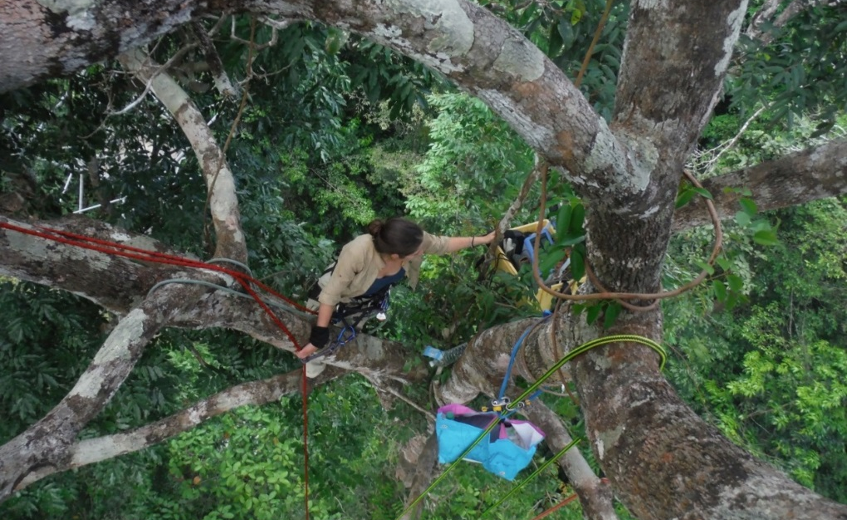
Department environment
Cutting-edge research for a better understanding, conservation and management of the world’s natural capital, combined with high-quality education in the stewardship of natural resources.
Topics:
  Impact of climate change on ecosystems
  Bioeconomy, ecosystem services, and nature-based solutions
  Resilience and robustness of ecosystems
  Interdisciplinary, multidisciplinary, and transdisciplinary research
Impact:
  • Providing an independent, critical voice through the Natural Capital Research Platform
  • Increasing awareness and action for the conservation and sustainable management of natural resources

Slide 33
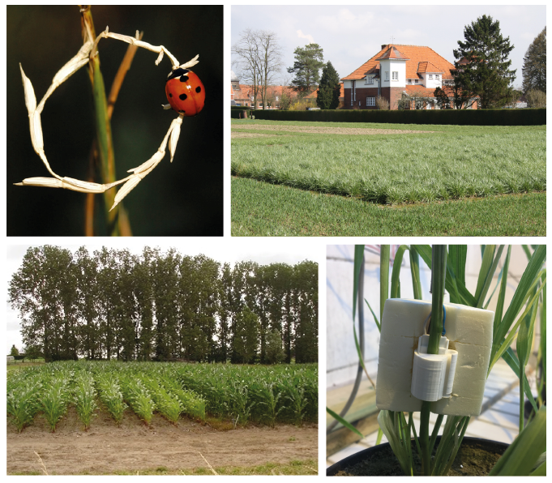
Department of Plant and Crop Sciences
Generating knowledge and providing education on the creation, ecophysiological functioning and cultivation of healthy plants and crops within dynamic, socially responsible production systems.
Topics
• Production systems
• Plant breeding
• Ecophysiology
• Diseases, pests, weeds and their integrated management
• Applied entomology and acarology
• Biotechnology
• Monitoring and modelling
Impact:
• Sustainable production of plants and crops for diverse applications
• Educating plant and crop scientists with open, critical minds and an engineering mindset

Slide 34
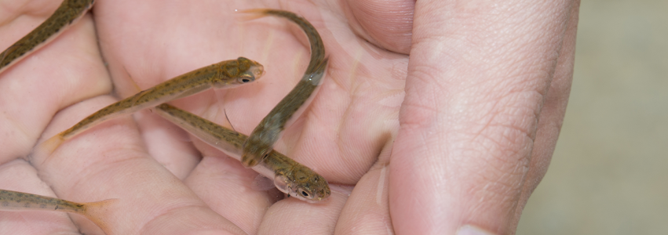


Department of Animal Sciences and Aquatic Ecology
Research, education, and social services related to various functions of animals for humans, including sustainable production of healthy food and the evaluation of anthropogenic influences on the environment in terms of optimal and sustainable exploitation.
Topics:
Animal feed and quality of animal products
Data-driven animal management
Immunology and biotechnology for humans and animals
Larviculture of aquatic animals
Integrated aquaculture
Aquatic ecology
Marine biotechnology & marine bioeconomy
Impact:
High-quality, safe, and sustainable use of animals with minimal impact on the environment and climate. Ecologically relevant risk assessment of anthropogenic environmental disruption in the context of sustainability policy.

Slide 35

Department of FOOD TECHNOLOGY, FOOD SAFETY, AND HEALTH
Internationally innovative research in food technology, chemistry, microbiology, nutrition, and health.
The department is committed to conducting versatile applied and fundamental research with significant societal relevance, in national and international collaboration with the food industry, government, consumer organizations, and other stakeholders.
Topics:
Food technology
Food chemistry
Food microbiology
Food packaging
Nutrition and health
Impact:
Providing consumers with tasty, safe, and nutritious food.
Interaction with various stakeholders: the food industry, the research community, government, and NGOs.

Slide 36
Green Chemistry & Technology Department
Internationally recognized research in both fundamental and applied aspects of chemistry in bioengineering sciences. From sophisticated analysis, (bio)chemical conversion, physicochemical purification techniques to sustainable process design.
Topics:
Advanced analytical chemistry and ultra-trace mass spectrometry
Applied eco-chemistry with an emphasis on trace elements, isotopes, and organic micropollutants
Organic synthesis, sustainable raw materials, bio-organic chemistry, and microreactor technology
Particle and interface technology
Thermochemical conversion of biomass
Ecotechnology for air and water purification and recycling of raw materials
Control of biosystems
Life cycle analysis and sustainable process development
Catalysis
Impact:
Sustainable (re)use of bio-based raw materials and natural resources
Accessible technology for different target groups (e.g., developing countries, etc.)
Expertise and services for SMEs and non-profit organizations in the field of water treatment and reuse.

Slide 37

biotechnology department
Innovation through molecular characterization and optimization of biological organisms and processes for applications in agriculture, the food industry, the environment, and the medical world.
Topics:
Nanobiotechnology
Microscopy
Plant biotechnology
Epigenetics
Plant-pathogen interactions
Protein engineering
Metabolic engineering
Synthetic biologyIndustrial biotechnology
Microbial production and recovery of raw materials
Brewery and fermentation technology
Biological water treatment
Microbe-host interactions
Microbial ecology
Impact:
Optimizing biological organisms and processes for sustainable production and human health

Slide 38

Data Analysis and Mathematical Modeling Department
Multidisciplinary engineering approach to the entire data-to-decision cycle of biosystem modeling for science, industry, and society
Topics:
Data analysis for living matter: biostatistics and bioinformatics
Modeling of biological and natural processes
Design and optimization of processes for the reuse of raw materials and pharmaceuticals based on mathematical models
Impact:
Promotion and implementation of high-quality data analysis and modeling solutions for scientific, industrial, and societal problems.

Slide 39


department of agricultural economics
Economic and socio-political analyses of agriculture and food ‘from farm to fork’ in urban, semi-urban, and rural areas around the world.
Topics:
Agriculture and rural economy
Agri-food marketing
Consumer behavior
Business management
Agribusiness and supply chain management
Natural resource management
Agricultural and environmental policy analysis
Institutional, sociological, and political analysis
Impact:
Policy advice at local and (inter)national level
Capacity building in the South

Slide 40




@fbw.UGent
Faculteit Bio-ingenieurswetenschappen UGent
@fbwUGent
Faculty of Bioscience Engineering
www.ugent.be/bw

