Slide 1



Erasmus Mundus Master Global Studies Info session 23/01/2023

Slide 2
European Master in Global Studies
two-year internationally organised Master programme
founded in 2005 by four European universities:
Leipzig (coordinator), LSE, Vienna, Wroclaw
Roskilde joined in 2010
Ghent joined in 2017
courses are offered in English
international composition of the student body
funded by the EU’s excellence program “Erasmus Mundus”
See: https://globalstudies-masters.eu/about/erasmus-mundus-a-joint-program/

Slide 3

Erasmus Mundus programme
Objectives of the Erasmus Mundus programme:
to promote a quality offer in higher education with a distinct European added value
to encourage and enable highly qualified graduates and scholars from all over the world to obtain qualifications and/or experience in the EU
to improve accessibility and enhance the profile and visibility of higher education in the EU
http://eacea.ec.europa.eu/erasmus_mundus/

Slide 4
Global Studies as a research field
transnational: focused on the analysis of ideas, processes, events, activities, trends, flows and phenomena that appear across national boundaries and cultural regions.
interdisciplinary: global phenomena are of economic, political, cultural, social, religious, ideological nature and can not be explained from the perspective of one discipline only
both contemporary and historical: the contemporary patterns of globalization can be fully understood only by analysing their historical precedents.
postcolonial and critical: critical examination of eurocentric approaches and academic imperialism; comparative perspective and the notion of multiple globalisations

Slide 5
Master of Arts in Global Studies
Research-based Master: combining perspectives, methods and theories developed in history, the social sciences, cultural as well as area studies and economics to investigate phenomena of global interconnectedness.
We understand the phenomena described as globalisation as a combination of political, economic, social and cultural projects to manage increasing transnational and transcontinental connectedness (the so-called global condition).
The multinational classroom of the programme and the cross-over of contributions from various disciplines and universities offer a substantial added value to the study of processes of globalisation.

Slide 6
International Master
Consortium of 6 European partners:
University of Leipzig (Germany) – coordinator and contact
Ghent University (Belgium)
University of Vienna (Austria)
University of Wroclaw (Poland)
University of Roskilde (Denmark)
London School of Economics (UK)
See: https://globalstudies-masters.eu/about/members/

Slide 7
International Master
and 9 world-wide partners:
Addis Abeba University (Ethiopia)
Dalhousie University (Halifax, Canada)
Fudan University (Shanghai, China)
Jawaharlal Nehru University (New Delhi, India)
Macquarie University (Sydney, Australia)
University of California at Santa Barbara (USA)
University of Otago (Dunedin, New Zealand)
Stellenbosch University (South-Africa)
University of Yaoundé (Cameroun)
See: https://globalstudies-masters.eu/about/partners/

Slide 8
Study programme
12 modules of 10 ECTS – common features:
Term 1: introduction to Global Studies
Term 2 and 3: studying concrete themes from different disciplines and world-regional angles
Term 4: Master thesis and courses helping students to frame their individual work within the larger research agenda of Global Studies
All modules comprise history, cultural, area studies, social or political science approaches to historical and contemporary processes of globalisation
See: https://globalstudies-masters.eu/program/a-joint-curriculum/

Slide 9
Mobility track
First Year (Term 1 & 2) - European Study Places
Gent
Wrocław
Second Year (Optional 3rd Term Mobility)
USA
China
Second Year (Team *3 &* 4) - European Study Places
Gent
Wrocław
Leipzig
Roskilde
Vienna
Canada
New Zealand
Australia
South Africa
Ethiopia
Cameroon
India
Leipzig
Roskilde
Vienna

Slide 10


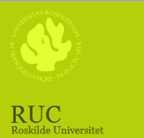


Specialisations per European partner
Ghent University (Belgium)
World History and Political Economy, Conflict and Development, Europe as a Global Actor, and area studies of Africa, the Middle East, Asia, and Latin America.
Leipzig University (Germany), Co-ordinating institution of the Consortium
Comparative analysis of global entanglements both historically and for the present times, focusing on Europe, Africa, the Middle East, East Asia, and the Americas as well as on the transregional ties between these parts of the world.
Roskilde University (Denmark)
Development studies, global political economy and global governance, political culture and civil society
University of Vienna (Austria)
International organizations, global history from 1500, a regional focus on East Asia, sub-Saharan Africa, Central Europe, and Latin America.
University of Wroclaw (Poland)
Recent transformation processes in Central and Eastern Europe, security issues, regional cooperation, communications, and media.

Slide 11









Addis Ababa University (Ethiopia)
Peace and Security, Gender Studies, Human Rights and Development Cooperation
Dalhousie University (Canada)
International Developmental Studies, Environmental Issues and Comparative Theory
Fudan University (China)
Modernity in Asia and Europe compared, Modern Chinese History and International Relations from a Chinese Perspective
Jawaharlal Nehru University (India)
Focus on Economics, Levels of Regional Development in India, Government and Politics in India
Macquarie University (Australia)
Globalization and Sustainable Development, the International System and the North-South Relationship
Otago University (New Zealand)
Studies of Asia, Europe and Latin America, Global Governance, etc.
University of California at Santa Barbara (USA)
Global Culture and Religion, Sustainable Development and the Environment, Contemporary Globalization
University of Stellenbosch (South Africa)
Focus on Global Political Economy, Conflict Studies and Negotiating Transition
University of Yaoundé (Cameroon)
Socio-cultural, Political and Economic Aspects of Postcolonialism

Slide 12
Joint activities in the programme
Joint admission and selection procedure
Circulation of Information: newsletter, website, mailing list
Assessment of courses and the consortiums performance
Joint or double degrees
Spring School
Online Winter School or Excursion
Graduation Ceremony (November of graduation year)

Slide 13
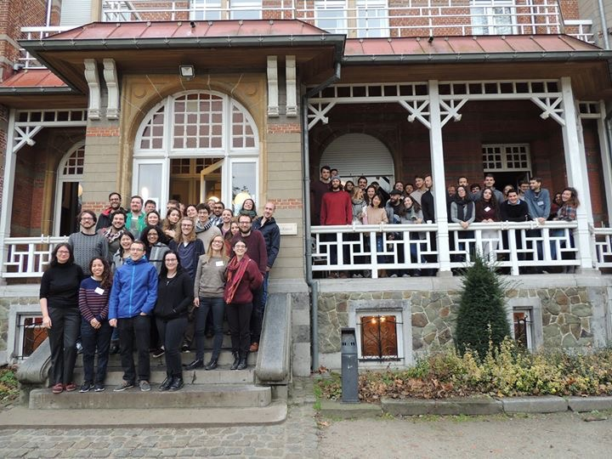
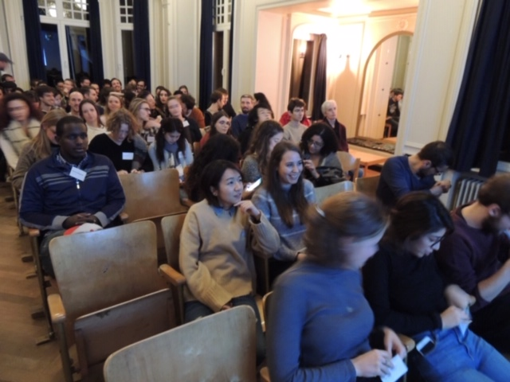
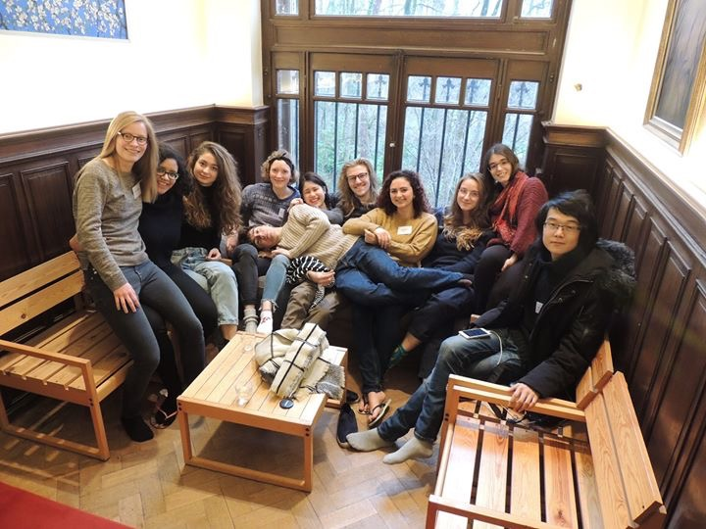
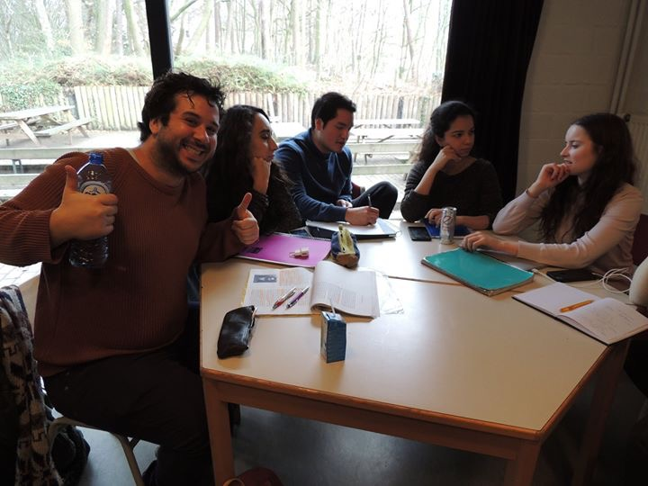
Winter school
Belgium, Lokeren,
December 2018

Slide 14
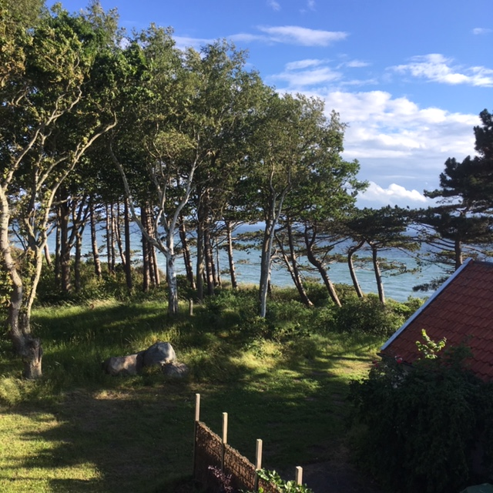

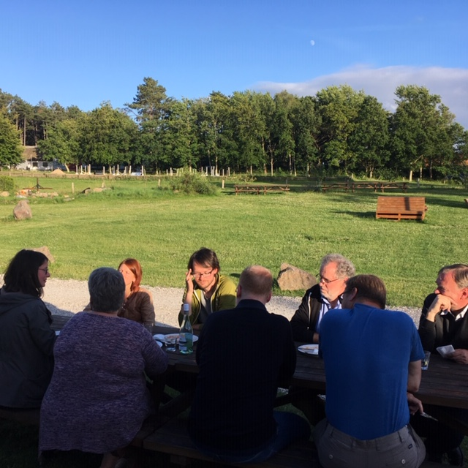
Summer school
Jagerspris, Denmark,
July 2017

Slide 15


EMGS @ UGent
Academic seat:
Ghent Centre for Global Studies
Administrative seat:
Faculty of Political and Social Sciences
in cooperation with the Faculty of Arts and Humanities
Academic contact and representative to the consortium:
Professor dr. Eric Vanhaute – Eric.Vanhaute@ugent.be
Dept. of History (Faculty of Arts & Humanities, Campus Ufo, Sint-Pietersnieuwstraat 35)
Programme coordination and administrative contact:
Starry Chung, dr. Julie Carlier and Marissa Van Laecke – emgs@ugent.be
Dept. of Conflict and Development Studies (Faculty of Political and Social Sciences, Campus Ufo-Technicum, Sint-Pietersnieuwstraat 41)

Slide 16
EMGS @ UGent
Ghent Centre for Global Studies:
Interdisciplinary research platform, uniting 8 research groups from 5 different faculties in Social Sciences and Humanities
EMGS courses and lecturers from:
Global History and Global Ethics (Faculty of Arts & Philosophy)
Conflict and Development Studies, International and EU Studies (Faculty of Political & Social Sciences)
General economics (Faculty of Economics & Business Administration)
Human Rights Law (Faculty of Law)

Slide 17


Slide 18
EMGS @ UGent
PROGRAMME AT A GLANCE: MODULES
First year
https://studiekiezer.ugent.be/master-of-arts-in-global-studies-en/programma/2023
(First year + course schedule per semester)*
Introduction to Global History and Global Studies
Global governance and Global Justice
Conflict and Development in a Globalizing World I
History and Political Economy of Global Capitalism
Europe as a Global Actor
EMGS Joint Winter (online) and Spring School
* Program subject to change – new courses on offer as from 2022-2023

Slide 19
EMGS @ UGent
PROGRAM AT A GLANCE: MODULES
Second year
https://studiekiezer.ugent.be/master-of-arts-in-global-studies-en/programma/2023
(Second year + course schedule per semester)*
7. Global History: Europe and the World
World Societies: Regions in Global Studies I
World Societies: Regions in Global Studies II
Conflict and Development in a Globalizing World II
11. Advanced Research Seminar in Global Studies
Master Thesis
* Program subject to change

Slide 20
EMGS @ UGent
First year study program – modules:
Introduction to Global History and Global Studies – 2 mandatory courses
Critical Global Theories – 5 ECTS
(Master dissertation I) Research Seminar Global Studies – 5 ECTS
Global governance and Global Justice – choose 2 out of 3 electives
Globalisation and Global Governance – 5 ECTS
Global Ethics – 5 ECTS
EU and Global Justice* – 6 ECTS
Conflict and Development in a Globalizing World I – 2 mandatory courses
Politics of conflict – 5 ECTS
Seminars in Politics of Conflict and Development – 5 ECTS

Slide 21
EMGS @ UGent
First year study program – modules:
4. History and Political Economy of Global Capitalism – 2 mandatory courses
Introduction to Global Economic History – 5 ECTS
Economic Globalisation – 5 ECTS
5. Europe as a Global Actor – choose 2 electives
EU East Asia Relations – 5 ECTS
European Union Trade Policy – 5 ECTS
The European Union’s Neighbourhood Policies – 5 ECTS
The European Union’s International Development Policies – 5 ECTS
Global Energy Politics – 5 ECTS
Grand Strategy and the Multipolar World* – 6 ECTS
Joint Winter (online) and Spring school – mandatory
– 5 ECTS each (10 ECTS in total)
all EMGS students from all 6 European partner universities

Slide 22
EMGS @ UGent
Second year study program – modules:
Global History: Europe and the World – choose 2 electives
History of Globalisation – 6 ECTS
European overseas expansion in Global History, 1500-1800 – 5 ECTS
Research Seminar: World History – 5 ECTS

Slide 23
EMGS @ UGent
Second year study program – modules:
World Societies: Regions in Global Studies I – choose 2 electives
Research Seminar: History of Africa – 5 ECTS
Poverty, development and inequality in Modern African History – 5 ECTS
Conflict and Society in Central and Eastern Africa – 5 ECTS
Contentious Politics in North Africa – 5 ECTS
Capital and class in the Middle East – 5 ECTS
State and Society in Asia – 5 ECTS
History of the Americas – 5 ECTS
Culture in Perspective: South and East Asia – 6 ECTS
Culture in Perspective: Near East and the Islamic World – 6 ECTS
Russia between East and West – 5 ECTS
Literature, Media and the Arts in Central and Eastern Africa – 5 ECTS
Politics of memory in Southeast Europe – 5 ECTS
World Societies: Regions in Global Studies II – choose 2 electives (other than the ones selected in module 8) from the same list as module 8

Slide 24
EMGS @ UGent
Second year study program – modules:
Conflict and Development in a Globalizing World II – choose 2 electives
Urbanisation in a Global Perspective – 5 ECTS
Human Rights in Developing countries – 5 ECTS
Gender and globalisation – 5 ECTS
Postcolonial Studies – 5 ECTS
Sustainable Development – 5 ECTS
Rural Sociology – 5 ECTS
Politics of Islam – 5 ECTS
Transnationalism and Migration – 5 ECTS

Slide 25
EMGS @ UGent
Second year study program – modules:
(Master dissertation II) Advanced Research Seminar Global Studies – 5 ECTS
Global Studies Research Seminar – themes and methodologies
Thesis tutorials
(Master dissertation III) Master’s thesis – 15 ECTS

Slide 26
Admission criteria
Applicants should fulfill the following minimal requirements:
A three-year bachelor’s degree or the recognized equivalent from an accredited institution in the humanities or social sciences, with a minimum of 15% global studies–relevant courses
Excellent English skills: Proficiency in English needs to be proven with an official English certificate. Native English speakers must provide proof of knowledge of a language other than English at the A2 level
Knowledge of another foreign language at the A2 level (to be proven by a high school certificate and/or an internationally recognized test, score certificates, or equivalent proof of participation in language courses)
The recognition of the respective documents and degrees is based on the requirements set by the German Central Office for Foreign Education.
See: https://globalstudies-masters.eu/admission/application/admission-and-selection-criteria/

Slide 27
Selection criteria
The decision on admission is made by the EMGS Study Purposes and Selection Committee and are based on the following criteria:
50%: Academic excellence and quality/recognition of home institution that has awarded the first degree
15%: Motivation and academic potential
20%: Compatibility of previous degree(s) with the EMGS programme
15%: Work experience/professional qualifications
See: https://globalstudies-masters.eu/admission/application/admission-and-selection-criteria/

Slide 28
Application
How to apply? https://globalstudies-masters.eu/admission/application/application-documents/
Documents to be included in the application:
A curriculum vitae in English (cf Europass)
Motivation letter in English
Proof of nationality (e.g. copy of passport)
Proof of residence (only for applicants who wish to apply for the Erasmus Mundus scholarship)
High school diploma or equivalent
Official high school transcripts
University diplomas
Official transcripts from your university
English language certificate test results (TOEFL, IELTS, CPE/CAE)
Proof of knowledge of another foreign language
One recommendation letter by an academic teacher
If applicable, proof of extracurricular activities and work experience

Slide 29
Language certificates
TOEFL: https://www.ets.org/toefl – Brussels
IELTS: https://www.ielts.org – British Council Brussels
CAE: http://www.cambridgeenglish.org – British Council Brussels

Slide 30
Application
Deadlines:
31 March 2023 (application for admission & Erasmus Mundus grant)
31 May 2023 (application admission for “self-paying” students)
Applicants will be informed at the latest at the end of July about the outcome of their application.
The application for EMGS is at Leipzig University (no matter if your preferred mobility track includes Leipzig University or not).
Online application information: https://globalstudies-masters.eu/admission/application/application-documents/

Slide 31
Fees and support
See: https://globalstudies-masters.eu/admission/fees-support/
tuition fee of € 4,000 per year to nationals from Erasmus+ programme countries (EU / EEA – EFTA)
tuition fee of € 5,500 per year to all other nationals
Regular Erasmus + scholarship possibilities for mobility between European partner universities (from year 1 to 2)
Limited fee waivers of €2500 available (based on scores on selection criteria)
Limited number of Erasmus Mundus Scholarships is available, see: https://globalstudies-masters.eu/admission/fees-support/eligibility-for-erasmus-mundus-scholarships/

Slide 32
Further information
https://www.facebook.com/europeanmasterglobalstudies/
https://globalstudies-masters.eu
Application procedure: https://globalstudies-masters.eu/admission/application/
Fees and support: https://globalstudies-masters.eu/admission/fees-support/
Contact coordinating University – Leipzig:
European Master in Global Studies Global and European Studies Institute Emil-Fuchs-Str. 1, 04105 Leipzig, GERMANY
For any question regarding the application (requirements, documents and procedure), please contact: em@uni-leipzig.de
See also FAQ: https://globalstudies-masters.eu/contact-faq/faq/

Slide 33
Coordination and contact – UGent
Starry Chung, Julie Carlier and Marissa Van Laecke
Faculty of Political and Social Sciences
Sint-Pietersnieuwstraat 41
9000 Gent
emgs@ugent.be

