Slide 1



Erasmus Mundus Master Global Studies
Info session 30/01/2025

Slide 2
Erasmus Mundus Master Global Studies
Two-year internationally organised Master programme
Founded in 2005 by four European universities:
Leipzig (coordinator), LSE, Vienna, Wroclaw
Roskilde joined in 2010
Ghent joined in 2015
LSE is not part of the consortium anymore. Instead, a Double Master in Global Studies and Economic History was launched in 2023.
Nine non-European partner universities
Courses are offered in English
International composition of the student body
Funded by the EU’s excellence programme “Erasmus Mundus”

Slide 3

Erasmus Mundus Programme
Objectives of the Erasmus Mundus programme:
to promote a quality offer in higher education with a distinct European added value
to encourage and enable highly qualified graduates and scholars from all over the world to obtain qualifications and/or experience in the EU
to improve accessibility and enhance the profile and visibility of higher education in the EU
http://eacea.ec.europa.eu/erasmus_mundus/

Slide 4
Global Studies as a research field
Transnational: focused on the analysis of ideas, processes, events, etc that appear across national boundaries and cultural regions.
Interdisciplinary: global phenomena are of various nature and can not be explained from the perspective of one discipline only
Both contemporary and historical: the contemporary patterns of globalisation can be fully understood only by analysing their historical precedents.
Postcolonial and critical: critical examination of eurocentric approaches and academic imperialism; comparative perspective and the notion of multiple globalisations
Notes:
Transnational: focused on the analysis of ideas, processes, events, activities, trends, flows and phenomena that appear across national boundaries and cultural regions.
Interdisciplinary: global phenomena are of economic, political, cultural, social, religious, ideological nature and can not be explained from the perspective of one discipline only
Both contemporary and historical: the contemporary patterns of globalization can be fully understood only by analysing their historical precedents.
Postcolonial and critical: critical examination of eurocentric approaches and academic imperialism; comparative perspective and the notion of multiple globalisations

Slide 5
Master of Arts in Global Studies
Research-based Master: combining perspectives, methods and theories developed in multi- discipline to investigate phenomena of global interconnectedness.
Understand the phenomena described as globalisation as a combination of various projects to manage increasing transnational and transcontinental connectedness.
The multinational classroom of the programme and the cross-over of contributions from various disciplines and universities offer a substantial added value to the study of processes of globalisation.
Notes:
Research-based Master: combining perspectives, methods and theories developed in history, the social sciences, cultural as well as area studies and economics to investigate phenomena of global interconnectedness.
We understand the phenomena described as globalisation as a combination of political, economic, social and cultural projects to manage increasing transnational and transcontinental connectedness (the so-called global condition).
The multinational classroom of the programme and the cross-over of contributions from various disciplines and universities offer a substantial added value to the study of processes of globalisation.

Slide 6
Study programme
12 modules of 10 ECTS – common features:
Semester 1: introduction to Global Studies
Semester 2: studying concrete themes from different disciplines and world-regional angles
Semester 3: optional 3rd semester abroad/ studying concrete themes from different disciplines and world-regional angles
Semester 4: Master thesis and courses helping students to frame their individual work within the larger research agenda of Global Studies
All modules comprise history, cultural, area studies, social or political science approaches to historical and contemporary processes of globalisation
See: https://globalstudies-masters.eu/program/a-joint-curriculum/

Slide 7
Mobility track
First Year (sem 1 & 2) - European Study Places
Gent
Wrocław
Second Year (Optional 3rd sem mobility*)
USA
China
Second Year (sem 3* & 4) - European Study Places
Gent
Wrocław
Leipzig
Roskilde
Vienna
Canada
New Zealand
Australia
South Africa
Ethiopia
Cameroon
India
Leipzig
Roskilde
Vienna
South Korea

Slide 8
International Master
Consortium of 5 European partners:
University of Leipzig (Germany) – coordinator and contact
Ghent University (Belgium)
University of Vienna (Austria)
University of Wroclaw (Poland)
University of Roskilde (Denmark)
See: https://globalstudies-masters.eu/about/members/

Slide 9


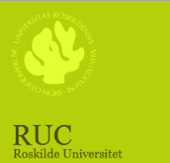


Ghent University (Belgium)
World History and Political Economy, Conflict and Development, Europe as a Global Actor, and area studies of Africa, the Middle East, Asia, and Latin America.
Leipzig University (Germany), Co-ordinating institution of the Consortium
Comparative analysis of global entanglements both historically and for the present times, focusing on Europe, Africa, the Middle East, East Asia, and the Americas as well as on the transregional ties between these parts of the world.
Roskilde University (Denmark)
Development studies, global political economy and global governance, political culture and civil society
University of Vienna (Austria)
International organizations, global history from 1500, a regional focus on East Asia, sub-Saharan Africa, Central Europe, and Latin America.
University of Wroclaw (Poland)
Recent transformation processes in Central and Eastern Europe, security issues, regional cooperation, communications, and media.

Slide 10
International Master
Nine worldwide partners:
Addis Abeba University (Ethiopia)
Dalhousie University (Halifax, Canada)
Fudan University (Shanghai, China)
Jawaharlal Nehru University (New Delhi, India)
Macquarie University (Sydney, Australia)
University of California at Santa Barbara (USA)
University of Otago (Dunedin, New Zealand)
Stellenbosch University (South-Africa)
University of Yaoundé (Cameroun)
Sogang University (South Korea)* from AY25-26
See: https://globalstudies-masters.eu/about/partners/

Slide 11









Addis Ababa University (Ethiopia)
Peace and Security, Gender Studies, Human Rights and Development Cooperation
Dalhousie University (Canada)
International Developmental Studies, Environmental Issues and Comparative Theory
Fudan University (China)
Modernity in Asia and Europe compared, Modern Chinese History and International Relations from a Chinese Perspective
Jawaharlal Nehru University (India)
Focus on Economics, Levels of Regional Development in India, Government and Politics in India
Macquarie University (Australia)
Globalization and Sustainable Development, the International System and the North-South Relationship
Otago University (New Zealand)
Studies of Asia, Europe and Latin America, Global Governance, etc.
University of California at Santa Barbara (USA)
Global Culture and Religion, Sustainable Development and the Environment, Contemporary Globalization
University of Stellenbosch (South Africa)
Focus on Global Political Economy, Conflict Studies and Negotiating Transition
University of Yaoundé (Cameroon)
Socio-cultural, Political and Economic Aspects of Postcolonialism

Slide 12
Joint activities in the programme
Joint admission and selection procedure
Circulation of Information: newsletter, website, mailing list
Assessment of courses and the consortium performance
Joint degrees of five university
Winter and Summer School (First year)
Online lectures and senimars
Graduation Ceremony (November of graduation year)
EMGS Graduation Ceremony 2023

Slide 13
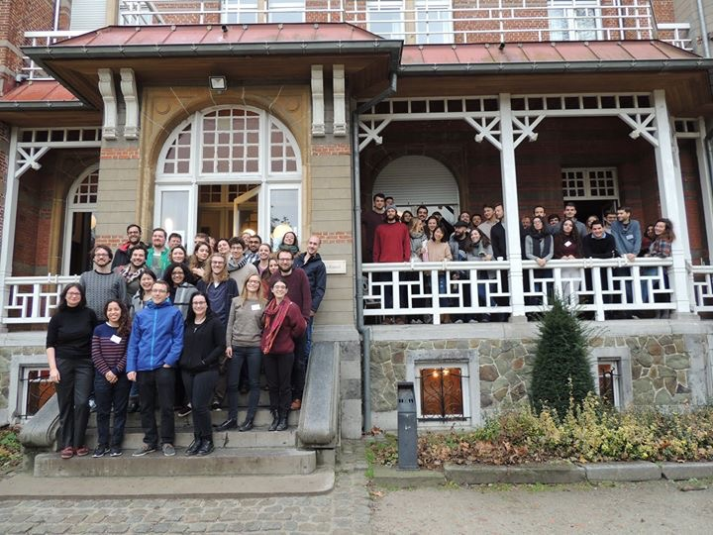
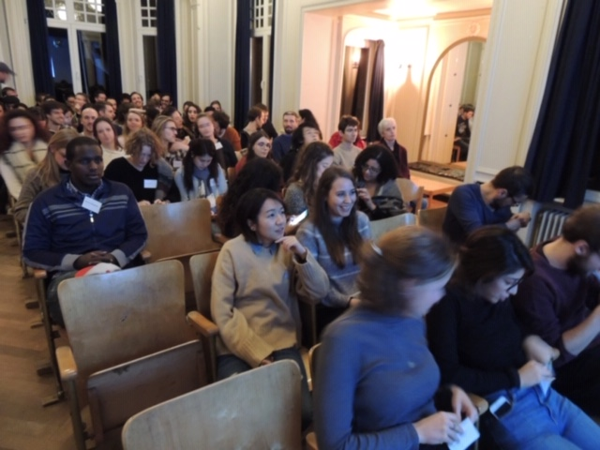
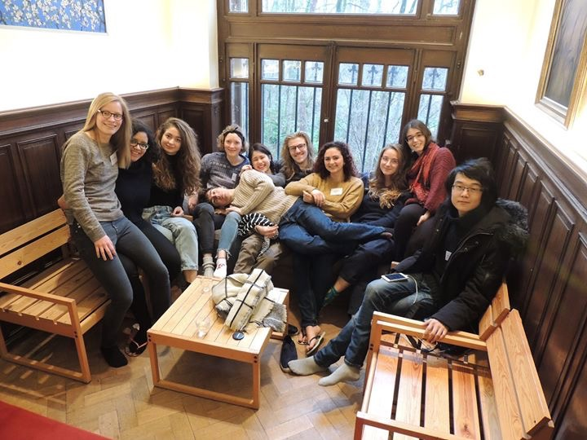
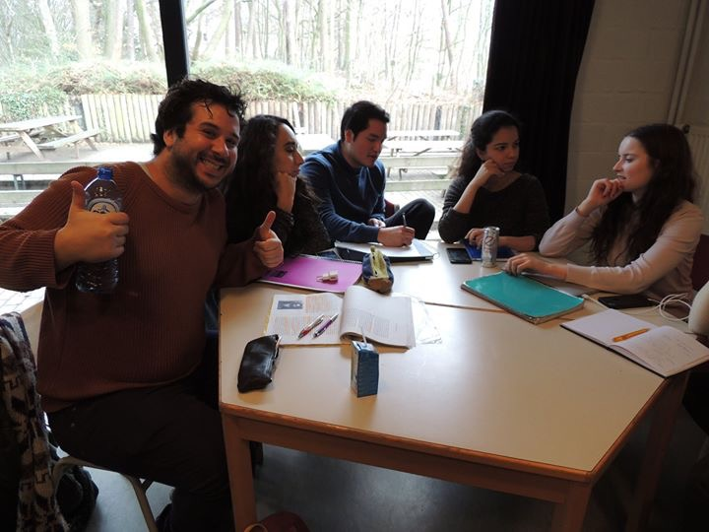
Winter school
Belgium, Lokeren,
December 2018

Slide 14
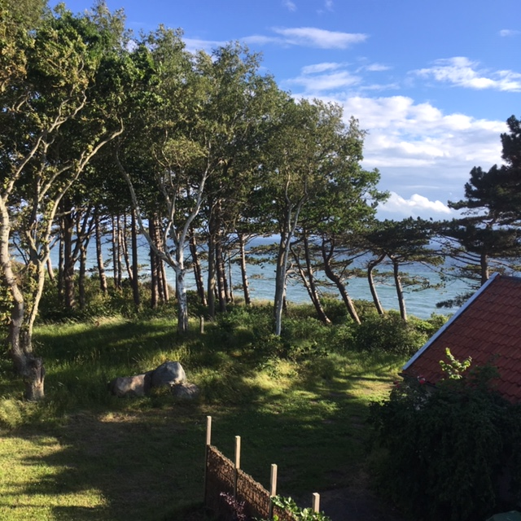
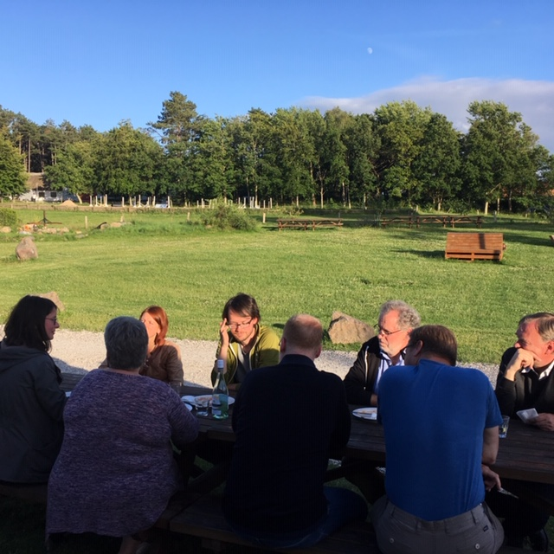
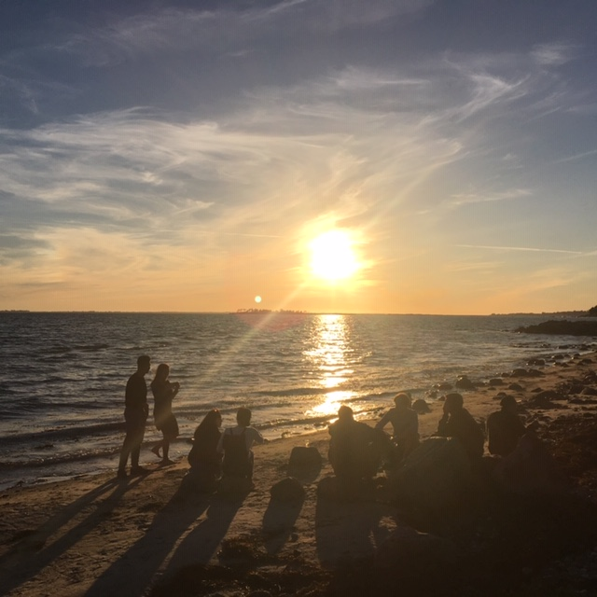
Summer school
Jagerspris, Denmark,
July 2017

Slide 15
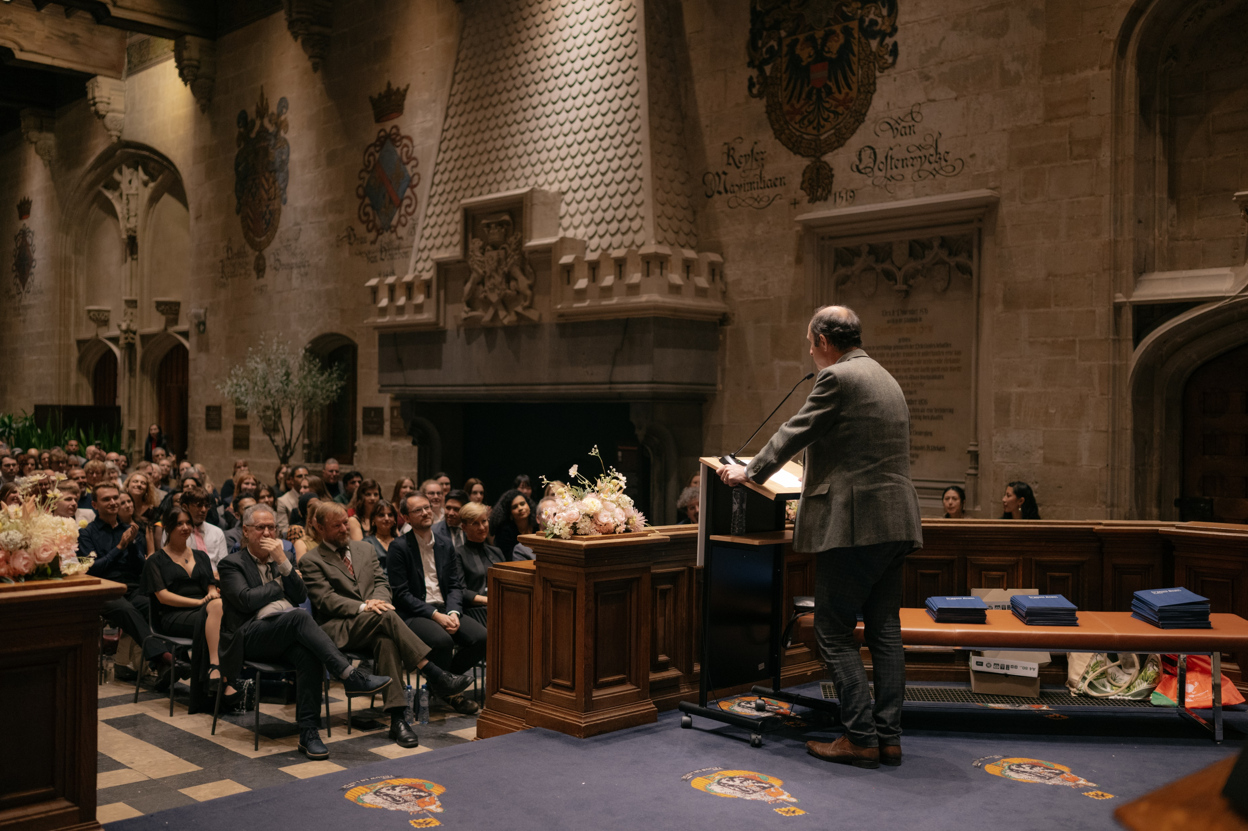
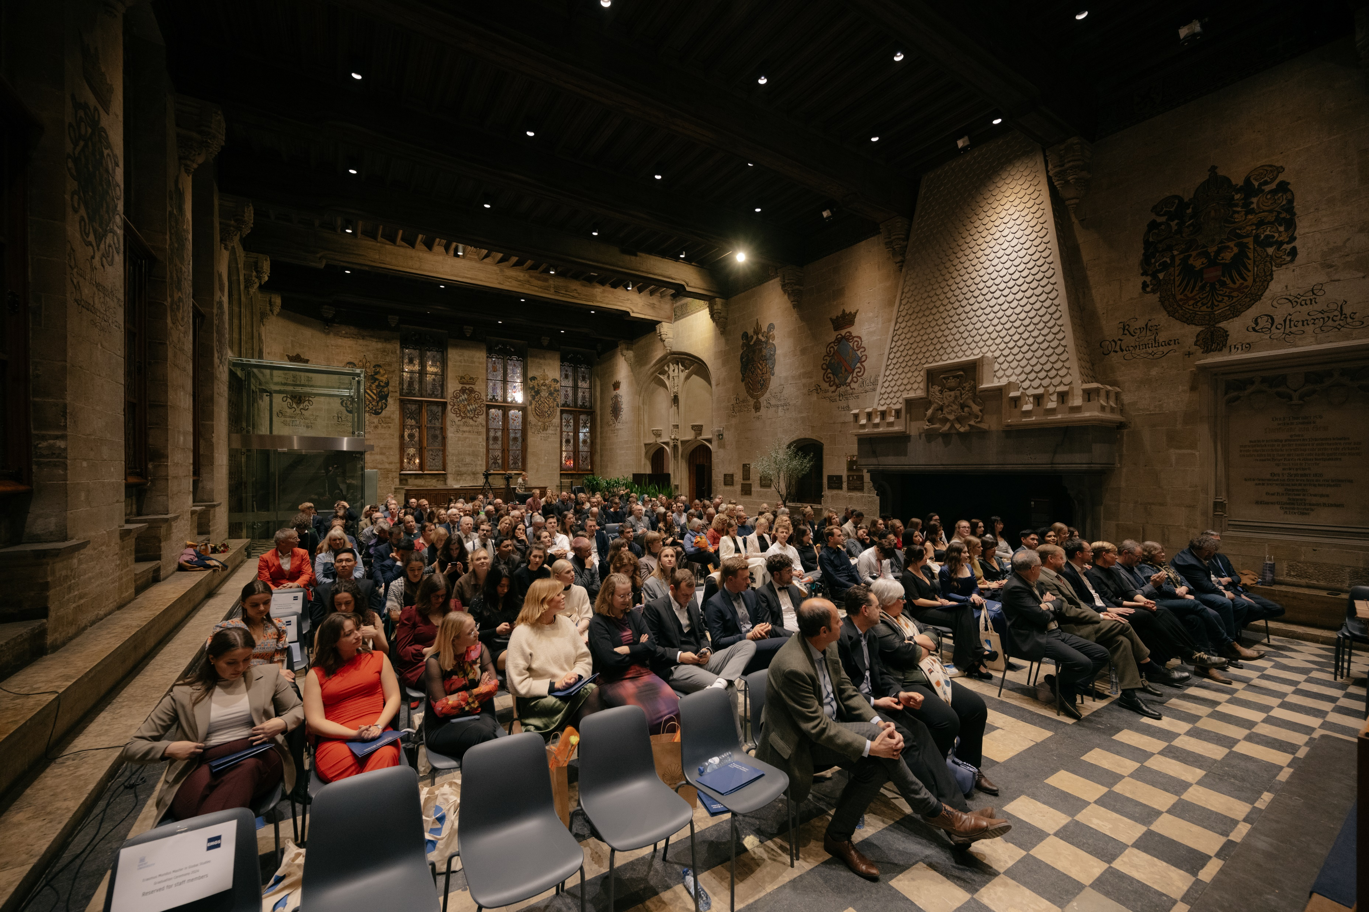
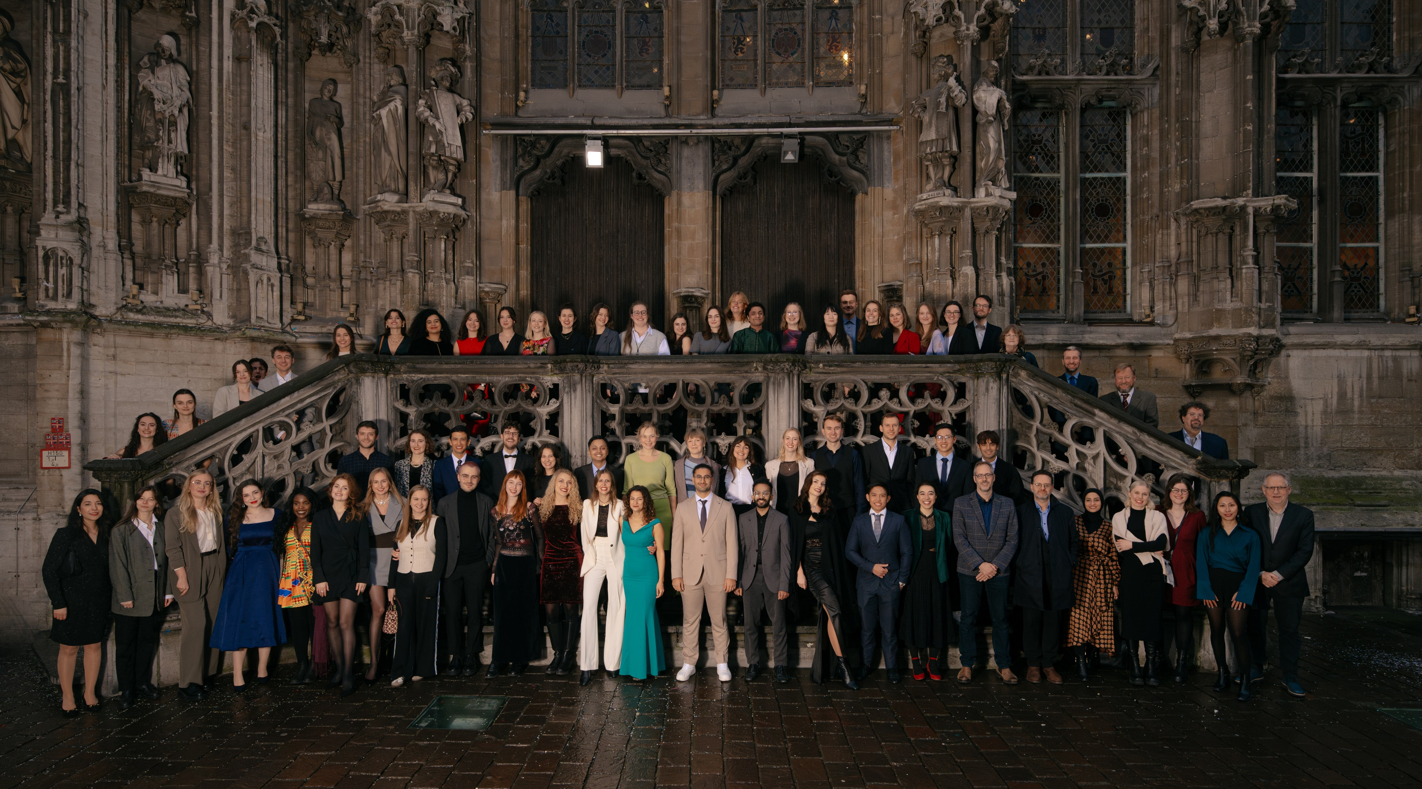
Graduation Ceremony
Gent, Belgium,
Nov 2024

Slide 16
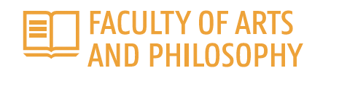

Who are we? EMGS @ UGent
Administrative seat:
Faculty of Political and Social Sciences
in cooperation with the Faculty of Arts and Humanities
Academic contact and representative to the consortium:
Prof. Dr. Samuël Coghe
Dept. of History (Faculty of Arts & Humanities, Campus Ufo, Sint-Pietersnieuwstraat 35)
Programme coordination and administrative contact:
Starry Chung and Marissa Van Laecke
Dept. of Conflict and Development Studies (Faculty of Political and Social Sciences, Campus Ufo-Technicum, Sint-Pietersnieuwstraat 41)

Slide 17
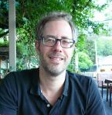
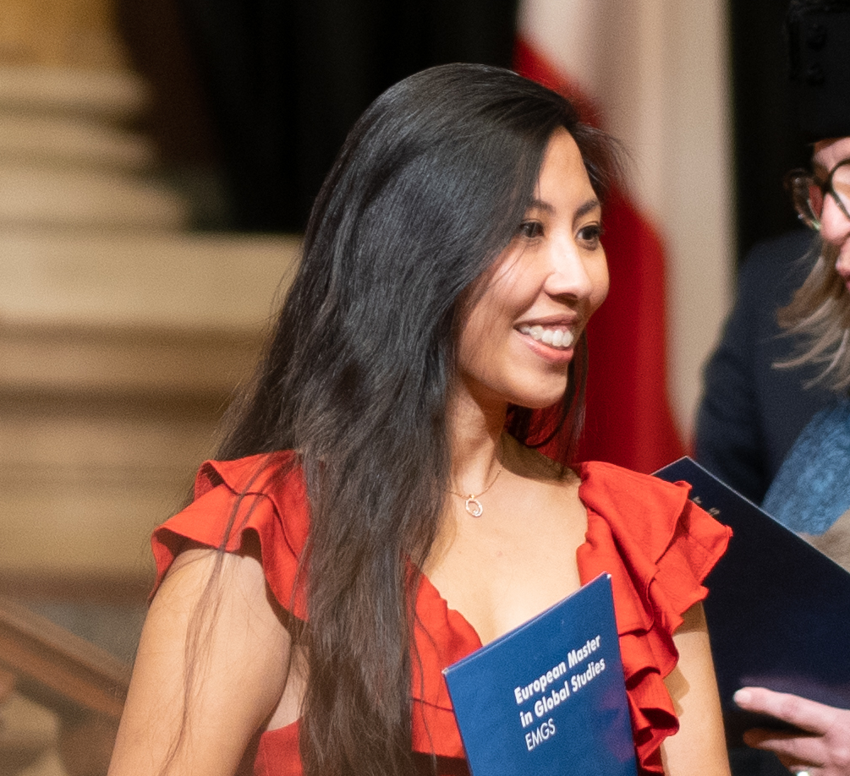

Who are we? EMGS @ UGent
Prof. Dr. Samuël Coghe
EMGS Academic Director
African and Global History
Dutch, English, French, German, Portuguese
Starry Chung, M.A.
EMGS Programme Coordinator
Migration and Transnational politics
Cantonese, English, Mandarin, Japanese
Marissa Van Laecke
Student Administrator
Dutch, English
emgs@ugent.be

Slide 18
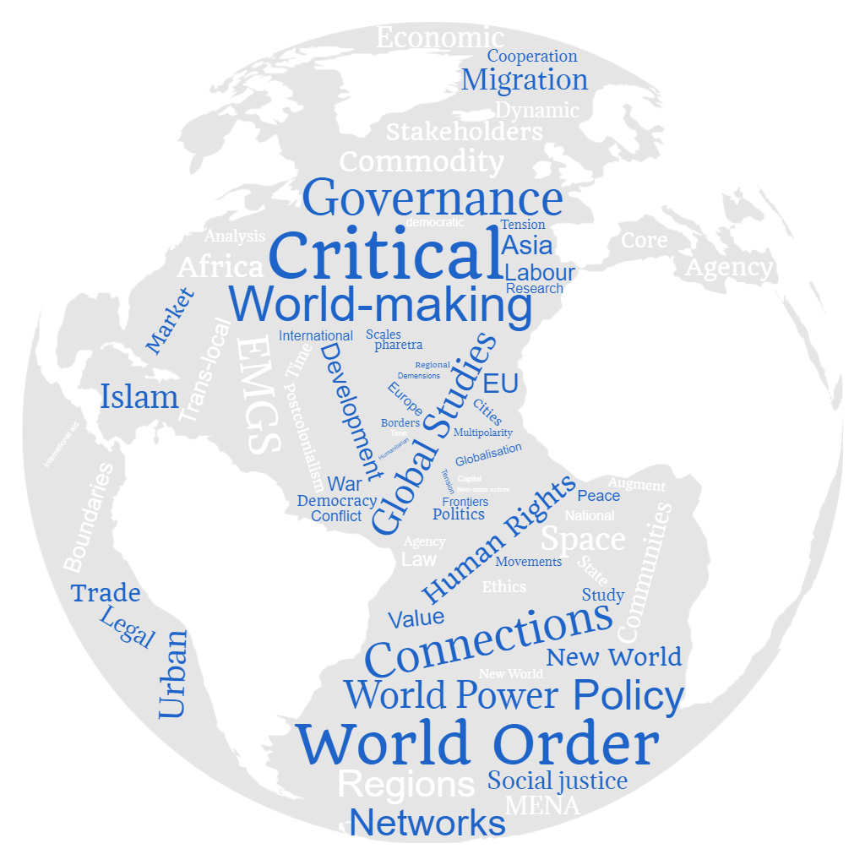

Slide 19


EMGS @ UGent
PROGRAMME AT A GLANCE: MODULES
First year
https://studiekiezer.ugent.be/2025/master-of-arts-in-global-studies-KMGSJD-en/programma
(First year + course schedule per semester)*
Foundation
Global governance and Global Justice
Global History and Globalisation
Europe as a Global Actor
World Societies: regions in Global Studies
EMGS Joint Winter and Summer School
* Programme subject to change

Slide 20
EMGS @ UGent
PROGRAMME AT A GLANCE: MODULES
Second year
https://studiekiezer.ugent.be/2025/master-of-arts-in-global-studies-KMGSJD-en/programma
(Second year + course schedule per semester)*
Global History and Globalisation
Europe as a Global Actor
World Societies: regions in Global Studies
Conflict and Development in a Globalising World
Master Thesis
* Programme subject to change

Slide 21
Admission criteria
Applicants should fulfill the following minimal requirements:
A three-year bachelor’s degree or the recognized equivalent from an accredited institution in the humanities or social sciences, with a minimum of 15% global studies–relevant courses
Excellent English skills: Proficiency in English needs to be proven with an official English certificate. Native English speakers must provide proof of knowledge of a language other than English at the A2 level
Knowledge of another foreign language at the A2 level (to be proven by a high school certificate and/or an internationally recognized test, score certificates, or equivalent proof of participation in language courses)
The recognition of the respective documents and degrees is based on the requirements set by the German Central Office for Foreign Education.
See: https://globalstudies-masters.eu/admission/application/admission-and-selection-criteria/

Slide 22
Selection criteria
Following criteria:
50%: Academic excellence and quality/recognition of home institution that has awarded the first degree
15%: Motivation and academic potential
20%: Compatibility of previous degree(s) with the EMGS programme
15%: Work experience/professional qualifications
The decision on admission is made by the EMGS Study Purposes and Selection Committee

Slide 23
Application
Documents to be included in the application:
A curriculum vitae in English (cf Europass)
Motivation letter in English
Proof of nationality (e.g. copy of passport)
Proof of residence (only for applicants who wish to apply for the Erasmus Mundus scholarship, scholarship holders must study at universities outside of their country of residence)
High school diploma or equivalent
Official high school transcripts
University diplomas
Official transcripts from your university
English language certificate test results (TOEFL, IELTS, CPE/CAE)
Proof of knowledge of another foreign language
One recommendation letter by an academic teacher
If applicable, proof of extracurricular activities and work experience
Apply online via this link

Slide 24
Application
Deadlines:
15 March 2025 (application for admission & Erasmus Mundus grant)
31 May 2025 (application admission for “self-paying” students)
Announcement: between early June to end of July
The application for EMGS is at Leipzig University
Apply online via this link

Slide 25
Fees and support
Participation costs:
€2300 per year (all nationality)
Do not cover travel costs to/from Winter and Summer schools
Full participation costs will be incurred for each extra semester
Support:
Students with special needs can apply for financial support
Regular Erasmus + scholarship for mobility between European partner universities (from year 1 to 2)
GRANTS & SCHOLARSHIPS

Slide 26
Further information
Facebook page
Official website
LinkedIn
Contact coordinating University – Uni. Leipzig:
European Master in Global Studies Global and European Studies Institute Emil-Fuchs-Str. 1, 04105 Leipzig, GERMANY
For any question regarding the application (requirements, documents and procedure), please contact: em@uni-leipzig.de
See also FAQ

