Slide 1


shareholders questioning the board
Law & Business Conference
Vanderbilt Law School/Ghent Law School
May 20-21, 2022
Anne Lafarre (Tilburg) and Christoph Van der Elst (Ghent and Tilburg)

Slide 2

Shareholders questioning the board
Notes:
The hottest issue since some years and it was already visible in many presentations we have had yesterday: corporate sustainability
Large focus on Responsible Investment in research and practice;
Many features have been extensively investigated but not all: we try to further disentangle the complexities and interactions in corporate life regarding corporate sustainability and add some missing links

Slide 3
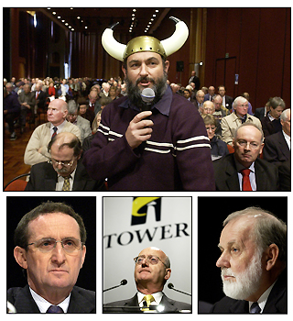

Shareholders questioning the board
The action:
The shareholders:
Hedge funds
Mutual funds
Pension funds
Retail investors
Other shareholders
Their representatives:
Investor associations
Socially oriented sponsors
The goal:
Business strategy
Corporate structure
Governance
Remuneration
Capital structure
Sustainability
Invisible:
Wall street rule (exit)
Private meetings/
negotiations
GM related:
“vote no”
Shareholder proposals
Proxy fight
Shareholder questions
Visible:
Naming and shaming/
public communication
Sue the company
Takeover
Notes:
This research:
Assesses the theoretical and practical importance of shareholder questions on corporate sustainability matters;
Uses NLP techniques that can be useful in empirical legal research;
Finds some indications that shareholder questions may have a positive impact on corporate sustainability conduct, like shareholder proposals.
Disclaimer: very first version (robustness checks etc. are lacking)!

Slide 4
Shareholders questioning the board
Text analysis:
  Step 1: gathering sustainability questions and related from unstructured meeting minutes (Atlas.ti)
  Step 2: applying quantitative NLP techniques (R) to the corpus.

Slide 5
Shareholders questioning the board
Text analysis:

Slide 6
Shareholders questioning the board
Engagement effects (I) (to be further developed):
Variables:
  Refinitiv ESG scores (overall, and partial scores matched with question topics)
      ESG, resource use, emissions, workforce, human rights, environmental innovation
  Sustainability questions and questions per topic
  [sentiment scores]
  Refinitiv control variables including market cap, ROA, free float and industry (based on Lee and Lounsbury, 2011; Dam and Scholtens, 2012; Liang and Renneboog, 2017; Semenova, 2021, Barko et al., 2021).
Model specification:
  Fixed effects and random effects (with industry fixed effects) panel data models
  Time = year, observation = company

Slide 7
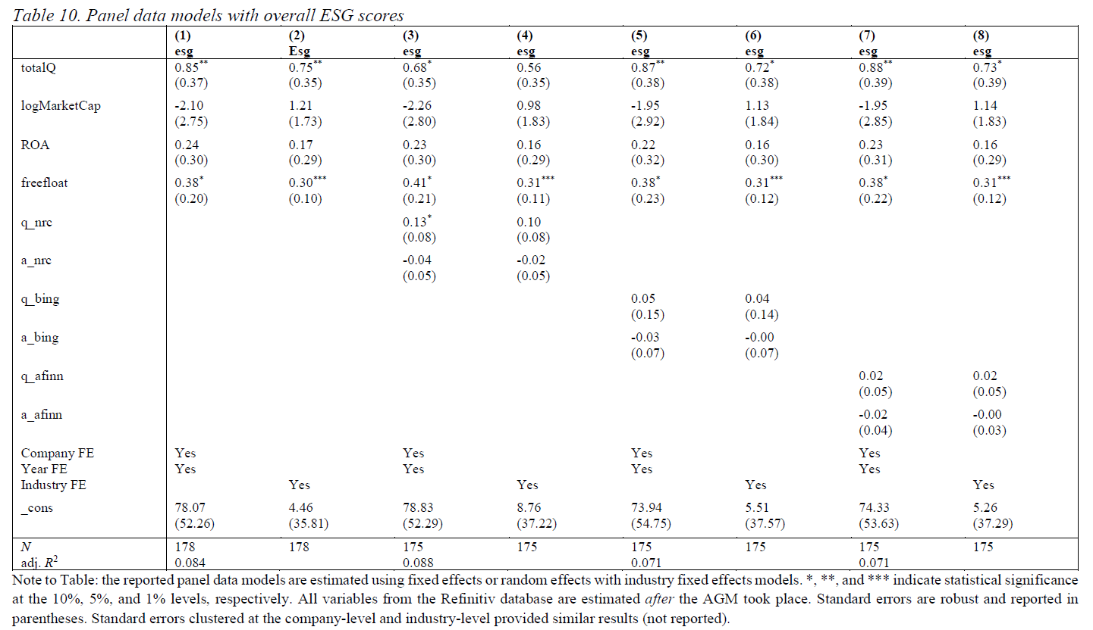
Shareholders questioning the board
Engagement effects (II) (to be further developed):

Slide 8
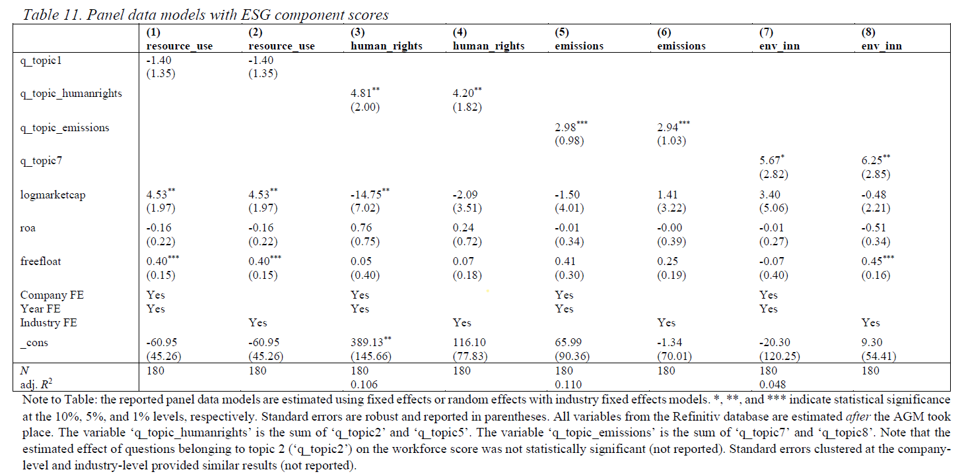
Shareholders questioning the board
Engagement effects (III) (to be further developed):

Slide 9
Shareholders questioning the board
Conclusion
Fills important gap in current literature (questioning tool available to all shareholder types and actively being used by different types of shareholders);
Already some (strong) indications that shareholder questions may have a positive impact on corporate sustainability conduct;
Second aim: showing the richness of quantitative text analysis in legal research.
Disclaimer: research (incl. text analysis and regression models) needs to be further developed!
Next steps:
Further develop topic modeling (LDA) and sentiment analyses, consider answers, etc.
Causality problems: robustness checks, incl. treatment and control group (but: Azar et al., 2021, etc.)

